Slide 1
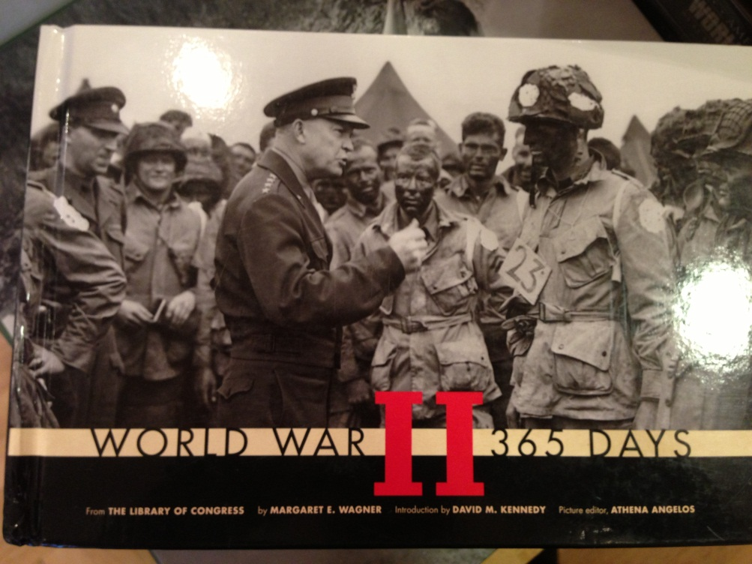
World War II
Do Now
Agenda
Take out notes over Ch. 25 and complete Nuclear Weapons Chart on pg. 41 in HW packet.
How did WWII start?
U.S. in the war
Homefront
Homework:
Content Check
WWII FRQ – 35 minutes!
Quiz over Ch. 23/24 on Thursday

Slide 2
WWII Overview
Topic | The Second World War The Home Front During the War
Big Questions | What were the causes of WWII? What were the arguments for/against America involving itself in the war? How do times of economic crisis and war affect the execution of justice?

Slide 3
This week, you will identify and explain:
-The rise of fascism and militarism in Japan, Italy, and Germany
-Prelude to war: policy of neutrality
-The attack on Pearl Harbor and United States declaration of war
-Fighting a multi-front war
-Diplomacy, war aims, and wartime conferences
-The United States as a global power in the Atomic Age
-Wartime mobilization of the economy
-Urban migration and demographic changes
-Women, work, and family during the war
-Civil liberties and civil rights during wartime
-War and regional development
-Expansion of government power

Slide 4
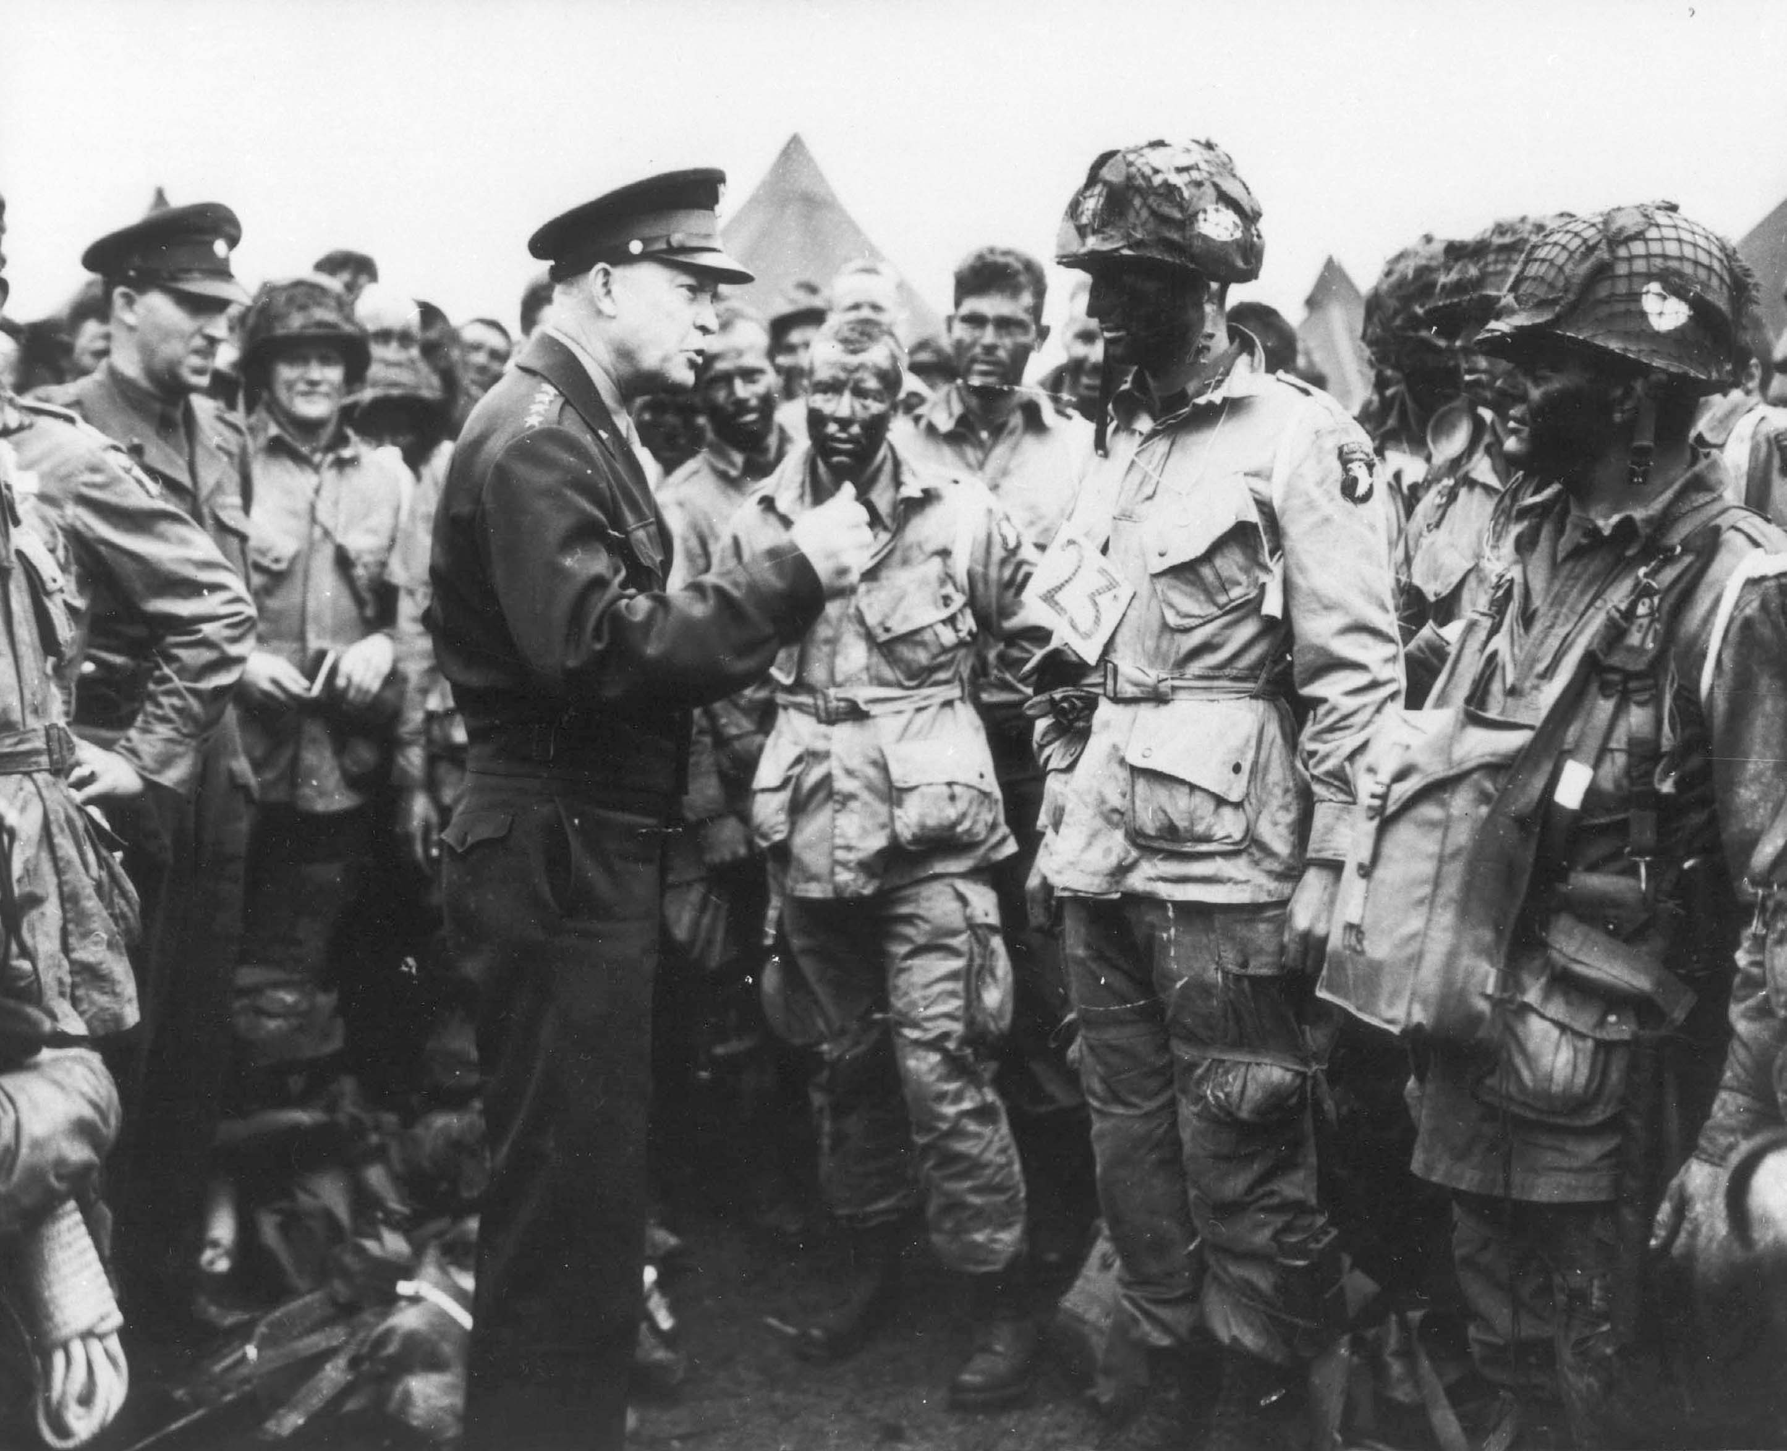
Why do we study history?

Slide 5
Leading up to U.S.’s entry…

Slide 6
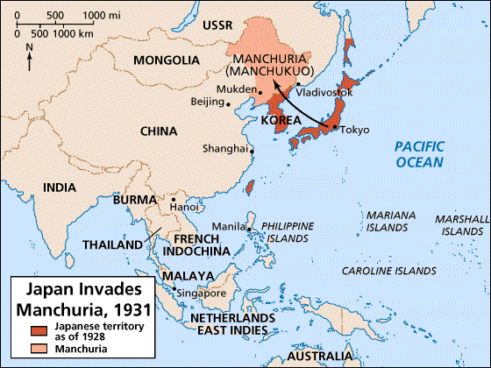
American Responses to the Growing Threat of War
The Stimson Doctrine
Sept. 1931 → Japan invaded/conquered Chinese province of Manchuria
In 1932 – Stimson Doctrine declared that US wouldn’t recognize any territorial acquisitions achieved by force
Although US didn’t recognize the Japanese occupation, the Hoover administration refrained from taking military action
Significance – failure of US and other powers to take any concrete action marked the failure of collective security

Slide 7

Totalitarianism
authoritarian and dictatorial governments whose goal is to control all aspects of public and private life.
State > Individual

Slide 8

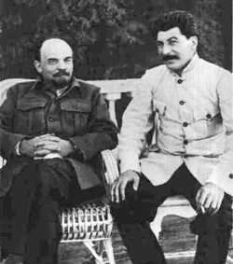
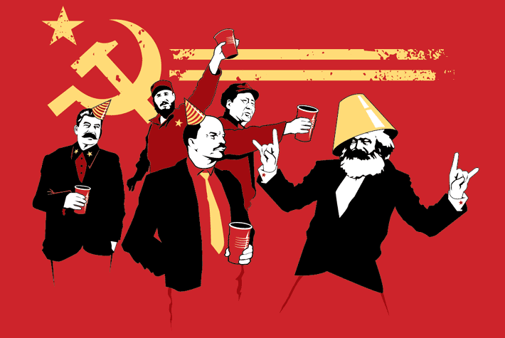
Communist Party
(Russia/Soviet Union)
1917
Vladimir Lenin
Joseph Stalin

Slide 9
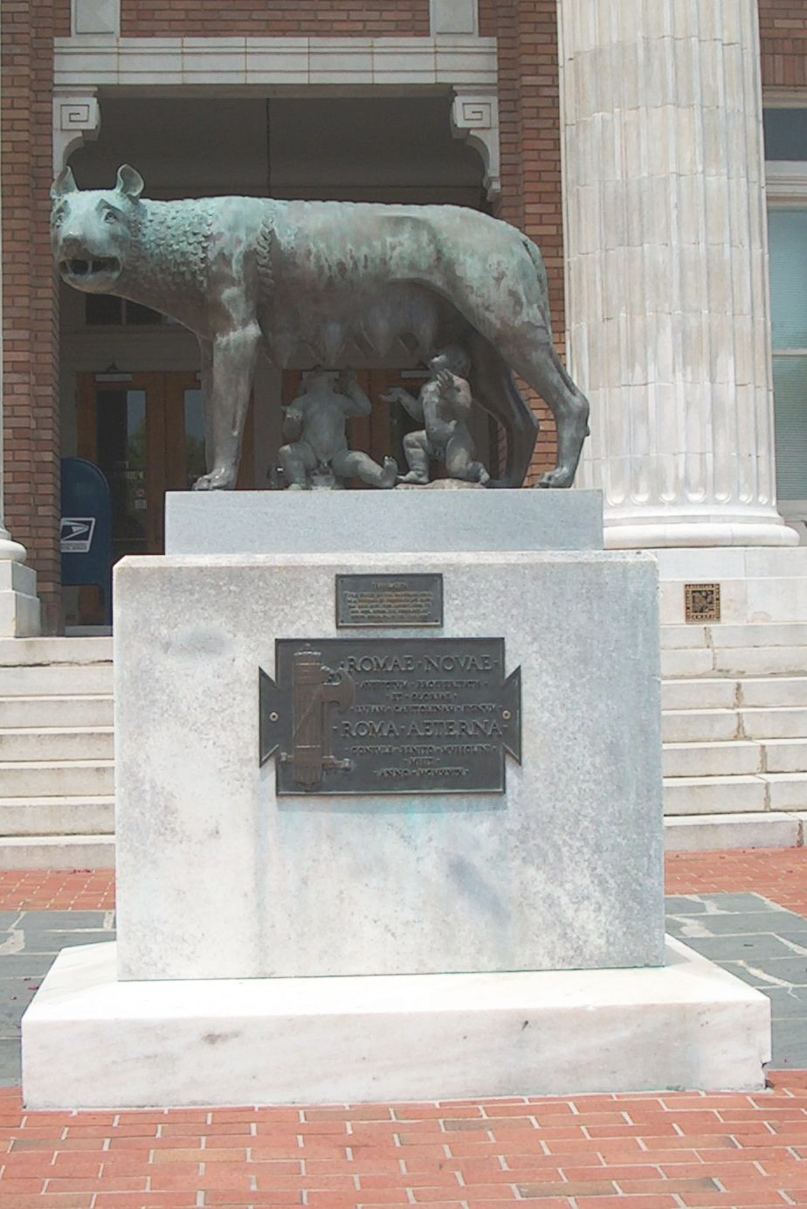

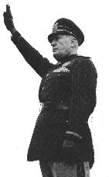
Fascism
(Italy)
1922
Benito Mussolini
Il Duce
Statue of Romulus and Remus in Rome, GA

Slide 10


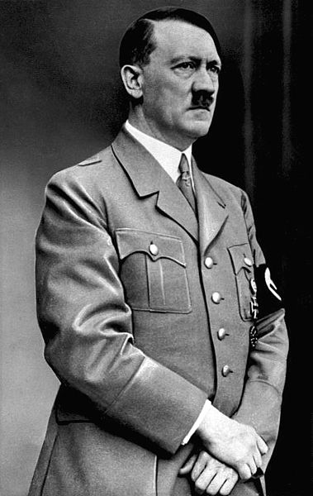

Nazi Party
(Germany)
1933
Adolf Hitler
der Fürher
National Socialist
German Workers Party

Slide 11
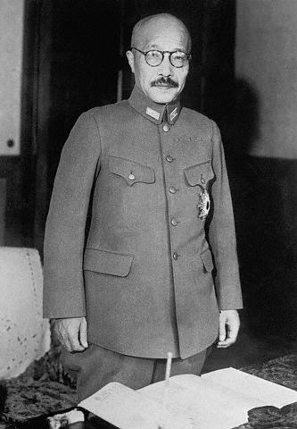

Japanese Militarism
Flag of the
Imperial Japanese Army
Hideki Tojo
“Prime Minister”

Slide 12
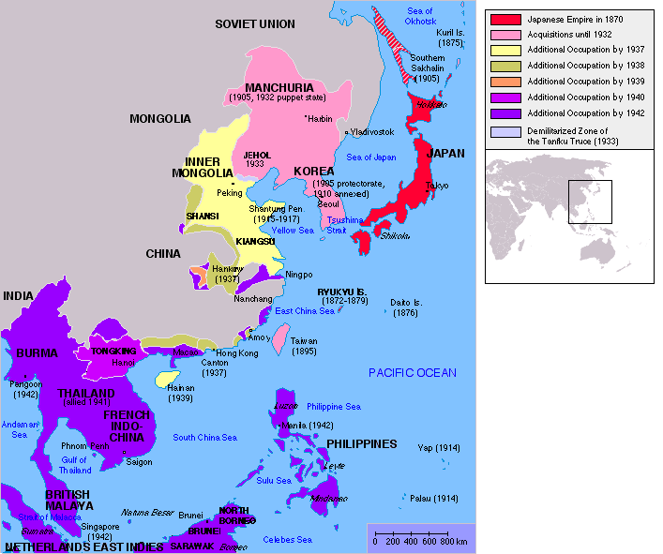
Japanese Expansion

Slide 13
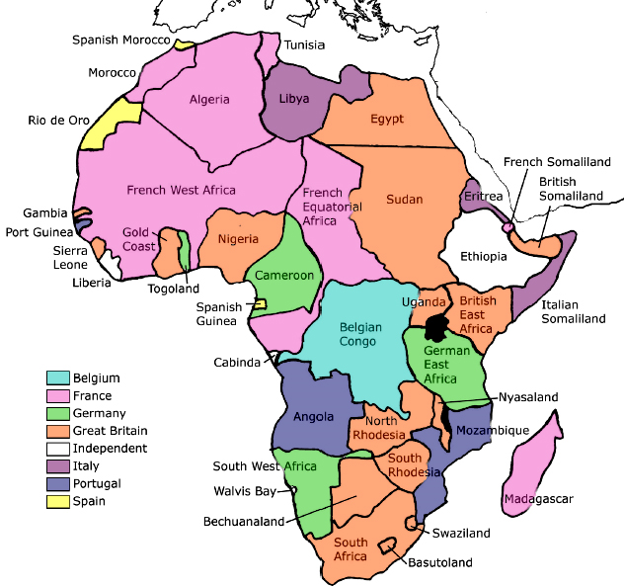
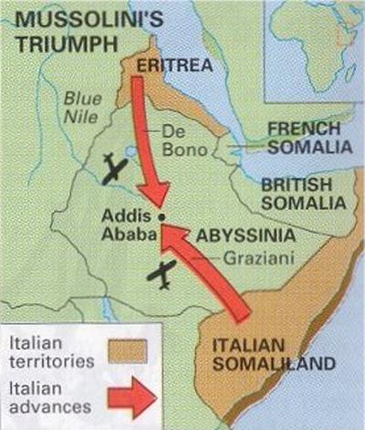
Mussolini’s Conquest of Ethiopia
1935-1936

Slide 14
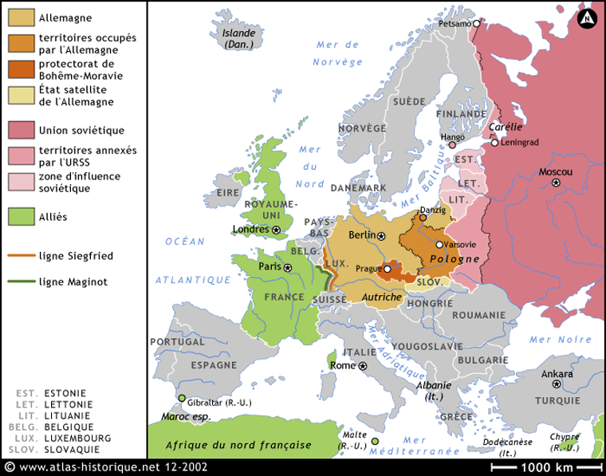
Europe
September, 1939
Invasion of Poland = Declaration of War

Slide 15
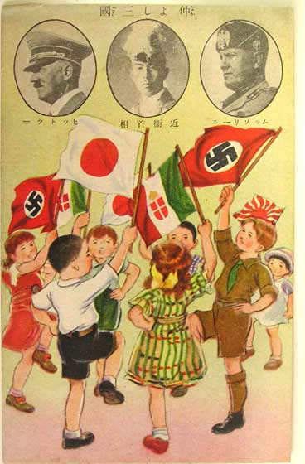
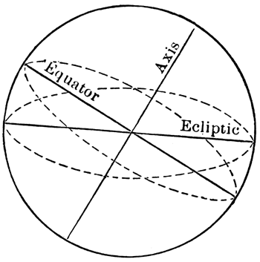
Axis Pact
Japan, Germany, and Italy agree to cooperate in their efforts… They further undertake to assist one another with all political, economic and military means if one of the Contracting Powers is attacked by a Power at present not involved in the European War or in the Japanese-Chinese conflict.

Slide 16
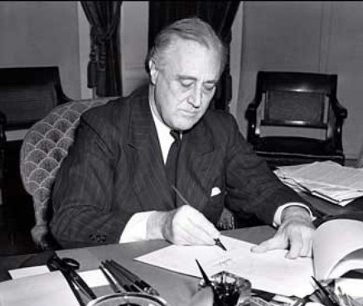

The Neutrality Acts
Neutrality Acts of 1930s were expressions of a commitment to isolationism
During 1930s, isolationists drew support for their position from Washington’s Farewell Address
FDR
“And while I am talking to you mothers and fathers, I give you one more assurance. I have said this before, but I shall say it again and again and again:
Your boys are not going to be sent into any foreign wars.”
-- Franklin D. Roosevelt
Boston, 10/30/1940

Slide 17
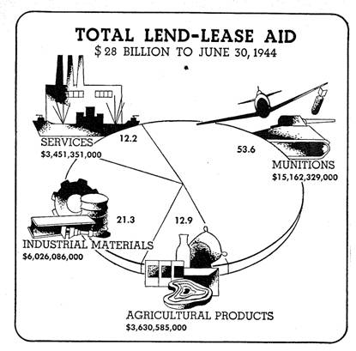
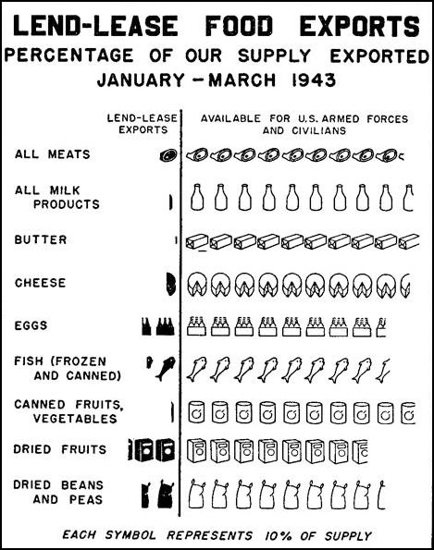
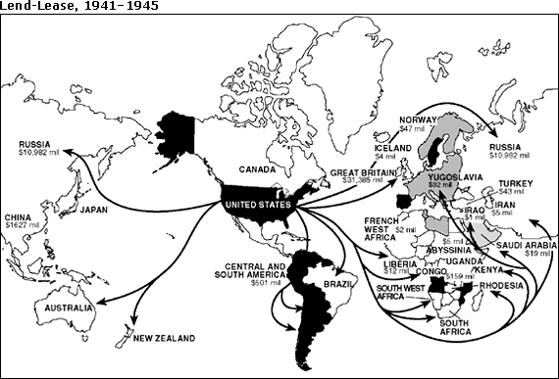
The Lend-Lease Program
FDR authorized the sale of surplus military equipment to the Allies
Lend-Lease program was used primarily to help Great Britain and the Soviet Union resist Nazi Germany

Slide 18
The U.S. enters the war…

Slide 19
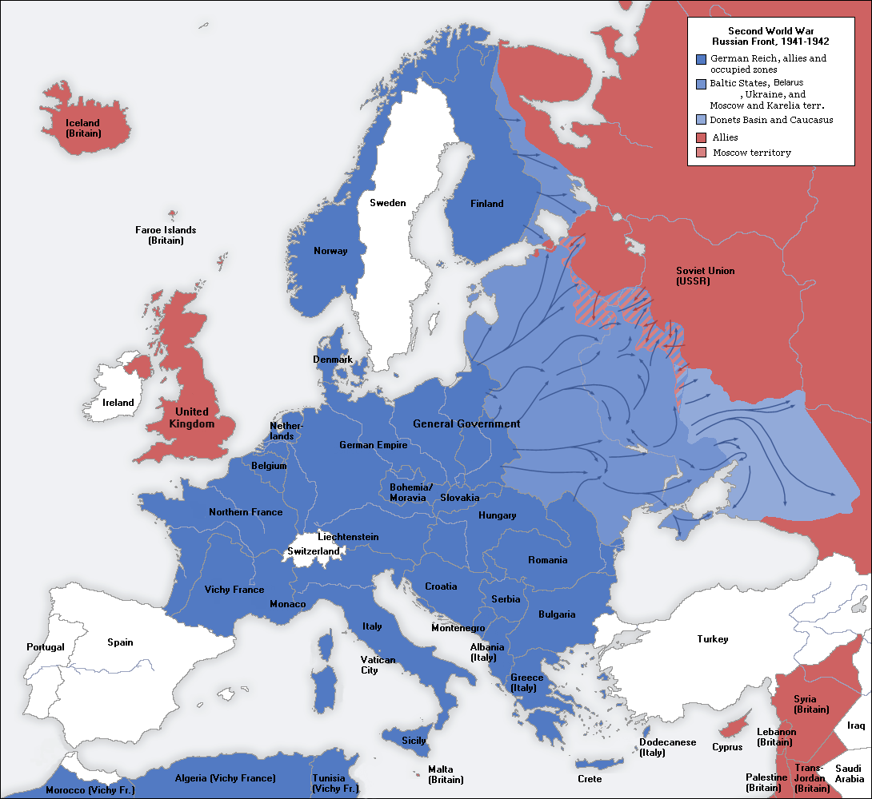
Europe (1941)

Slide 20
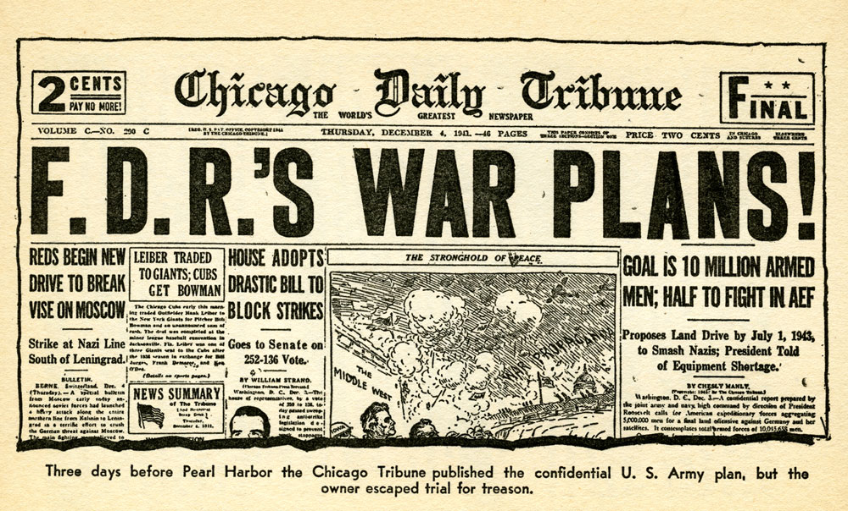
Three Days Before Pearl Harbor

Slide 21
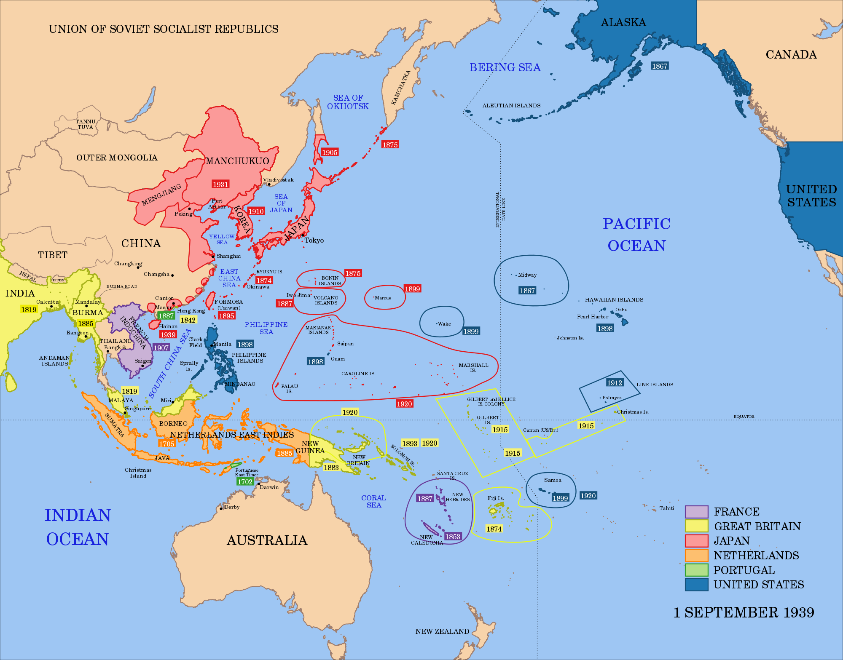

Slide 22
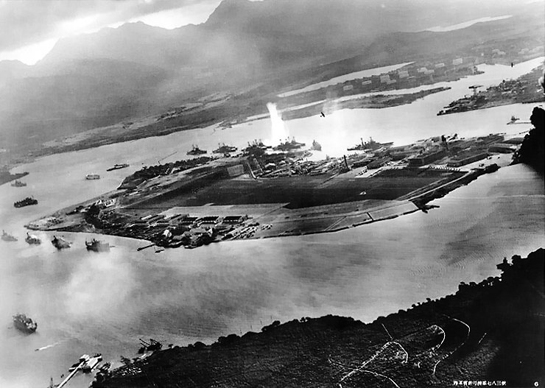
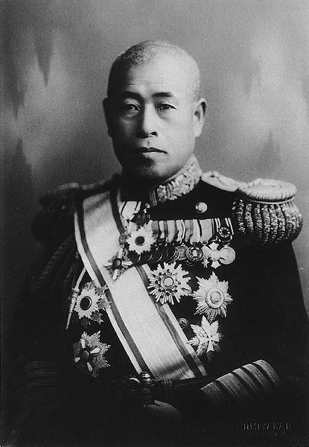
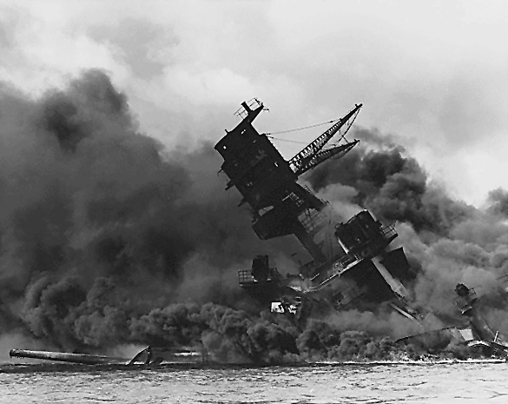
Pearl Harbor Attack
December 7, 1941
Admiral Yamamoto
U.S.S. Arizona

Slide 23
http://www.youtube.com/watch?v=3VqQAf74fsE

Slide 24
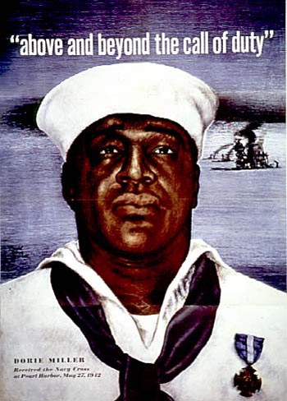
Causes:
Japanese war machine dependent on shipments of oil, aviation gasoline, steel, & scrap iron from US
Late 1940 - FDR imposed embargoes on Japan-bound supplies
Mid 1941 – FDR froze Japanese assets in the US and halted all shipments of gasoline
Japanese leaders had two alternatives:
  Give in to American demands that they withdraw from Manchuria
  Thwart embargo by attaching US naval fleet at Pearl Harbor AND seize oil supplies and other raw materials in SE Asia
Note:
Japanese attack on Pearl Harbor occurred after diplomatic negotiations with the US reached a stalemate
Pearl Harbor is only battle to have appeared on APUSH exam
Pearl Harbor

Slide 25
Germany First Strategy
And here we go…
Japanese attack unified the US
Americans wanted to avenge the attack on Pearl Harbor
US declares war on Japan and Axis powers (Germany, Italy) declare war on US
After the attack on Pearl Harbor, the US announced a strategy of 1st defeating Germany and then turning to a full-scale attack on Japan
At first unpopular, the “get Germany first” strategy prevailed
US couldn’t allow Hitler to defeat Great Britain and the Soviet Union, thus transforming the continent into a massive dictatorship

Slide 26

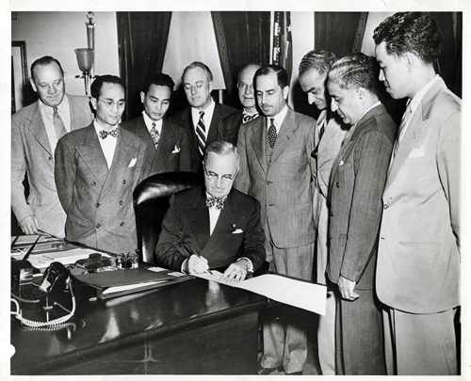
Latin America
Based upon the principles of the Good Neighbor Policy, FDR’s administration formally renounced the right to intervene in Latin America
During WWII, the US sought greater cooperation with the nations of Latin America, primarily to create a hemispheric opposition to fascism (dictatorships)
The Philippine Islands
In response to widespread anti-imperialist sentiments, the US pledged to grant independence to the Philippine Islands
The Philippines gained independence from the US in 1946

Slide 27
On the Home Front…

Slide 28
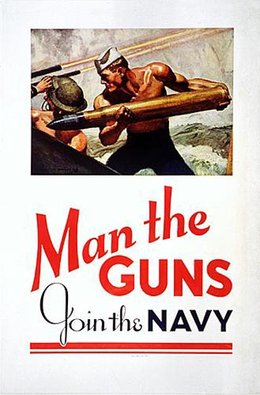
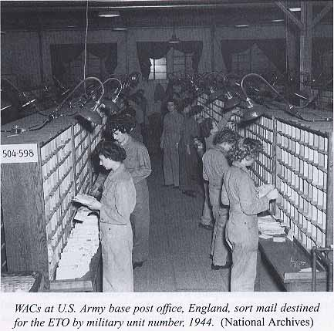
Building up troops
15 million men and 250,000 women enlisted
  Women in non-combat positions
  WAACs (army), WAVES (navy)
Selective Service Act → 18 and up register for draft
To keep production going, certain groups of workers eliminated from draft

Slide 29
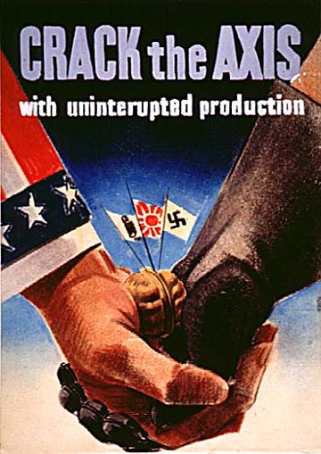
Wartime Mobilization of the Economy
Impact of Military Spending
Military spending revived the US economy
As American industry prepared for war, unemployment plummeted
The dramatic increase in military spending enabled the US to finally emerge from the Great Depression

Slide 30
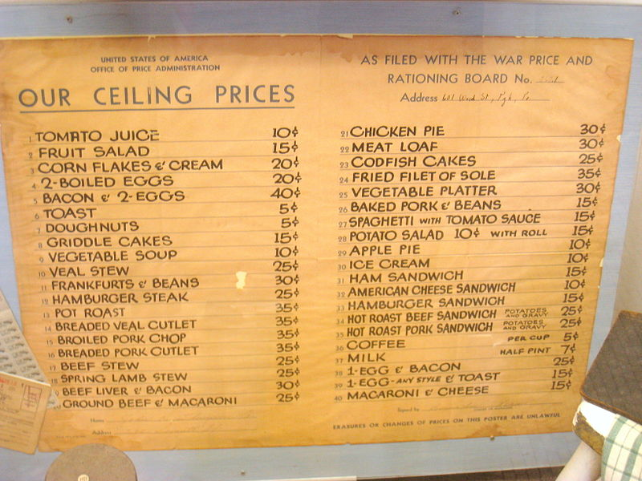
Price Controls
The government instituted direct price controls to halt inflation
The Office of Price Administration (OPA) established a nationwide rationing system for consumer goods such as coffee and gasoline

Slide 31
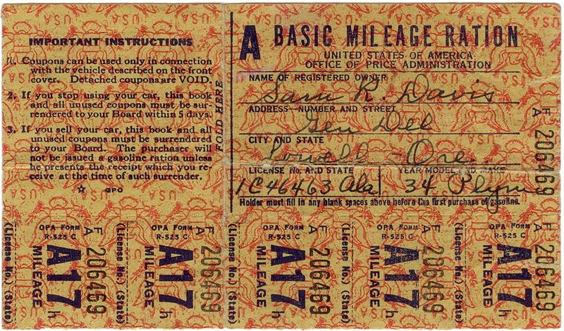
Rationing

Slide 32
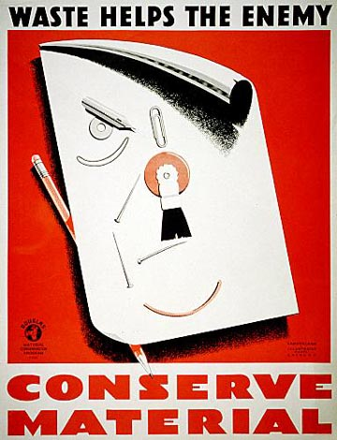
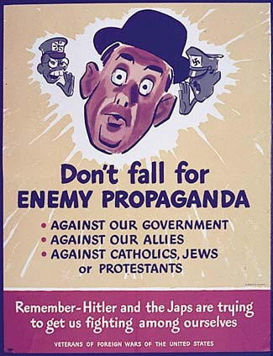
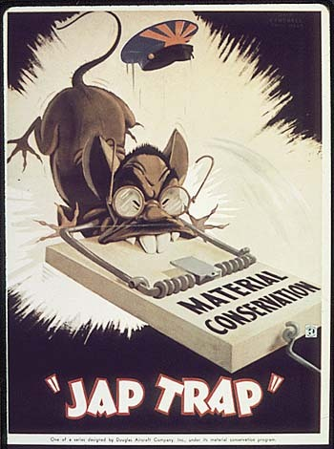
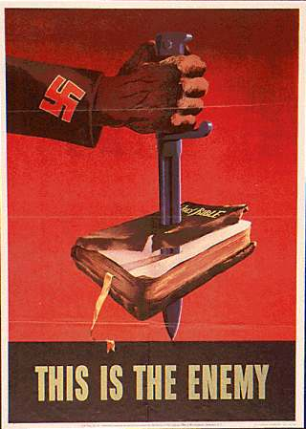
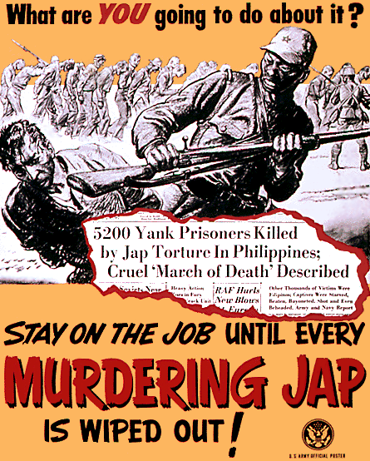
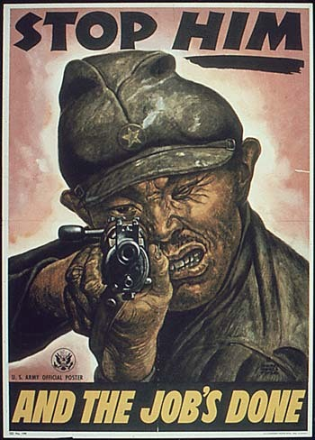
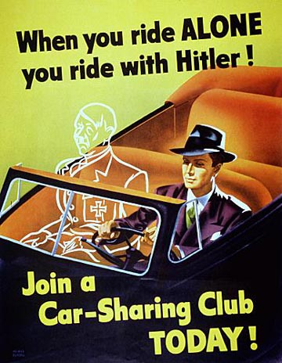
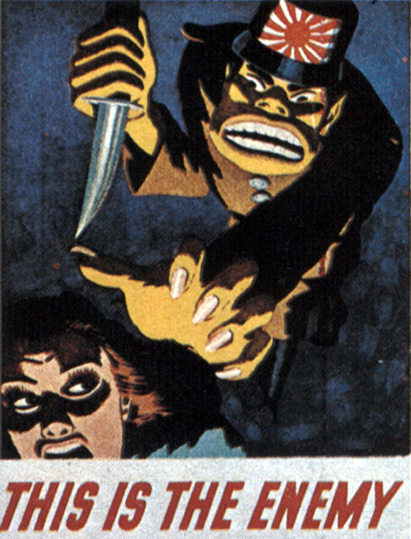
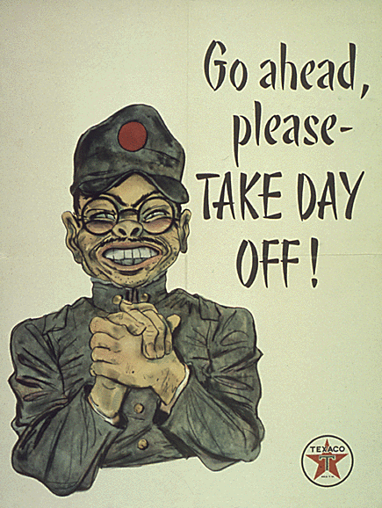

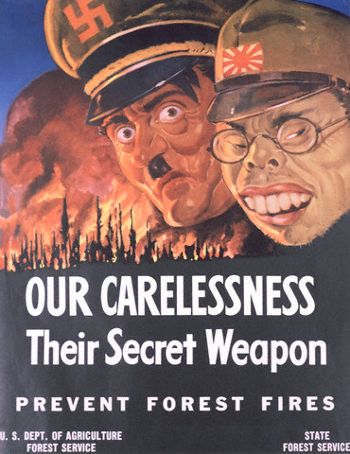
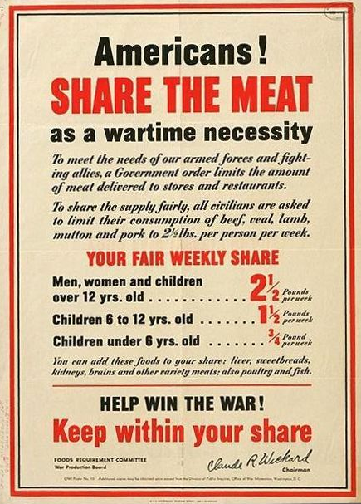
http://www.densho.org/
http://pwencycl.kgbudge.com/P/r/Propaganda.htm

Slide 33
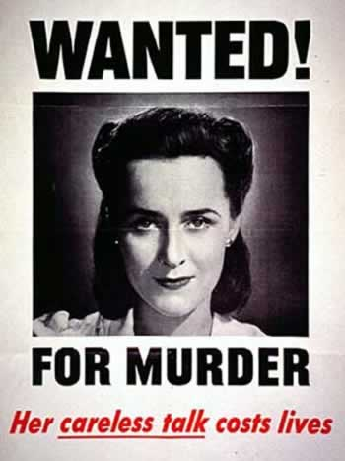
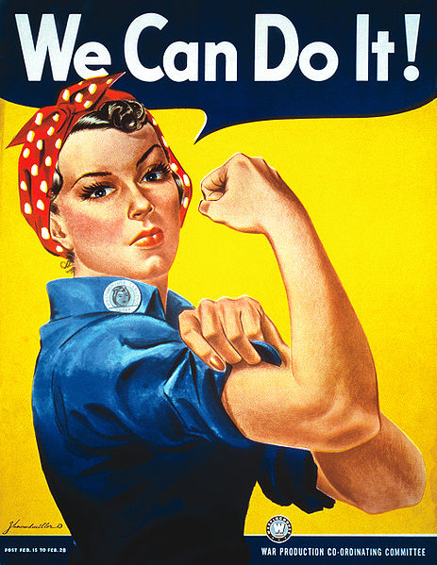
Women in
World War II
Rosie the Riveter
American women contributed to the war effort by working in munitions factories.

Slide 34
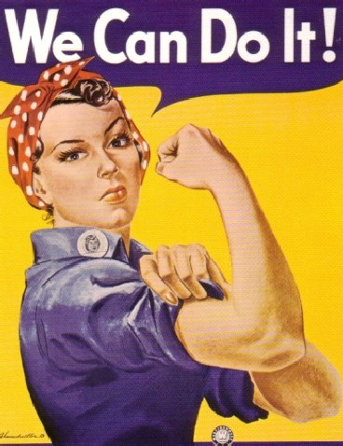
Women in WWII
“Rosie the Riveter” was a nickname given during WWII to American women who did industrial work in the 1940s
The war mobilization caused a significant movement of married women into the workforce
Did Women’s Roles Really Change?
Men continued to dominate supervisory positions
Women still paid less
WOMEN FORCED OUT OF THE WORKFORCE AT THE END OF THE WAR!
  1950s: Women return role of housewives in suburbs
Women veterans were not recognized for benefits until 1979.

Slide 35
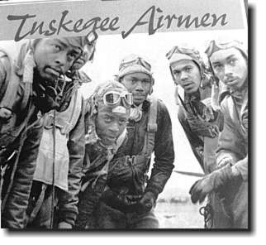
African Americans in WWII
The war years witnessed a continued migration of African Americans from the rural South to urban centers in the North and West
  About 1.6 million African Americans left the South
  President Roosevelt issued an executive order forbidding discrimination in defense industries → monitored by the Fair Employment Practices Commission
Double Victory campaign: Victory against dictators abroad, and racism at home
Some victories: more job opportunities, increased migration to North and West (esp. CA)
Still, much racism: blacks paid less, discriminated in housing, in public facilities
Racism in military
Soldiers of color enlisted, but in segregated units
Many of these units were the most decorated of the war
  African-Americans: Tuskegee Airmen
  Mexican-Americans: Company E of the 141st Regiment
  Japanese Americans: 442nd Regimental Combat Team
  Native-Americans: Served in Marine Corps as Navajo Code Talkers

Slide 36
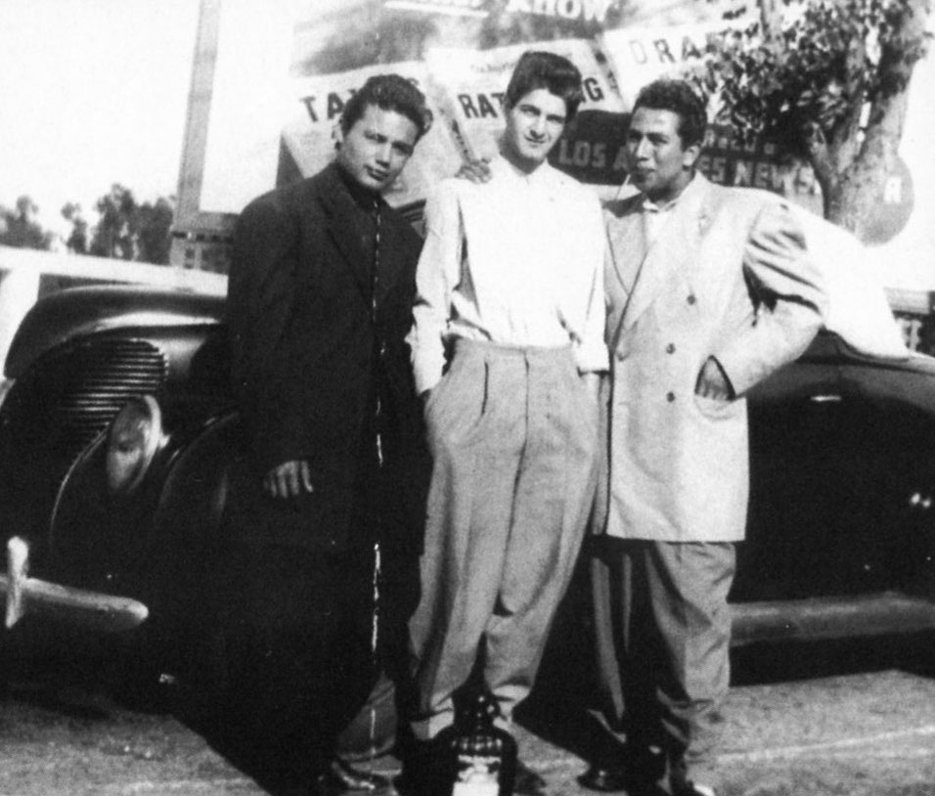
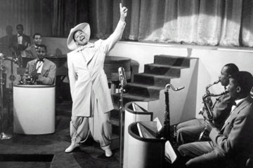
Racial Tensions in LA during WWII
Racism against Mexican Americans and the fear of teen crime
Mexican American teenagers who wore “zoot suits” were targeted.
June 1943: 2500 soldiers and sailors attacked Mexican American neighborhoods in LA → Zoot Suit Riots

Slide 37
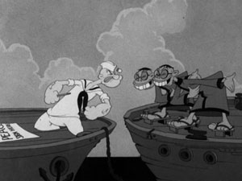
Civil Liberties: The Internment of the Japanese Americans
Public rallied behind WWII like never before
Many feared that immigrant groups were not unified with allied cause and were actually enemy agents
  Germans and Italians: forced to move away from military bases, dealt with curfews, often jailed as spies without proof

Slide 38


Slide 39

Japanese-American
Internment Camps
In March 1942, President Roosevelt ordered that all Japanese Americans living on the West Coast be removed to “relocation centers” for the duration of the war
Japanese Americans were sent to the internment camps on the grounds that they were, allegedly, a potential security threat
Former horse stalls converted for temporary occupation by Japanese American internees at Tanforan Assembly Center, San Bruno, California, 1942

Slide 40

Korematsu v. United States
The relocation of Japanese Americans during World War II raised the constitutionality of the internment of Japanese Americans as a wartime necessity
The Supreme Court ruling in Korematsu v. United States upheld the constitutionality of the internment as a wartime necessity

Slide 41
Europe First…

Slide 42

Europe (April, 1944)

Slide 43

D-Day (June 6, 1944)
Anglo-American Amphibious Landing
Normandy (Northern France)

Slide 44

Yalta Conference
February, 1945
The Big Three
The Big Three = Roosevelt, Churchill, and Stalin
Demanded the unconditional surrender of Germany and Japan
Held their final meeting at Yalta in February 1945
The Presence of Soviet troops in Poland limited President Roosevelt’s options of the Yalta Conference
Churchill
Stalin
FDR
The
“Big Three”

Slide 45

V-E Day
May 8, 1945

Slide 46


Anti-Semitism in Nazi Germany
“Hence today I believe that I am acting in accordance with the will of the Almighty Creator: 'by defending myself against the Jew, I am fighting for the work of the Lord.‘”
-- Adolf Hitler
Mein Kampf
http://www.mosaisk.com/auschwitz/Adolf-Hitler-about-the-Jews.php

Slide 47

Kristallnacht (1938)

Slide 48

Kristallnacht (1938)

Slide 49

Kristallnacht (1938)

Slide 50


“Crimes Against Humanity”
Holocaust
Concentration Camps
Genocide
“Final Solution”
Auschwitz Extermination Camp (Poland)
Mass Grave

Slide 51

Nuremburg Trials
1945-1946
INDICTMENTS:
Participation in a…
crime against peace
Planning, initiating and
waging wars of aggression…
War crimes
Crimes against humanity

Slide 52


The State of Israel
(1948)
Zionism had been around since the late nineteenth century, but it took the Holocaust to get the Western powers to actively involve themselves in the creation of a Jewish state.

Slide 53
Now onto the Pacific…

Slide 54

Pacific Theatre Map
Naval Battles
Island Hopping
2
5
4
1
3

Slide 55

Battle of Midway
June 4-7, 1942
US Naval Base
AIRSTRIP
The “Turning Point” of the Pacific

Slide 56


VICTORY!!!
LOSSES
United States | Japan
1 carrier sunk | 4 carriers sunk
1 destroyer sunk | 1 cruiser sunk
150 aircraft destroyed | 248 aircraft destroyed
307 killed | 3,057 killed
Once again, Japan failed to destroy the U.S. carrier fleet, destroying any hope of Japanese naval supremacy.

Slide 57


Battle of Iwo Jima
2/19 – 3/26/1945

Slide 58



Kamikaze
Ensign
Kiyoshi Ogawa
Kamikaze Pilot
USS BUNKER HILL hit by two Kamikazes in 30 seconds on 11 May 1945 off Kyushu.
Dead-372.
Wounded-264.
Notes:
Kamikazes were used late in the war, when it was obvious that Japan could not win but the Japanese authorities were reluctant to surrender.

Slide 59


The Manhattan Project
President Roosevelt authorized the Manhattan Project
President Truman authorized the use of the atomic bomb on Japanese cities Hiroshima and Nagasaki
The United States was the only country possessing atomic bombs in 1945
J. Robert Oppenheimer
Physicist
“father of the atomic bomb”

Slide 60



Potsdam Conference
July-August, 1945
POTSDAM DECLARATION
U.S., U.K., & China
“We call upon the government of Japan to proclaim now the unconditional surrender of all Japanese armed forces, and to provide proper and adequate assurances of their good faith in such action. The alternative for Japan is prompt and utter destruction."
OR

Slide 61

The Atomic Bomb
Truman’s Decision
Continuing to use conventional weapons would result in the loss of thousands of American lives
Using the atomic bomb would persuade the Japanese to surrender
Ending the war against Japan as quickly as possible would prevent Soviet intervention
Using the atomic bomb would convince the Soviet Union of the need to be more cooperative in formulating its postwar plans

Slide 62



The Enola Gay
Paul Tibbets
The Crew of the Enola Gay

Slide 63


August, 1945
“Little Boy”
(Hiroshima)
“Fat Man”
(Nagasaki)
August 6, 1945
August 9, 1945
Unconditional Surrender: August 14-15, 1945

Slide 64
https://www.youtube.com/watch?v=gwkyPvlWPM0

Slide 65






Slide 66

September 2, 1945
“V-J Day” in U.S.
Gen. MacArthur signs Japan’s unconditional surrender at a formal ceremony aboard the U.S.S. Missouri.

Slide 67
http://archive.org/details/Japanese1943
Japanese Internment

