Slide 1
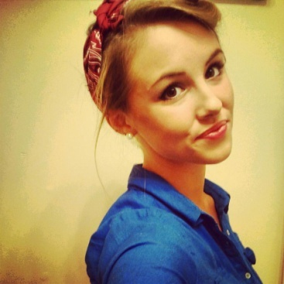
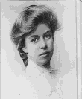
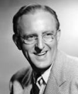
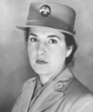
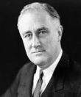
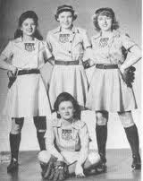
facebook
Wall
Photos
Friends
Rosie the Riveter
Logout
Laura Padilla A3/5
Profile Picture Here
Rosie the Riveter, here to empower women out there!
Wall
Info
Photos
Boxes
What’s on your mind?
Write something…
View photos of Rosie (5)
Send Rosie a message
Rosie the Riveter
January 23 1947 via typewriter
Poke Rosie
They just invented this thing called the microwave… Makes my life so much easier!
Like ⋅ Comment ⋅ Share 6
Information
45 people like this
Occupation: CEO of
Rosebuilders
Studied at: Kentucky High
Birthday: January 6, 1942
From: Science Hill, Kentucky
Lives: Clarksville, Indiana
Write a comment.
Friends
Rosie the Riveter
August 16, 1945 via typewriter
Yay! My husband is coming home! I’m looking forward to stay at home all day and cooking! #sarcasm
Like ⋅ Comment ⋅ Share 28
Eleanor Roosevelt
Shirley Jameson
Kay Kyser
64 people like this
Ovetta C. Hobby
Glad the war is finally over.
Like ⋅ Reply ⋅
Ovetta C. Hobby
Franklin D. Roosevelt
Ann Harnett

Slide 2
facebook
Wall
Photos
Friends
Rosie the Riveter
Logout
Laura Padilla A3/5
Profile Picture Here
Rosie the Riveter, here to empower women out there!
Wall
Info
Photos
Boxes
What’s on your mind?
Write something…
View photos of Rosie (5)
Send Rosie a message
Rosie the Riveter
September 24, 1944 via typewriter
Poke Rosie
An elderly woman told me that she was very proud of me for working outside my home, and I inspired her daughter to work too. #feelingaccomplished
Like ⋅ Comment ⋅ Share 6
Information
15 people like this
Occupation: CEO of
Rosebuilders
Studied at: Kentucky High
Birthday: January 6, 1942
From: Science Hill, Kentucky
Lives: Clarksville, Indiana
Write a comment.
Einstein She is right! Thank you, Rosie!
Like ⋅ Reply ⋅ 2 May 29 at 11:58 PM
Friends
Rosie the Riveter
June 29, 1943 via typewriter
Geys, check it out! I’m featured in a song! #winning http://www.youtube.com/watch?v=55NCElsbjeQ
Like ⋅ Comment ⋅ Share 28
Eleanor Roosevelt
Shirley Jameson
Kay Kyser
64 people like this
Write a comment.
Ovetta C. Hobby
Franklin D. Roosevelt
Ann Harnett

Slide 3
facebook
Wall
Photos
Friends
Rosie the Riveter
Logout
Laura Padilla A3/5
Profile Picture Here
Rosie the Riveter, here to empower women out there!
Wall
Info
Photos
Boxes
What’s on your mind?
Write something…
View photos of Rosie (5)
Send Rosie a message
Rosie the Riveter
June 1, 1943 via typewriter
Poke Rosie
just a few months in and it already seems that most of us are lower classed women working
Like ⋅ Comment ⋅ Share 6
Information
25 people like this
Occupation: CEO of
Rosebuilders
Studied at: Kentucky High
Birthday: January 6, 1942
From: Science Hill, Kentucky
Lives: Clarksville, Indiana
Write a comment.
Friends
Rosie the Riveter
May 31, 1943 via typewriter
and they said women shouldn't work outside the home…i can get used to this.
Like ⋅ Comment ⋅ Share 1
Eleanor Roosevelt
Shirley Jameson
Kay Kyser
14 people like this
Write a comment.
Ovetta C. Hobby
Franklin D. Roosevelt
Ann Harnett

Slide 4
facebook
Wall
Photos
Friends
Rosie the Riveter
Logout
Laura Padilla A3/5
Profile Picture Here
Rosie the Riveter, here to empower women out there!
Wall
Info
Photos
Boxes
What’s on your mind?
Write something…
View photos of Rosie (5)
Send Rosie a message
Rosie the Riveter
May 30, 1943 via typewriter
Poke Rosie
Going to the inauguration of the All-American Girls Professional Baseball League!!
Like ⋅ Comment ⋅ Share 6
Information
65 people like this
Occupation: CEO of
Rosebuilders
Studied at: Kentucky High
Birthday: January 6, 1942
From: Science Hill, Kentucky
Lives: Clarksville, Indiana
Write a comment.
Friends
Rosie the Riveter
March 27, 1943 via typewriter
Wow! I cannot believe so many race riots are occurring.
Like ⋅ Comment ⋅ Share 2
Eleanor Roosevelt
Shirley Jameson
Kay Kyser
14 people like this
Write a comment.
Ovetta C. Hobby
Franklin D. Roosevelt
Ann Harnett

Slide 5
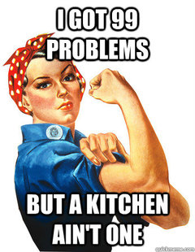
facebook
Wall
Photos
Friends
Boxes
NAME
Logout
Laura Padilla A3/5
Profile Picture Here
Rosie the Riveter, here to empower women out there!
Wall
Info
Photos
Boxes
What’s on your mind?
View photos of Rosie (5)
Rosie the Riveter
June 27, 1942 via typewriter
Send Rosie a message
Poke Rosie
Information
Occupation: CEO of Rose
Builders
Studied at: Kentucky High
Birthday: January 6, 1942
From: Science Hill, Kentucky
Lives: Clarksville, Indiana
Like ⋅ Comment ⋅ Share 6
67 people like this
Haha! I don’t have that problem either. ;)
Like ⋅ Reply
Friends
Rosie the Riveter
May 27, 1942 via typewriter
Why have a man do the work when you can have a WO(nder)MAN do it?
Eleanor Roosevelt
Shirley Jameson
Like ⋅ Comment ⋅ Share 2
Kay Kyser
68 people like this
Write a comment.
Ovetta C. Hobby
Franklin D. Roosevelt
Ann Harnett

Slide 6
facebook
Wall
Photos
Friends
Rosie the Riveter
Logout
Laura Padilla A3/5
Profile Picture Here
Rosie the Riveter, here to empower women out there!
Wall
Info
Photos
Boxes
What’s on your mind?
View photos of Rosie (5)
Send Rosie a message
Rosie the Riveter
December 14, 1941 via typewriter
Poke Rosie
My husband has left to the war. It is time for us women to help our nation!
Like ⋅ Comment ⋅ Share 6
Information
248 people like this
Occupation: CEO of Rose
Builders
Studied at: Kentucky High
Birthday: January 6, 1942
From: Science Hill, Kentucky
Lives: Clarksville, Indiana
Write a comment.
Ellie Roberts It’s time for us women to get to work!
Like ⋅ Reply ⋅ 12May 14 at 1:34 PM
Friends
Rosie the Riveter has joined WORLD WAR II
December 7, 1941 via typewriter
Like ⋅ Comment ⋅ Share 2
Eleanor Roosevelt
Shirley Jameson
Kay Kyser
156 people like this
Franklin D. Roosevelt
I will help our nation through this.
Ann Harnett
Like ⋅ Reply ⋅ 62
December 8 at 11:58 PM
Ovetta C. Hobby
Franklin D. Roosevelt

Slide 7
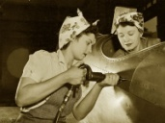
facebook
Wall
Photos
Friends
Rosie the Riveter
Logout
Profile Picture Here
Rosie the Riveter, here to empower all the women out there!
Wall
Info
Photos
Boxes
Basic Information
Birthday: January 3, 1942
Relationship Status: Married
Children: Lost Count
Religious Views: Catholic
Political Views: Democrat
View photos of Rosie (6)
Send Rosie a message
Personal Information
Poke Rosie
About me: I am a regular hardworking woman trying to help my hear country U.S.A., who is in the Second World War. Even though I was raised with my momma’s conservative ideals in my home state of Kentucky. I am a tough woman. I stand as an example to all the other women out there that WE CAN DO IT! I hope to inspire millions of women to follow my lead and help the United States in its time of need. Working in the factories aint easy, but I love doing it as long as it means helping my country. It is time to put the broom down and raise our hammers. USA!
Activities: Baking, using a drill, sewing, fixing cars, working out, and recycling.
Interests: World War II, Women’s Movement, B
Quotes: We Can Do It!
Information
Occupation: CEO of Rose
Builders
Studied at: Kentucky High
Birthday: January 6, 1942
From: Science Hill, Kentucky
Lives: Clarksville, Indiana
Work and Education
Job: Riveter at American Defense Factory
Job: CEO of Rose Builders
School: Kentucky High
School: No College
Photos
2 Albums
Contact Information
PIC
On the Job
Updated last Thursday
Address: 117 Lynda Ave Clarksville, IN 47129
Phone Number: (812)-575-1129
Email: rosie42@gmail.com
PIC
I’M FAMOUS!! Updated two months ago

Slide 8
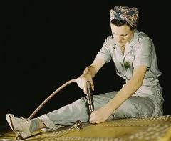
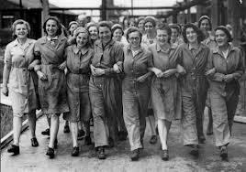
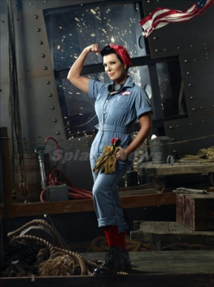
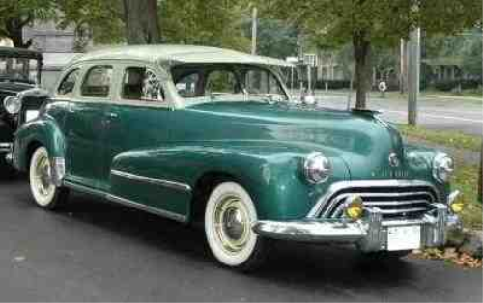
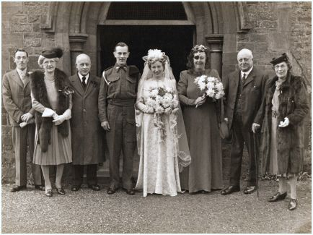
facebook
Wall
Photos
Friends
Rosie the Riveter
Logout
PICTURE
Rosie the Riveter’s photos
Wall
Info
Photos
Boxes
Photos of Rosie 6 Photos
Insert Picture
Insert Picture
Work flow #gettingitdone
My besties!
Inspiring others :)
Insert Picture
My sweet ride!
Charlie and I’s wedding
No caption needed!

