Slide 1
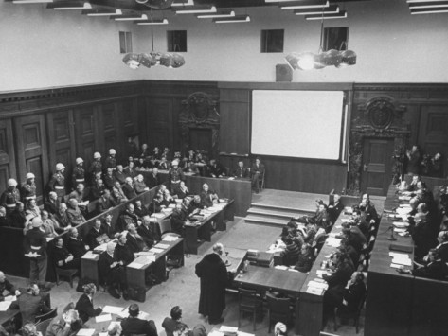
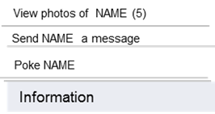
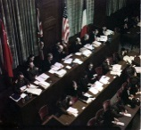
facebook
Wall
Photos
Friends
Boxes
Nuremberg Trials
Logout
Profile Picture Here
Nuremberg Trials are serving justice.
Wall
Info
Photos
Boxes
Basic Information
Event before this: World War Two, Holocaust, Defeat of Nazi Regime
Event after this:
U.S. President: Roosevelt, Truman
Religious Affiliation: N/A
Political Affiliation: Democratic vs. Fascists
Type of Event:: Court Rulings
People Involved: Robert
Jackson, President Truman,
IMT, Allies, included Hermann
Goering, Albert Speer,
Rudolf Hess,
Countries: United States,
Great Britain, France, Soviet
Union
Dates: November 20, 1945-
April 13, 1949
Location: Palace of Justice,
Nuremberg Germany
Events After this: The Genocide
Convention, 1948.
The Universal Declaration of
Human Rights, 1948.
The Nuremberg Principles, 1950.
The Convention on the Abolition
of the Statute of Limitations on
War Crimes and Crimes against
Humanity, 1968.
The Geneva Convention on the
Laws and Customs of War,
1949; its supplementary
protocols, 1977.
Personal Information
About me: I am the Nuremberg Trials. I took four years from 1945 to 1949 to complete. The countries that were included in my trials were the United States, Great Britain, Soviet Union, and France. I resided in the Palace of Justice in Nuremberg Germany. The first part, and most widely known part of me were the Major War Criminals Trials. During this section, prosecutors and judges along with Allied countries, charged the Major War Criminals of Conspiracy to Wage Aggressive War, crimes against peace ,war crimes, and crimes against humanity. Important Major War Criminals, each with different approaches to their ruling included Hermann Goering, Albert Speer, and Rudolf Hess. The second part of admitted were the subsequent trials from 1946 to 1949 which were the Judges Trial, followed by the Doctors Trials, and Einsatzgruppen Trials . These 12 following trials consisted of further significant figures of the Nazi regime, yet that did not have as great as power as the Major War Criminals.
Activities: Prosecuting, giving a fair trial, ruling, jailing, sentencing, executing.
Interests: Bringing peace and justice back to humanity.
Quotes: "A victor's justice" – Goering
"Why don't you just shoot us?" Unknown Nazi war criminal
“Death by hanging. That, I thought, I would be spared." Keitel
"I die innocent. The verdict is wrong." Sauckel
Photos
Contact Information
1 Album
Address: Bärenschanzstraße 72 90429 Núremberg, Germany
Phone Number: +49 911 32179372
Email: nurembergtrial@gmail.com
Nuremberg Trials
Updated 6/7/13 Tuesday
Notes:
The accused in the dock. First row: Hermann Goering, Rudolf Hess, Joachim von Ribbentrop, Wilhelm Keitel, Ernst Kaltenbrunner, Alfred Rosenberg, Hans Frank, Wilhelm Frick, Julius Streicher, Walther Funk, Hjalmar Schacht.Second row: Karl Donitz, Erich Raeder, Baldur von Schirach, Fritz Sauckel, Alfred Jodl, Franz von Papen, Arthur Seyss-Inquart, Albert Speer, Konstantin von Neurath, Hans Fritzsche.

Slide 2
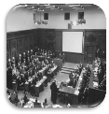
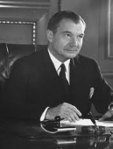
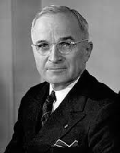
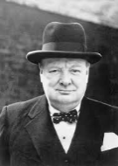
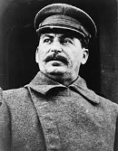
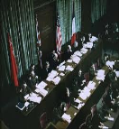
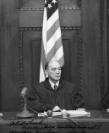
facebook
Wall
Photos
Friends
Boxes
Nuremberg Trials
Logout
Elizabeth Corronel
A 6/7
Nuremberg Trials are serving justice.
Wall
Info
Photos
Boxes
Write something…
Share
View photos of Nuremberg Trials (6)
Send a message
Nuremberg Trials
November 20 via headset
Poke
Information
Major War Criminals Trial begins today. Indictments also read today to defendants .Tomorrow Robert Jackson is to give opening speech.
Type of Event:: Court Rulings
People Involved: Robert
Jackson, President Truman,
IMT, Allies, included Hermann
Goering, Albert Speer,
Rudolf Hess,
Countries: United States,
Great Britain, France, Soviet
Union
Dates: November 20, 1945-
April 13, 1949
Location: Palace of Justice,
Nuremberg Germany
Like ⋅ Comment ⋅ Share 5
M International Military Tribunal likes this
Nuremberg Trials
January 7 via headset
Over the past few months, screenings of Concentration Camps have been shown, Otto Ohlendorf has admitted to executions of millions of Jews, and Nazi plans on the Final Solution
By 21 defendants
Friends
Like ⋅ Comment ⋅ Share 390
Hermann Goering
There is no reason for this unjust trial. We were all merely following orders.
President Truman
Rudolf Hess
Robert Jackson
Churchill
Where am I? I am certainly not guilty. I am mentally unfit for trial.
Pic
Geoffrey Lawrence
Hess, you’re really not helping our case…
Stalin
IMT

Slide 3
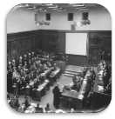
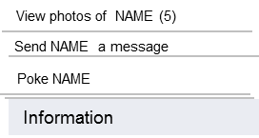
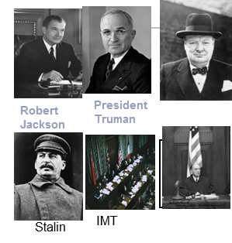
facebook
Wall
Photos
Friends
Boxes
Nuremberg Trials
Logout
Elizabeth Corronel
A 6/7
Nuremberg Trials are serving justice.
Wall
Info
Photos
Boxes
Write something…
Share
Nuremberg Trials
July 2 via Headset
All defendants have taken the stand.
Like ⋅ Comment ⋅ Share 5
75 people like this
Robert Jackson
Type of Event:: Court Rulings
People Involved: Robert
Jackson, President Truman,
IMT, Allies, included Hermann
Goering, Albert Speer,
Rudolf Hess,
Countries: United States,
Great Britain, France, Soviet
Union
Dates: November 20, 1945-
April 13, 1949
Location: Palace of Justice,
Nuremberg Germany
I hope the jury makes the right decisions and deliberates quickly..
Like ⋅ Reply ⋅
Nuremberg Trials
September 30
Today individual sentencing begins. It is predicted to take up to two days.
Like ⋅ Comment ⋅ Share 390
Friends
437593739 people like this
Nuremberg Trials
Update: 12 defendants sentenced to death, 7 to 10+ years of prison, and 3 are acquitted.
Nuremberg Trials
December 6 via Headset
The Judges Trial, followed by the Doctors Trials, and Einsatzgruppen Trials begin today.
Nuremberg Trials
Last day of Trials- April 10, 1948. The tribunal found them guilty on all counts, except two who were found guilty on only one count.

Slide 4
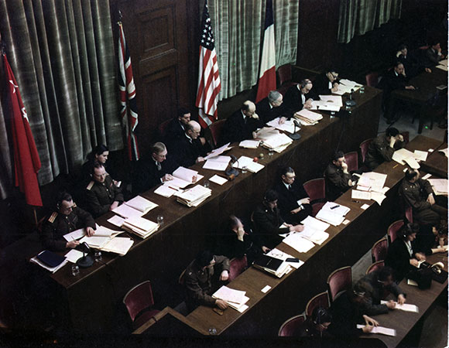
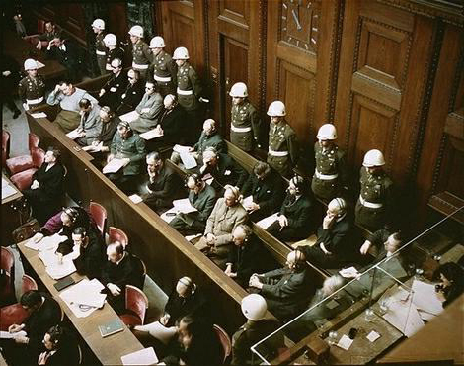
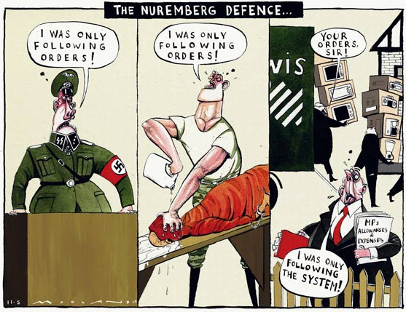
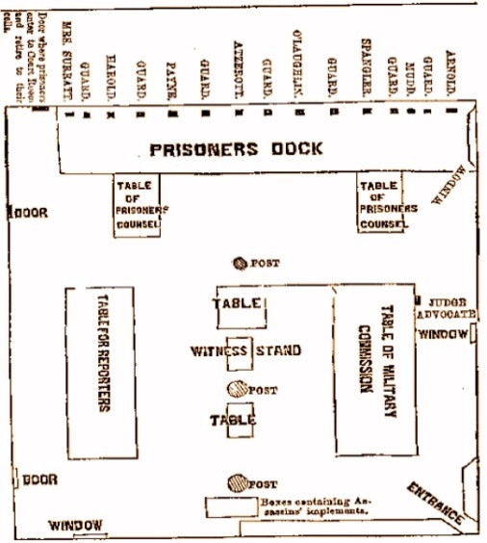
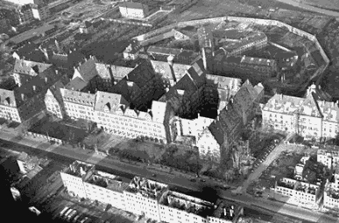
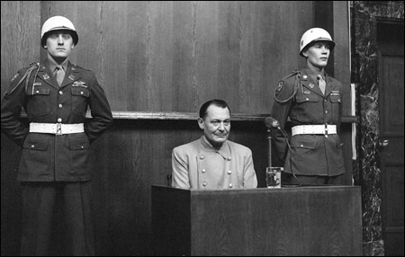
facebook
Wall
Photos
Friends
Boxes
Nuremberg Trials
Logout
Nuremberg Trials are serving justice.
Wall
Photos
Info
Boxes
Photos of Nuremberg Trials 6 Photos
International Judges
Major Nazi War Criminals, Allied Soldiers behind them
Political Cartoon of Nuremberg Defense Strategies
Palace of Justin, Nuremberg Germany
Very Recognizable picture of Goering at Nuremberg Trial
Diagram of Placement of attendees at Trials
Notes:
Add video

Slide 5
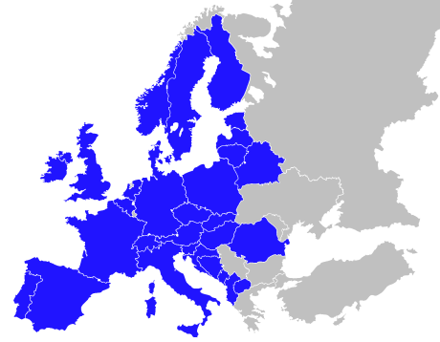
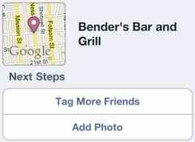
facebook
Wall
Photos
Friends
Boxes
Nuremberg Trials
Logout
Nuremberg Trials are serving justice.
Wall
Photos
Info
Boxes
Map
Nuremberg Trials Map and Check - Ins
Check In
London- Meeting with Allied Powers and discussion of captured Nazi leaders
1.
2.
Nuremberg, Germany- Location of Trials
Europe
Notes:
Add video

Slide 6
Work Cited Page
Websites/ sources
1.http://law2.umkc.edu/faculty/projects/ftrials/nuremberg/nurembergACCOUNT.html
2.http://www.loc.gov/rr/frd/Military_Law/Nuremberg_trials.html\
3.http://www.history.com/topics/nuremberg-trials
4.http://www.ushmm.org/outreach/en/article.php?ModuleId=10007722
5.http://www.bbc.co.uk/history/worldwars/wwtwo/nuremberg_article_01.shtml
6.http://www.historylearningsite.co.uk/quotes_nuremberg_trials.htm
7.http://imgc.allpostersimages.com/images/P-473-488-90/37/3790/HHEIF00Z/posters/ed-clark-the-courtroom-crowded-with-lawyers-and-defendents-during-the-nuremberg-trial.jpg
8.http://tj.facinghistory.org/reading/nuremberg-trials-fact-sheet
9.http://www.pbs.org/wgbh/amex/nuremberg/peopleevents/p_judges.html
10.http://historyimages.blogspot.com/2011/12/nuremberg-trials-removing-traces-of.html
Pictures in PowerPoint:
1.http://www.nurembergfilm.org/about_the_trial.shtml
2.https://commons.wikimedia.org/wiki/File:Defendants_in_the_dock_at_nuremberg_trials.jpg
3.http://www.englishblog.com/2009/05/cartoon-the-nuremberg-defence.html#.UbH8Ttwo7IU
4.http://law2.umkc.edu/faculty/projects/ftrials/lincolnconspiracy/courtroom.html
5.http://www.glogster.com/jaan99/nuremberg-trials-pictures/g-6llvb1jo2ur1nopprkhlma0
6.http://justiceinconflict.org/2011/11/29/making-war-illegal-the-crime-of-aggression-and-the-icc/

