Slide 1
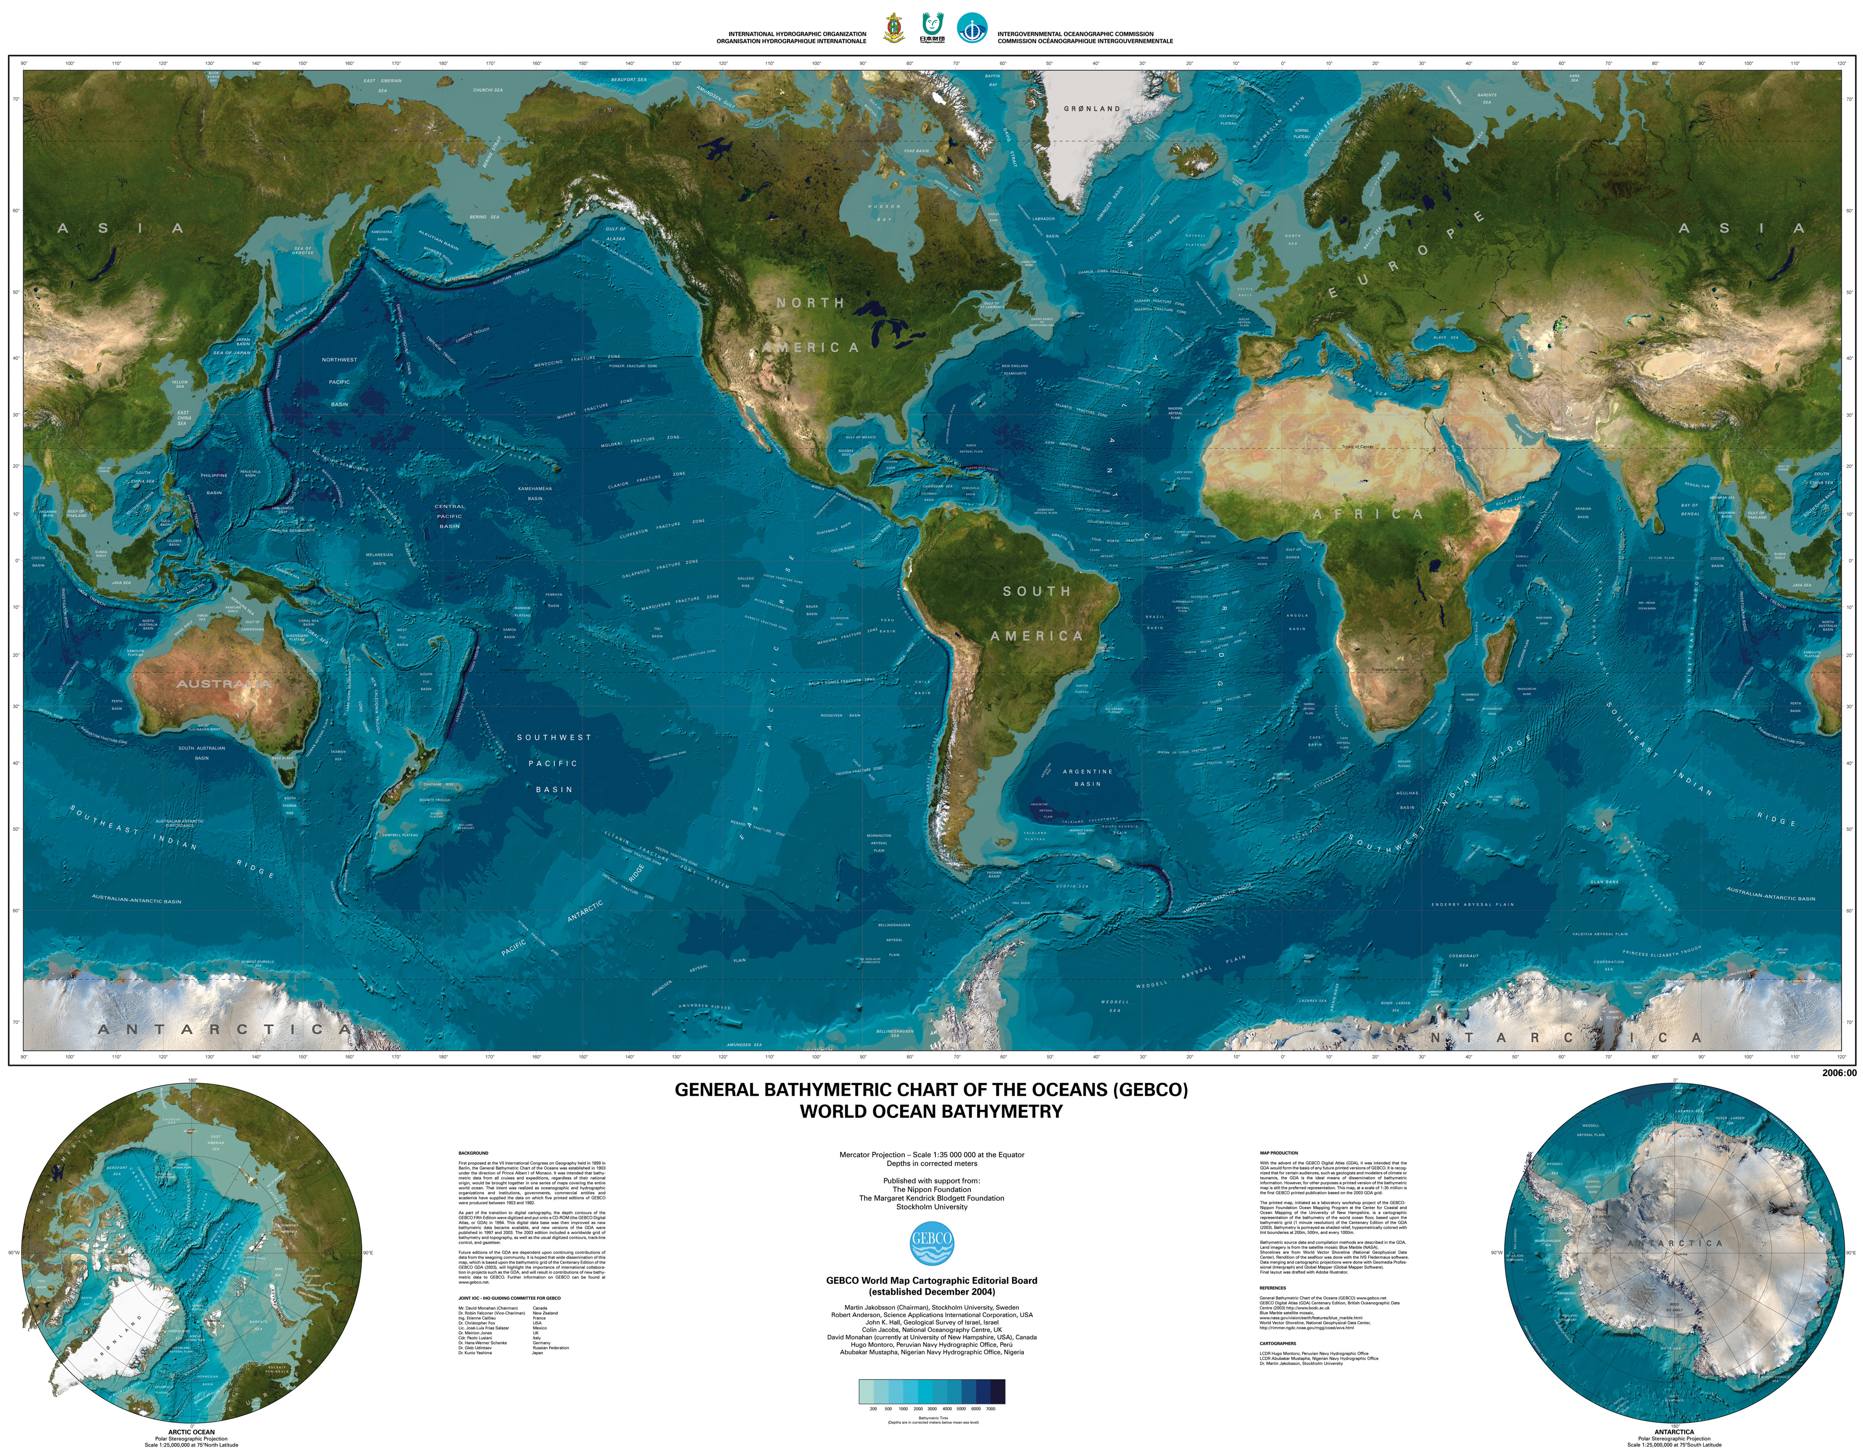
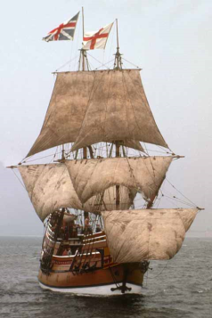
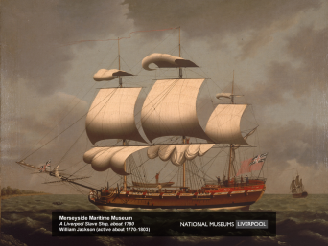
Immigration to the Colonies in the 1700’s
English didn’t immigrate as much.
Swedish
Dutch
French Huguenots
Scotch-Irish: settled on PA, VA, GA, SC/NC frontiers; anti-British. 7%
5%
Germans settles in PA farmlands; maintained their culture. 6%
Africans: taken captive and sold into slavery; some were granted freedom; 20% of colonial population; 90% lived in South, enslaved. Free Africans worked as wage-earners; every colony had discriminatory laws.
Factors
Land for farming
Opportunity to set up shop as a merchant or artisan
Factors
Religious persecution
Wars

Slide 2
Quiz Question 21
The greatest concentration of German immigrants came to
New Jersey
New York
Virginia
Quebec
Pennsylvania

Slide 3
Quiz Question 22
African Americans composed a majority of the population in which colony?
Massachusetts
Pennsylvania
South Carolina
Maryland
Delaware

Slide 4

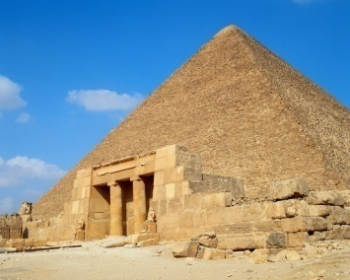
Colonial Society
English culture
  But influenced by diversity
Self-government
  Representative assembly
    elected by eligible voters.
  Governor
    Elected or appointed (by King or proprietor)
Religious Toleration
  RI & PA = the most tolerant
  MA = most intolerant (Catholics & non-Christians were excluded.)
No Aristocracy
  Class system was based on economics, not lineage.
Social Mobility
  Every white person could improve their standard of living by hard work.
Wealthy landowners
Craftspeople & small farmers

Slide 5

Colonial Families
Colonists married young and had lots of children.
90% lived on farms.
Men
Women
Worked
Owned land
Dominated politics
Had unlimited power at home (could beat wife)
Had many children
Cooked, cleaned, made clothes, in charge of medical care
Worked alongside husband
Divorce was legal.
Mutual Dependence protected women from abuse and gave them a role in decision-making.

Slide 6
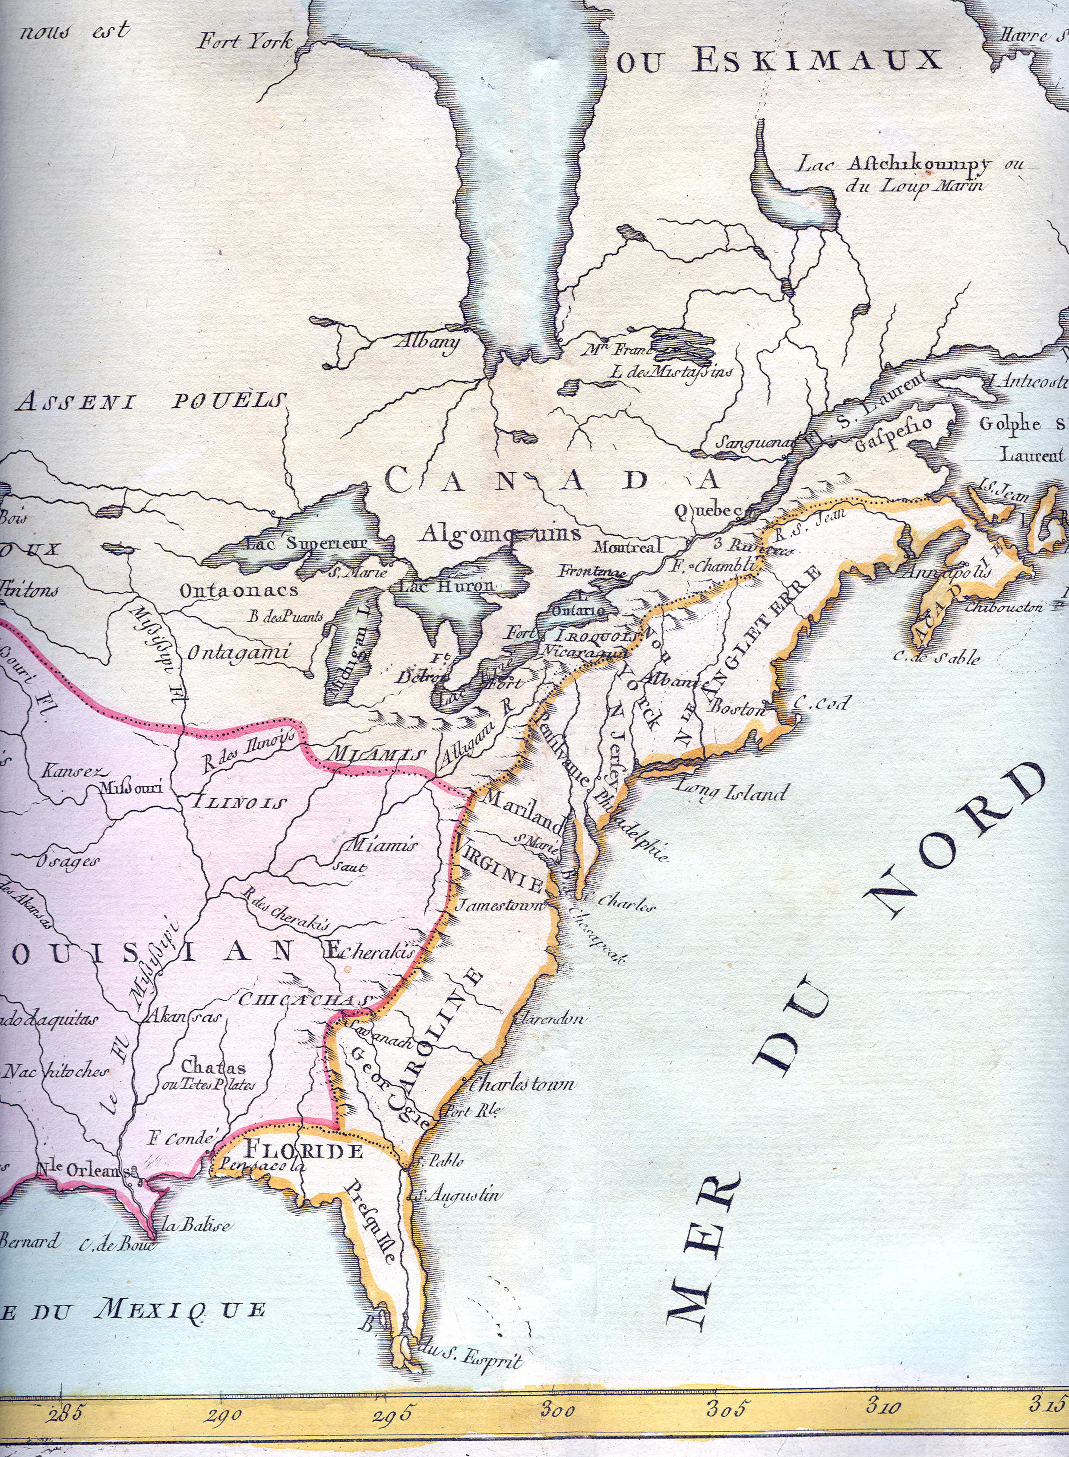
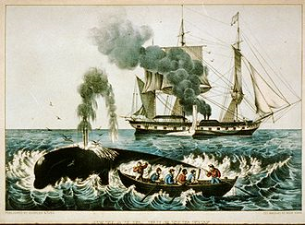
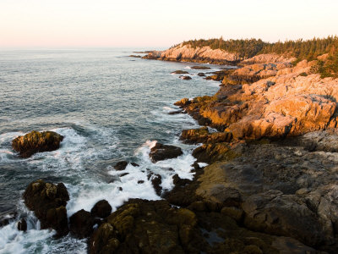
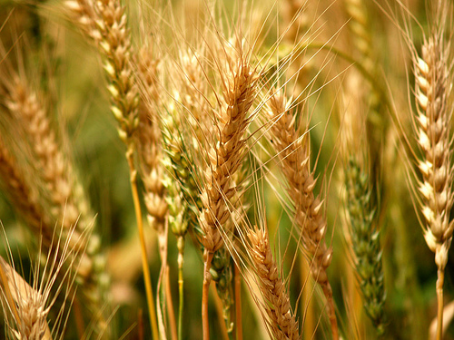
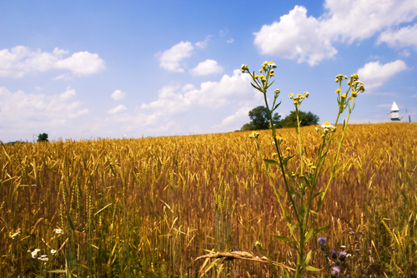



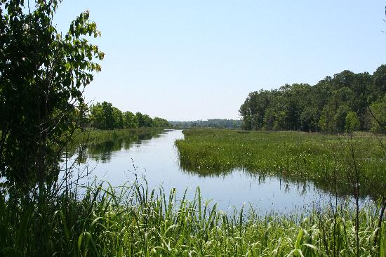
Colonial Economy
New England:
Rocky soil
Subsistence-only farming
Logging, shipbuilding, fishing, trading, run-distilling
Middle Colonies:
Rich soil ≤ 200 acre-farms
Indentured servants worked alongside family.
Exported wheat and corn
Iron-making
Southern Colonies
Varied climate→ different sized farms.
Farms ≤ 2000 + acres –work done by slaves
Many self-sufficient farms.
Cash crops:
  Tobacco (NC, Chesapeake)
  Rice, indigo (SC, GA)

Slide 7
Quiz Question 24
The economies of New England and the other colonies differed primarily because
Puritans resisted the use of slaves
Geographic differences led to the development of different industries
New Englanders tended to have a poorer work ethic than people in the middle and southern colonies
Tobacco would only grow in the New England climate
Puritans became experts in agricultural production

Slide 8

The Christian Religion in the Colonies
Christians
Protestants
Roman Catholics
Congregationalists
AKA: Puritans
Presbyterians
Dutch Reformed
Church of England
AKA: Anglicans
Mennonites
Quakers
Lutherans

Slide 9

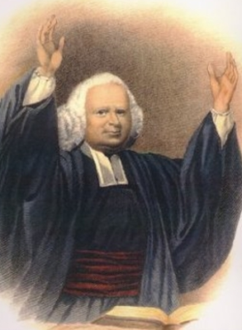
The Great Awakening
1730’s & 1740’s
Message of Great Awakening:
God is angry at sin.
If you are penitent, God will save you, but if you aren’t, you’ll face eternal damnation.
Ordinary people can understand the Bible without relying on ministers.
Results:
Emotionalism entered Protestant services.
Challenged traditional authority of church officials (people read Bible on their own)
The Congregational and Presbyterian denominations were divided:
  OLD LIGHTS: condemned the GA teachings.
  NEW LIGHTS: supported the GA teachings
  More denominations competing→ religious diversity
Shared American experience
Democratizing: new view of political authority. Commoners could make decisions without wealthy landowners.

Slide 10
Quiz Question 25
The first Great Awakening was
A religious revival that occurred throughout the colonies
A slave rebellion in colonial South Carolina
An eighteenth century religious movement among Native Americans dedicated to restoring traditional values
A massive migration of people from the south to the north
An early colonial protest against English imperial policy

Slide 11

Literature
“Sinners in the Hands of an Angry God” by Jonathan Edwards
Poor Richard’s Almanac by Benjamin Franklin
Common Sense by Thomas Paine
Phyllis Wheatley, poetry
Themes: religion & politics, American rights v. English authority

Slide 12
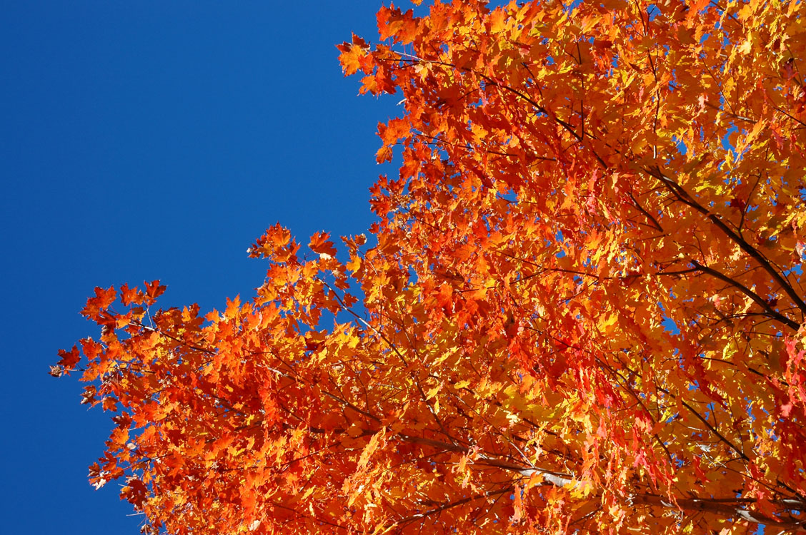
Education
New England Colonies
Puritans read the Bible, so literacy was important.
Middle Colonies
Church-sponsored private schools
Southern Colonies
Parents provided whatever education they could.
Had first tax-supported schools
Massachusetts law required primary and grammar schools, depending on town size.
Tutors on plantations instructed owners’ children.
Teachers lived with students’ families.
Early colonial colleges: Harvard, William and Mary (Anglican), Yale (Congregationalist)
Added after Great Awakening: Princeton (Presbyterian), Columbia (Anglican), Rutgers (Dutch Reformed), Dartmouth (Congregationalist), University of Pennsylvania (no affiliation)

Slide 13
Quiz Question 26
Harvard College and Yale College were established primarily to
Train lawyers and doctors
Encourage scientific advances
Ensure adequate supply of ministers
Prepare young men for political leadership
Preserve the traditions of classical scholarship

Slide 14

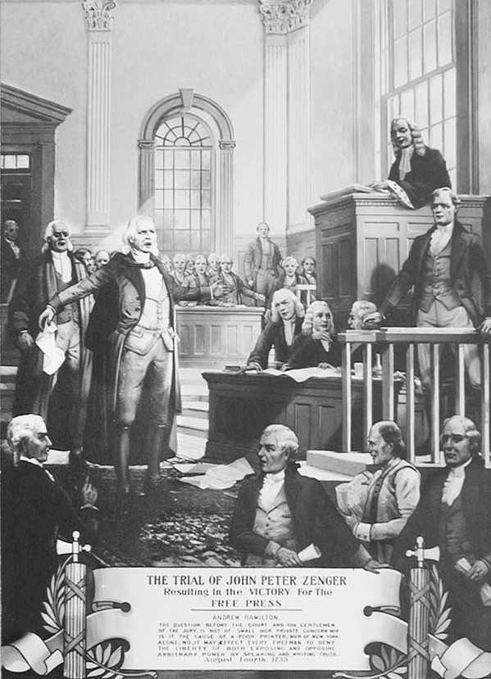
The Zenger Case
Peter Zenger printed the truth about the New York governor.
English common law called libel a criminal offense, regardless of its truth.
The jury found him not guilty.
This was a precedent for “Freedom of the press” in the United States; it encouraged newspapers to take more risks.

Slide 15
Quiz Question 27
Who was the individual who challenged the King and Governor over the issue of freedom of the press?
George Whitefield
Ben Franklin
John Winthrop
Peter Zenger
Roger Williams

Slide 16
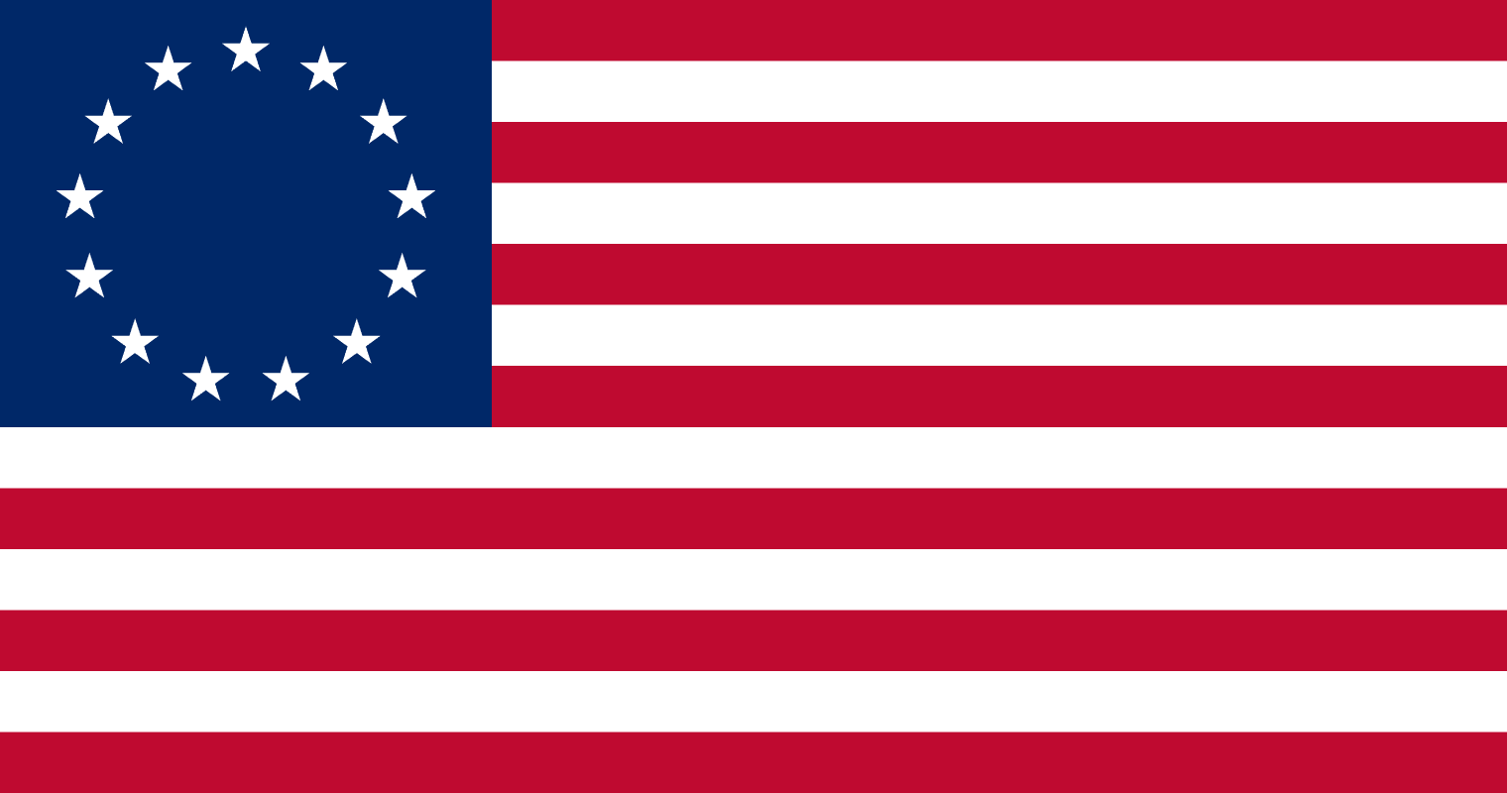
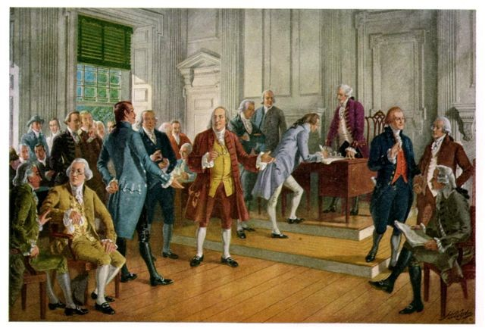
American Character
Free speech and free press
Electing representatives
Tolerating many religions
Restless, enterprising, practical, improving their circumstances

Slide 17
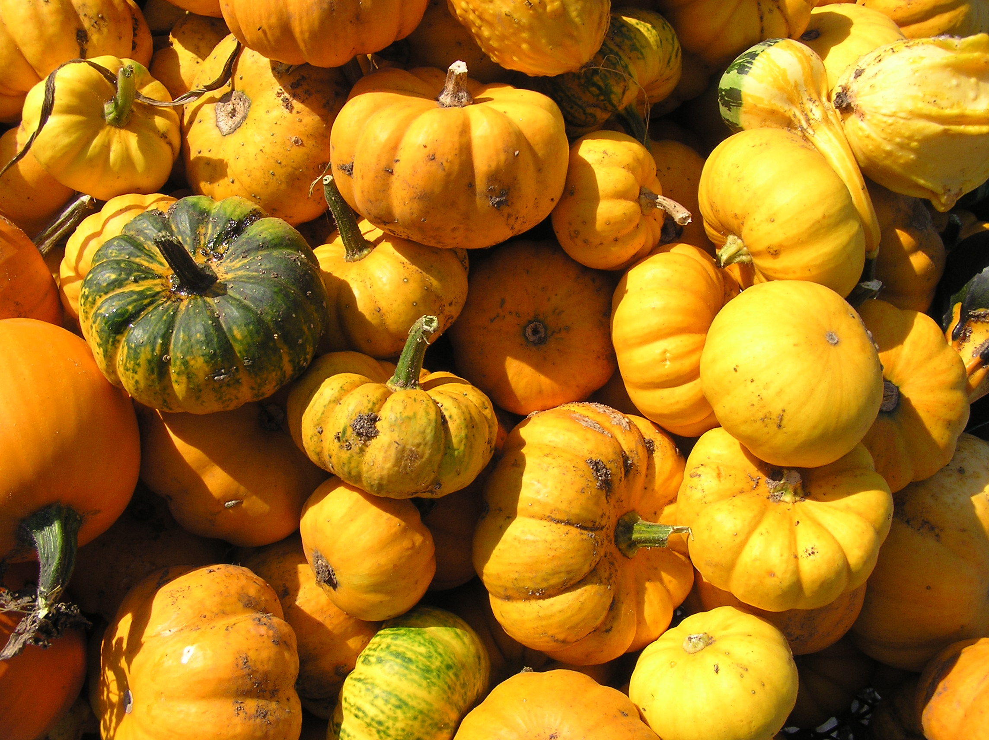
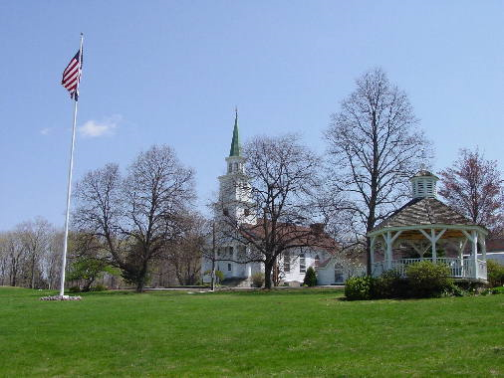
American Politics
8 Royal Colonies (governor appointed by the King) | 3 Proprietary Colonies (governor appointed by a proprietor) | 2 Self-Governing Colonies (governor elected by popular vote)
NH, MA, NY, NJ, VA, NC, SC, GA | MD, PA, DE | CT, RI
2-House Legislature Lower House (elected; makes tax laws) Upper House (appointed) | 2-House Legislature Lower House (elected; makes tax laws) Upper House (appointed) | 2-House Legislature Lower House (elected; makes tax laws) Upper House (elected)
Local Government:
New England: centered around a “Green.”
Town meeting = direct vote
South: spread out
Law-enforcing sheriff and county officials (appointed)

Slide 18
Quiz Question 23
The original colonies were similar in all of the following respects EXCEPT
Each colony enjoyed relatively peaceful relations with natives
There was some degree of social mobility, unlike in England
The family was the center of social and economic life
Each colony had some form of representative government
Men dominated politics

