Slide 1
The Growth of Cities and American Culture
1865-1900

Slide 2
Chicago’s World Columbian Exposition
America’s industrial development was showcased during the World’s Fair in Chicago in 1893
(“Columbian Exposition”)
1893: ¾ of Chicagoans were foreign-born or their children.
Urbanization, immigration, and industrialization were related forces.

Slide 3
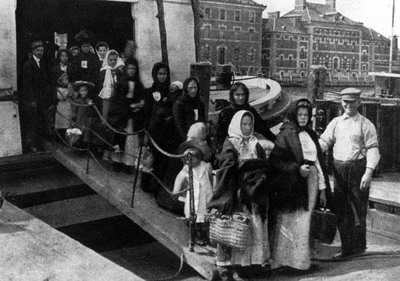
A Nation of Immigrants
Growth of Immigration
Push factors (negative factors in home country)
Poverty (farm-workers displaced by machines)
Overcrowding and joblessness in Europe
Religious persecution
Pull factors (positive factors in adopted country)
America’s reputation for religious and political freedom
Available land in Great Plains
Available industrial jobs
“Old Immigrants”
1840’s-1880’s: they came from northern and western Europe:
British Isles
Germany
Scandinavia
Protestant
Literate, skilled workers
“New Immigrants”
1890’s…: they came from southern and eastern Europe:
Italians
Greeks
Croats
Poles
Russians
Slovaks
Catholic, Orthodox, or Jewish
Crowded into poor ethnic neighborhoods
Most unskilled workers.

Slide 4
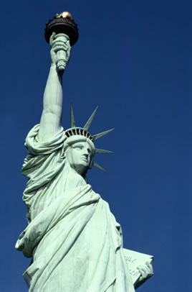
Restricting Immigration
1886:Statue of Liberty placed in New York harbor (“Give me your tired, your poor, your huddled masses yearning to be free.”)
Laws Restricted Immigration
Chinese Exclusion Act, 1882:
Banned all new immigrants from China
Law banned criminals and “mentally incompetent” from immigrating.
1885: Contract labor prohibited to protect American workers.
Ellis Island: 1892—medical and documents exams and entry tax required.
1920’s : Quota Acts
Supporters of Restrictions
Labor Unions
Nativists (American Protective Association)
Social Darwinists (biologically inferior)
1900: 15% of Americans were immigrants.

Slide 5
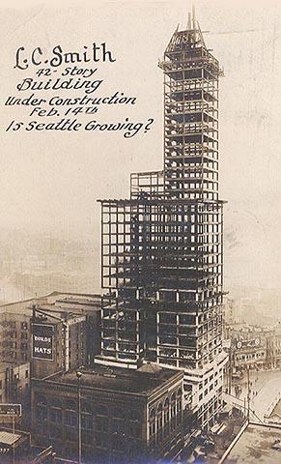
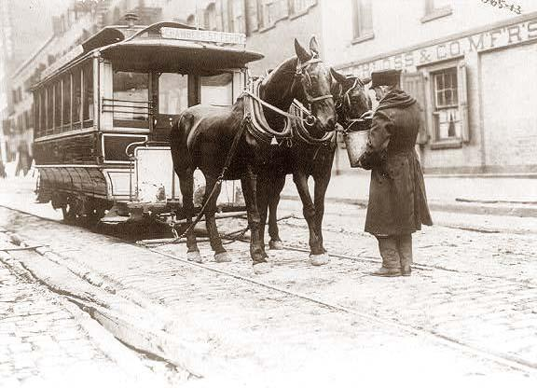
Urbanization: Changes in the Nature of Cities
Streetcar Cities
Ethnic Neighborhoods
Transportation improvements meant that live farther from the city center and commute to work.
Affluent citizens moved out, and poorer people moved to the city. They lived in tenements, tiny, windowless apartments.
Overcrowding and filth spread diseases like cholera and tuberculosis.
Immigrants lived in ethnic neighborhoods that were crime-ridden (“ghettos”), but from these many achieved the American dream.
Skyscrapers
Cities expanded upward when land values became higher; they were made with a steel skeleton. The elevator and central heating made them possible.

Slide 6
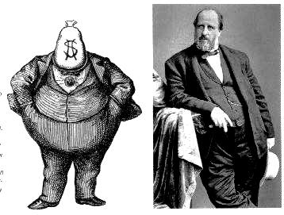
Suburbs & Political Machines
Residential Suburbs
Boss and Machine Politics
Wealthy Americans moved to the suburbs because of:
Lots of affordable land
Cheap transportation (trains)
Affordable construction
Ethnic and racial prejudice
Fondness for grass, privacy, and individual detached houses
Frederick Law Olmstead designed the first suburban community.
Political Machines were tightly organized groups of politicians.
Machines had a boss who was in charge and gave government jobs to supporters.
Tamany Hall (New York City) was a famous political machine
It coordinated the needs of businesses, immigrants, and underprivileged; people voted for them in return.
Welfare for new immigrants:
Machines would help newcomers find jobs, housing, and food.
Machines also stole from taxpayers (graft)
Boss Tweed was the most famous corrupt boss in New York City.
Municipal Services
Cities could not deal with the waste, pollution, disease, and crime that built up.
Citizens gradually advocated municipal services: water purification, waste removal, lighting, police departments

Slide 7
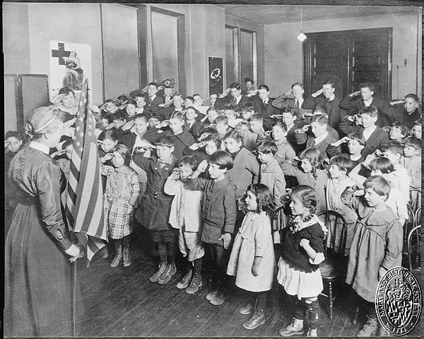
Middle Class Reform Movements
Books of Social Criticism
Encouraged Americans to support reform.
Progress and Poverty, Henry George
Criticized laissez-faire economics & proposed a land tax to end poverty.
Looking Backward, Edward Bellamy
Envisioned an era free of poverty, greed, and crime.
Settlement Houses
Idealistic, educated, middle-class women settled in immigrant neighborhoods to serve the poor & were also political activists.
Jane Addams, Hull House is the most famous (in Chicago)
Frances Perkins & Harry Hopkins served in New Deal program.
Families and Women in Urban Society
Urban life limited extended families.
Divorces increased.
Family size reduced.
In 1890, Elizabeth Cady Stanton and Susan B. Anthony founded National American Women’s Suffrage Association.
Wyoming granted women full suffrage in 1869.

Slide 8
Middle Class Reform Movements
Social Gospel
Protestants believed that Christians should pursue social justice: they should apply Christian principles to solve social problems.
Walter Rauschenbusch was a New York social gospel preacher.
This linked Christianity with the Progressive reform movement.
Religion and Society
Roman Catholicism
Cardinal James Gibbons defended the Knights of Labor and other unions.
Protestants
Dwight Moody (Moody Bible Institute) helped evangelists adapt Christianity to urban life.
The Salvation Army
Provided necessities to homeless and poor while preaching the gospel.
Christian Science
Mary Baker Eddy said that thinking correctly about “Father Mother God” brought health.
Families and Women in Urban Society
Urban life limited extended families.
Divorces increased.
Family size reduced.
In 1890, Elizabeth Cady Stanton and Susan B. Anthony founded National American Women’s Suffrage Association.
Wyoming granted women full suffrage in 1869.

Slide 9
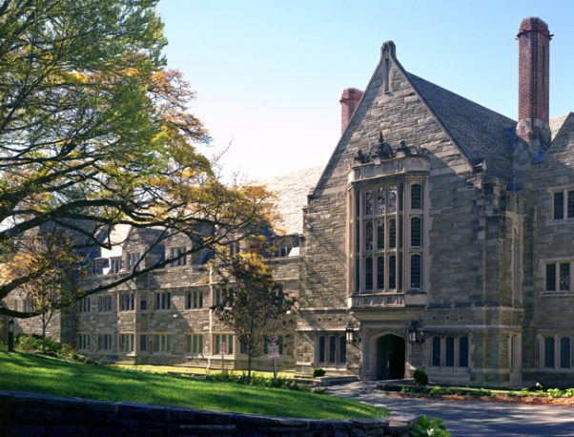
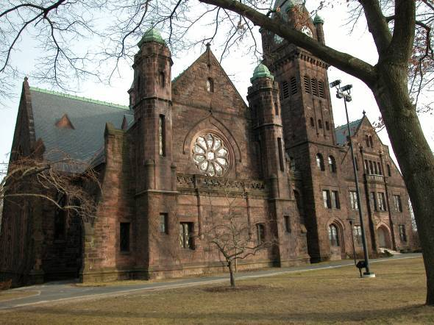
Changes in Education
Primary and Secondary School
Compulsory education laws.
Literacy was 90% by 1900.
Kindergartens became popular.
Tax-supported public schools emphasized vocational and citizenship education.
High Education
Reasons for increase in colleges:
land grant colleges were established under the Morrill Land Grant Act (1862, 1890)
Wealthy philanthropists founded universities (University of Chicago, Rockefeller)
Colleges for women were founded: Smith ,Bryn Mawr, Mount Holyoke (1900” 70% of colleges admitted women)
Electives, modern languages, and the sciences were taught.

Slide 10
Social Science and the Professions
Darwin’s theory of evolution influenced the social sciences:
Attacked laissez-faire economics as outdated.
Studied actual human behavior.
Oliver Wendell Holmes: law should evolve with the times and shouldn’t be limited by precedents.
Clarence Darrow: criminal behavior could be caused by a person’s environment.
W.E.B. DuBois: 1st African American to receive a PhD from Harvard.
Studied crime in urban neighborhoods, and advocated full equal rights for Blacks, integrated schools, and access to higher education.

Slide 11
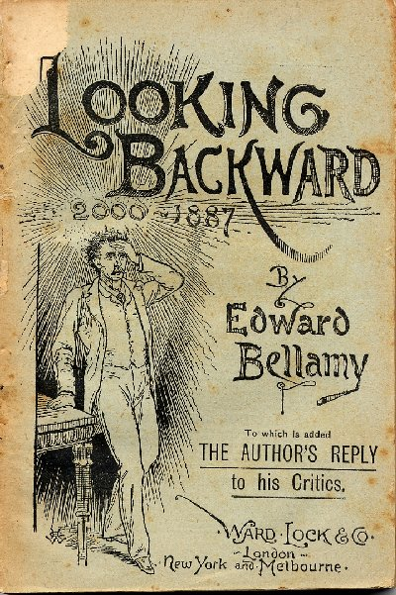
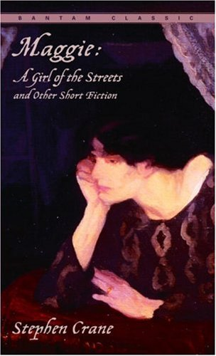
Realism and Naturalism
Realism was the most significant movement in American literature in the late 1800’s.
Realism examined characters who were “ordinary and uninteresting.”
It depicted life in rough mining camps and revealed racism, greed, and violence in society. It also examined problems of industrialization and unequal wealth.
Naturalism described how emotions and experience shaped the human experience.

Slide 12
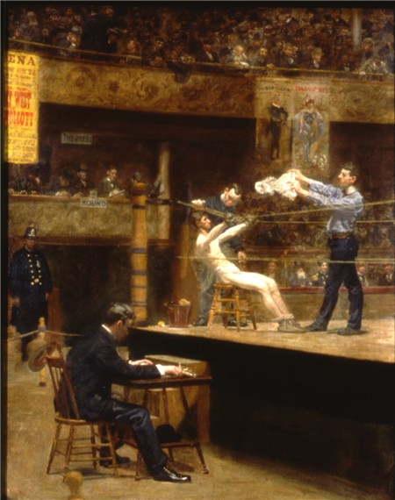
Painting: emphasized realism.
Winslow Homer painted scenes of nature in a matter-of-fact way.
Thomas Eakins painted everyday lives of working class men and women.

Slide 13
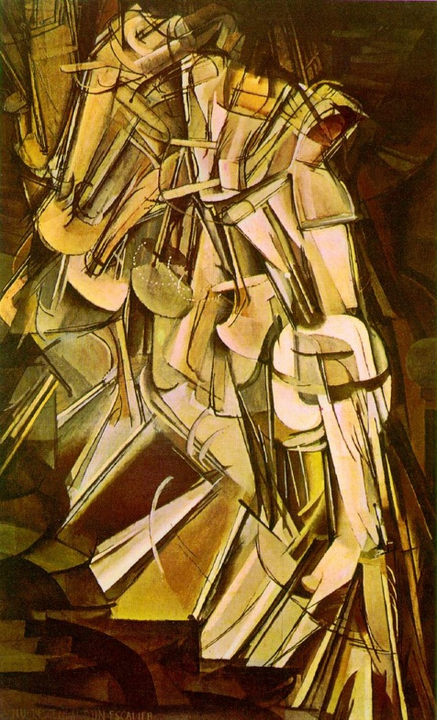
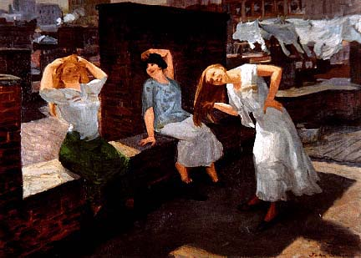
Art of the Industrial Revolution
The Ashcan school of Art focused on urban scenes such as crowded tenements and boisterous barrooms.
The 1913 Exhibition of Modern Art (“Armory Show”) first exposed the American public to new trends in European art. Visitors saw cubism and other modern art. This was a catalyst for American artists, who began to experiment with new art styles.

Slide 14
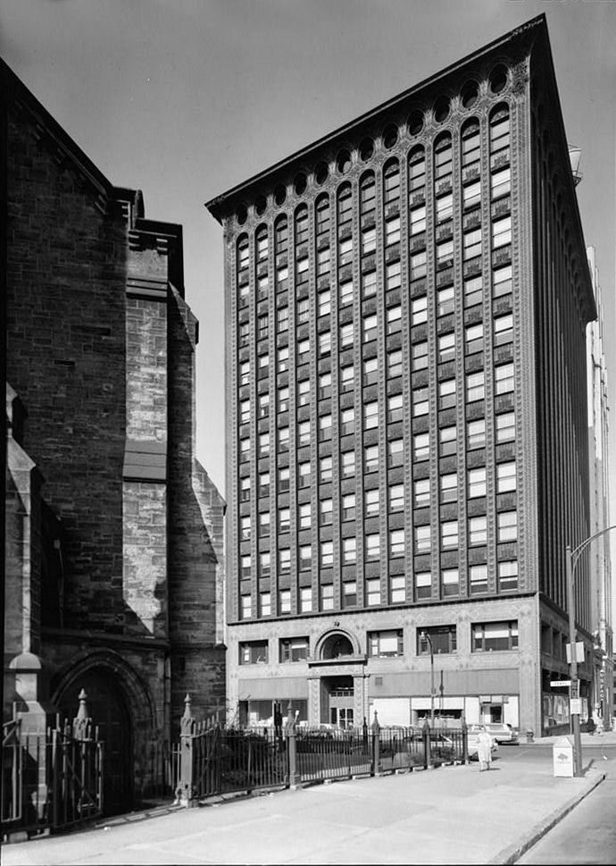
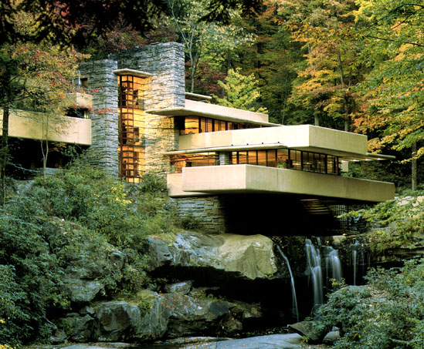
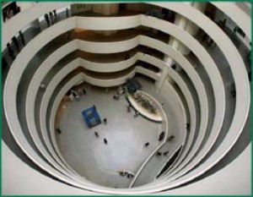
Architecture
Henry Hobson Richardson gave a stateliness to functional commercial buildings.
Louis Sullivan: form of office buildings followed function.
Frank Lloyd Wright: developed an organic style in harmony with its surroundings.

Slide 15
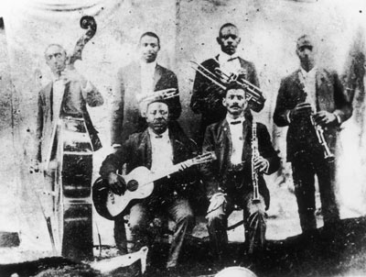
Music
By the 1900’s large cities had a symphony orchestra.
African American musicians (Jelly Roll Morton & Buddy Bolden) introduced Americans to jazz.
Blues music expressed the pain of the black experience.
As New Orleans performers heading north in the 1900’s, blues, jazz, and ragtime music became more popular.

Slide 16
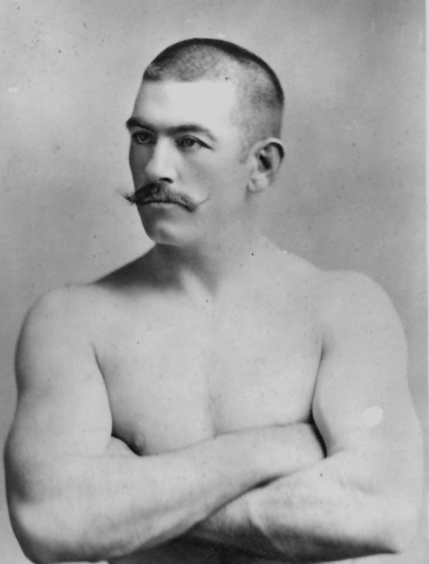
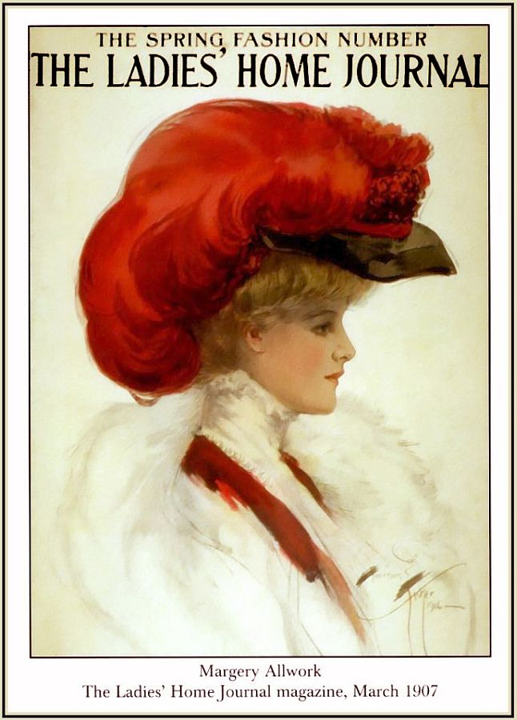
Popular Culture
Press
Newspapers (such as Pulitzer’s World) became popular by publishing sensational stories.
Magazines such as the Ladies’ Home journal became popular, too.
Amusements
Leisure time activities increased because:
People worked fewer hours
Transportation improved
Billboards and advertising promoted activities
Puritan and Victorian values that saw playing as wasted time declined.
Drinking, theaters, vaudeville (variety) shows, circuses, and the Wild West Show.
Spectator Sports
Professional sports became popular (baseball, football, basketball, boxing)
John L. Sullivan (boxer) = best known athlete.
Baseball required teamwork (urban age)
Basketball was invented in 1891
Football was a college sport until the 1920’s.
Amateur Sports
Sports began to be seen as healthy exercise.
Women couldn’t play sports, but they could bicycle and play croquet.
Golf, tennis, polo, and yachting were sports of the upper classes.
Jews and Catholics were kept out of clubs.
African Americans were excluded from playing on all-white teams until the 1940’s by the Jim Crow Laws.

