Slide 1
Do Now → Agenda:
1
2
3
Chapter 5 Multiple Choice
Colonial Map
Chapter 5 Review
Homework:
Tuesday: Formal Blog Post Format and Print
Wednesday: Blog Post

Slide 2
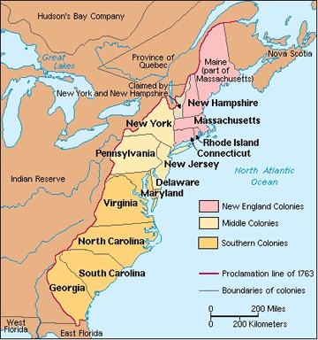

Slide 3
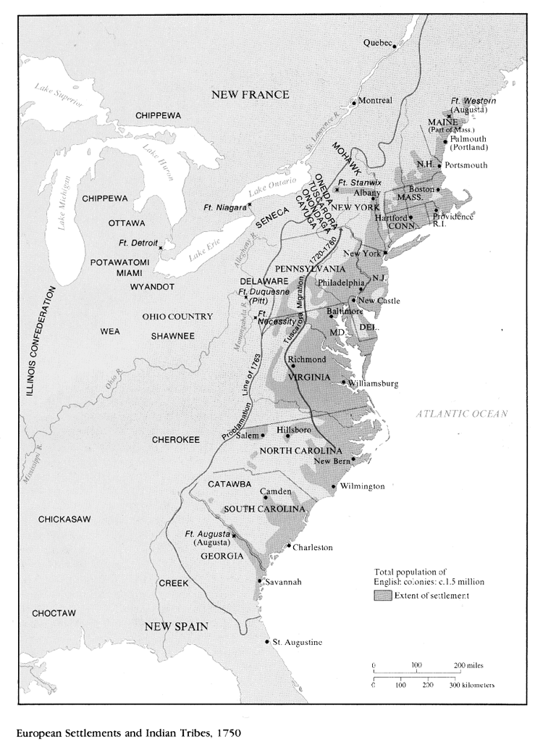

Slide 4
The First Great Awakening
= wave of religious revivals that began in New England in the 1730s → spread to all colonies by 1740
“New Light” ministers wanted an emotional approach to religious practice to encourage more church members
“Old Light” ministers wanted traditional ministers and churches
New Light ministers did the following:
Promoted growth of New Light institutions of higher learning (Princeton)
Sparked renewed missionary spirit that led to conversion of many African slaves
Led to greater appreciation for the emotional experiences of faith
Led to divisions within both Presbyterian and Congregational churches → more religious diversity
Led to popularity of traveling ministers
Led to an increase in the number of women in the church (most often majority)
Key Terms

Slide 5
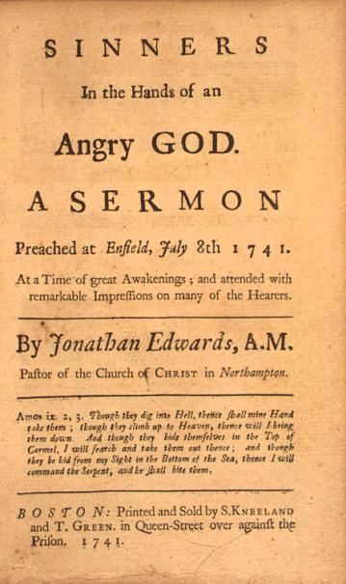
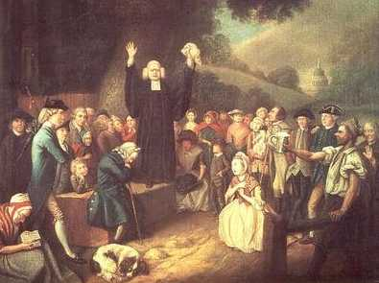
The First Great Awakening
Key Terms

Slide 6
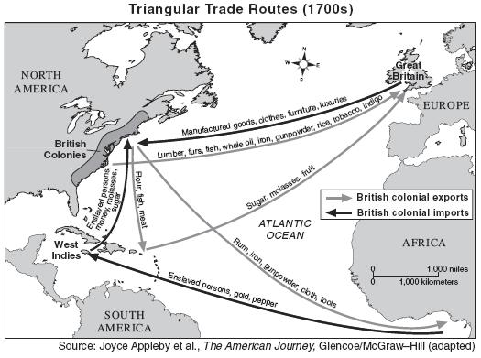
Mercantilism
= England’s dominant economic philosophy during the 17th and 18th centuries
Goal = England to have a advantageous balance of trade → colonies were expected to export raw materials and import finished goods
Designed to protect English industry and promote England’s prosperity (wealth)
Key Terms

Slide 7
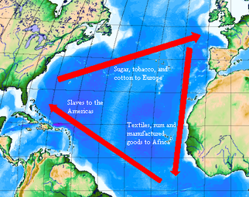
The Navigation Acts
Part of the British policy of mercantilism
Listed colonial products that could be shipped only to England (tobacco, cotton, sugar)
Led to subordination of the colonial economy to the mother country
The North American colonies took advantage of Great Britain’s policy of “salutary neglect” to work out trade agreements so they could acquire needed products from other countries
Key Terms

Slide 8
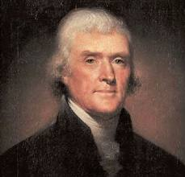
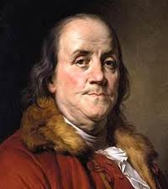
Enlightenment
18th century philosophy stressing that reason can be used to improve the human condition
Enlightenment thinkers stressed the idea of natural rights → seen in Declaration of Independence (“We hold theses truths to be self-evident…”)
Thomas Jefferson and Benjamin Franklin
Key Terms

Slide 9
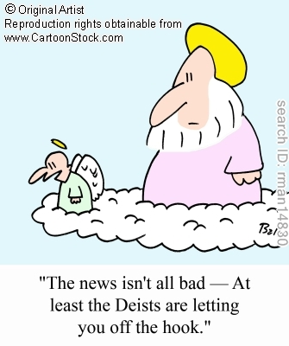
Deism
Belief that God created the universe that is governed by natural law
These natural laws can be discovered by the use of human reason
Key Terms

Slide 10
Republican Government / Republicanism
= belief that government should be based on the consent (approval) of the governed
Inspired 18th century American revolutionaries
Key principles:
Sovereignty (authority) comes from the people
Representation should be shared based on population
A republic is better than a monarchy b/c it establishes a small, limited govt that is responsible to the people
Widespread ownership of property is a bulwark (protection) of republican government
Standing armies are dangerous & should be avoided
Agrarian life is both desirable & virtuous
Key Terms

Slide 11
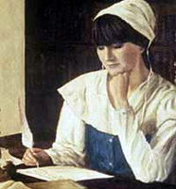
Anne Bradstreet
1612-1672
First notable American poet
First woman to be published in colonial America
Key Terms

Slide 12
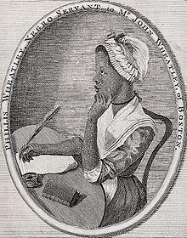
Phillis Wheatley
1753-1784
First published African American poet
Her writing helped create the genre of African American literature
Key Terms

Slide 13
Characteristics of 18th century colonial society:
Northern merchants & Southern planters amassed great wealth → no hereditary aristocracy
The number of non-English settlers continued to increase
Scotch-Irish & German immigrants moved into Appalachia as the Native Americans were defeated
Slavery generally accepted as a labor system → legal in all colonies
13 colonies = religiously diverse → no single Protestant denomination
Colonial cities = mercantile centers → collected agricultural goods and distributed manufactured goods
Most were ports that maintained close economic/cultural ties with England

Slide 14
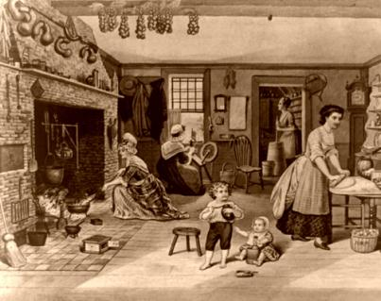
Characteristics of woman in 18th century colonial society:
Legal status of colonial women:
Women usually lost control of their property when married
Married women had no separate legal identity apart from their husband
Could NOT hold political office, serve as clergy, vote, or serve as jurors
Single women and widows did have the legal right to own property
Women serving as indentured servants had to remain unmarried until the period of indenture was over
Chesapeake
Scarcity of women led to women having a higher status than of women in New England

Slide 15
The Middle Passage

Slide 16
Characteristics of African Americans in 18th century colonial society:
Slavery legal in all 13 colonies
Africans kept cultural practices brought from Africa
Tobacco = most important cash crop grown in Chesapeake
Rice = most important cash crop grown in S. Carolina
Why slavery increased?
Supply of indentured servants decreased
Spread of tobacco cultivation westward = labor demand
Few 17/18th century White colonists viewed slavery as morally unacceptable
As its maritime power increased, England wanted to compete in the profitable slave trade begun by the Portuguese and Dutch

Slide 17
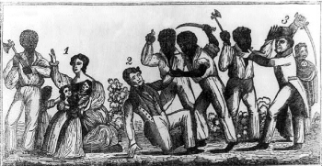
Characteristics of African Americans in 18th century colonial society:
Stono Rebellion
= one of the earliest known acts of rebellion against slavery in America
Organized and led by slaves living south of Charleston, SC
Slaves tried to unsuccessfully to flee to Spanish Florida (wanted to gain freedom)

