Slide 1
9/11 Do Now → Agenda:
1
2
3
Chapter 2 Review on your own
(45 minutes)
Review Chapter 2 Review Questions
(25 minutes)
Quick Notes, Summary, & Role Play Intro
(20 minutes)
Homework:
Tuesday: Read and create a defense for your
assigned role for the Role Play.
Wednesday: Complete blog post –
don’t forget evidence!

Slide 2
Discovering Columbus…
What is the first thing Columbus did when he arrived in the “New World”?

Slide 3
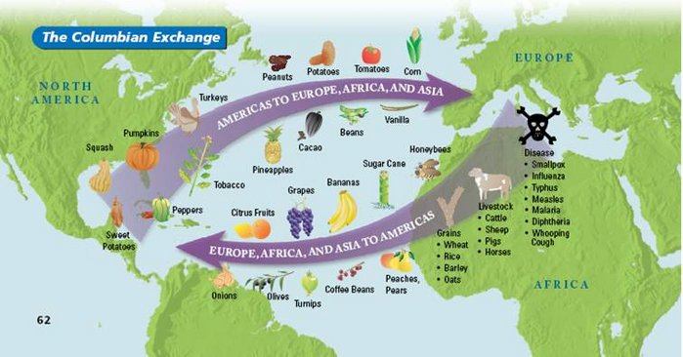
The Columbian Exchange
The exchange of foods, plants, animals, and diseases between the Europeans and Native Americans
Native Americans who interacted with the English became increasingly dependent on the fur-and-hide trade
European diseases such as smallpox, influenza, and measles decimated the Nat. Am. population
Key Terms

Slide 4
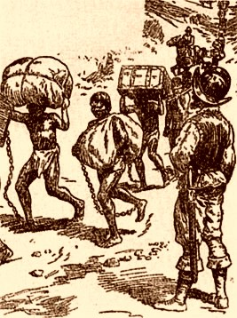
Encomienda
Exploitative labor system → one of my damaging institutions implemented by Spanish → Leads to slavery!
= Land grant that gave a Spaniard property rights over Nat. Am. Labor
Basically, the conquistador got a hacienda and indentured servants to make him rich
Key Terms

Slide 5
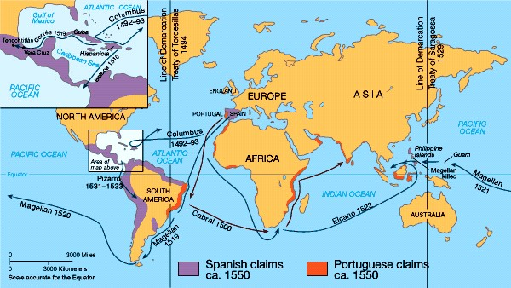
Treaty of Tordesillas
Imaginary line west of the Canary Islands that divided colonized land b/n Spain and Portugal
West of the line = Spain
East of the line = Portugal
Key Terms

Slide 6
Why did European exploration expand dramatically in the fifteenth century?
Bubonic plague: killed about a third of the European population; left the reduced population with an increased food supply, more wealth
European ambitions: Monarchs wanted more land and money
Scientific and technological advances: Inventions → hourglasses and astrolabes to navigate; printing press; caravel sailing ship to stow more supplies necessary for longer periods at sea
Comprehension and Analysis

Slide 7
What were the motives behind explorations?
Land
Money
Power
Religion
Comprehension and Analysis

Slide 8
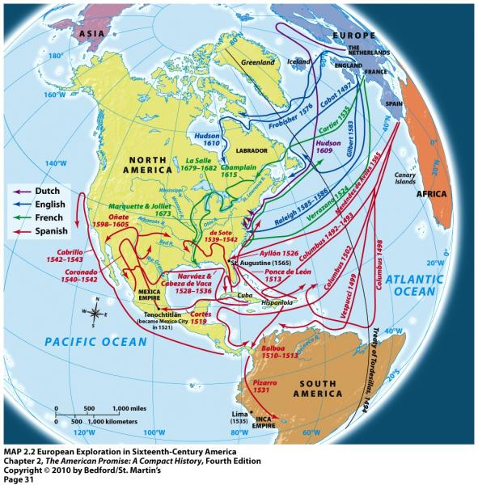
Which countries were most active in exploring the New World?
Comprehension and Analysis

Slide 9
How did Columbus’s landfall in the Carib­bean help revolutionize Europeans’ understanding of world geography?
Fifteenth-century conceptions of geography: Europe to Asia could be possible
Landfall and a route to Asia: revealed the existence of lands previously unknown to Europeans; raised hopes about a feasible sea route to Asia; and spurred other explorers and nations to explore
Comprehension and Analysis

Slide 10
What was the Pueblo Revolt, who did it involve, and why did it happen?
1680 - Present-day New Mexico → Pueblo Nat. Am., led by Pope, revolted against Spanish (Juan de Onate & crew) b/c trying to subjugate
Uprising suppressed, killing 800 Pueblo
No stability & another revolt → Sp. driven out
Sp. reestablished control over area in early 1700s
Comprehension and Analysis

Slide 11
How did the Columbian Exchange lead to redistributions of power and population?
Spanish conquest:
Cortés’s conquest of Mexico enabled Spain to gain control of the Mexican empire
Money in hands of Europeans, not Nat. Am.
Impact in the New World:
system of encomienda
European diseases decimated Nat. Am. Population
African slaves introduced after Nat. Am. die
Impact in Europe:
Spanish dominance in sixteenth-century Europe
Spanish = model for European countries/exploration
Comprehension and Analysis

Slide 12
The Spanish Conquest
CC set pattern for future Sp. Conquistadors
Ethnocentric (superiority of own ethnic group)
Conquistadors conquered/overthrew centralized governments
Hernan Cortes conquered Aztecs (Mexica)
Francisco Pizarro conquered Incas
Euro. Diseases decimate Nat. Am.
After collapse of Aztec Empire, Spanish renamed the region New Spain
Quick Notes

Slide 13
Key Facts About New Spain
Sp. Discovered/mined rich deposits of gold & silver
Columbian Exchange
brought horses & gunpowder to New World
corn, potatoes, & tomatoes to Euro → enriched diet & lengthened lifespans
Sp. Rulers = autocratic monarchs
Rewarded local officials by granting villages/control over Nat. Am. (encomienda)
Catholic Church sent missionaries to convert Nat. Am.
Sp. Church & govt. approved intermarriage b/n colonists and Nat. Am. → greater tolerance of racial differences than English settlers later
Quick Notes

Slide 14
The Spanish Southwest
Spanish expanded north from Mexico → established permanent settlements in now New Mexico
By 1630, 3,000 Sp. lived there
Sp. = most contact with Hopi & Zuni
Sp. exploited Nat. Am. → leads to Pueblo Revolt
Quick Notes

