Slide 1
Chapter 13
Do Now:
Take out class materials.
Write HW in agenda..
Multiple Choice Quiz
Agenda:
MC Quiz
Review
OER Thesis
HW:
Thesis Statement WAC

Slide 2
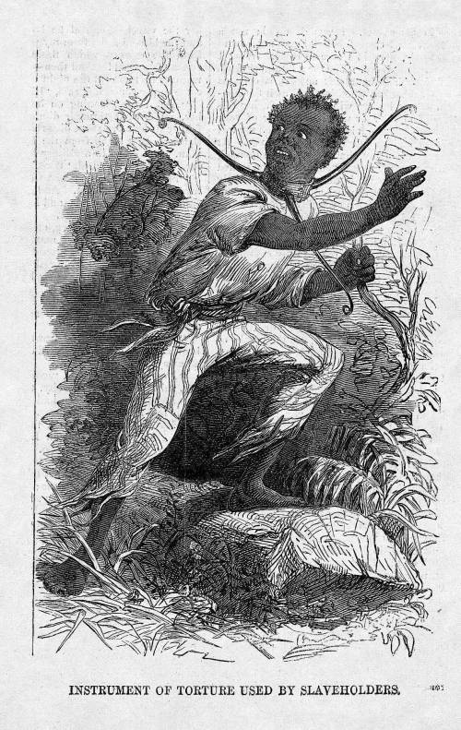
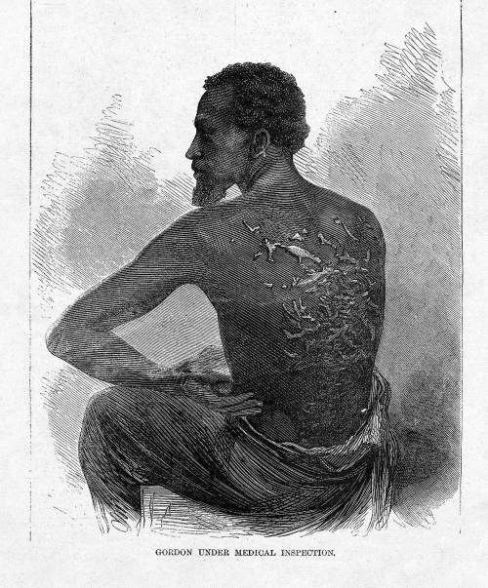
What do you see?

Slide 3
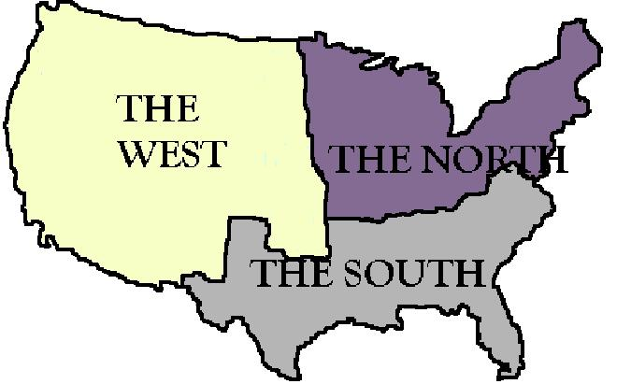
Sectionalism
“loyalty to a particular region”
Sectionalism divided the country and ultimately led the nation into the Civil War.
The nation was divided
into 3 regions:

Slide 4
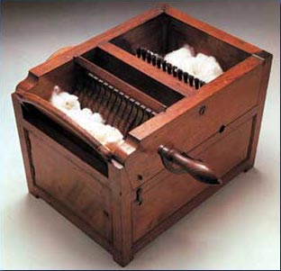
The Cotton Gin
Eli Whitney
During 1700s, inventions revolutionized textile industry → South couldn’t keep up with pace of production b/c of time it took to separate cotton and cotton seed (full day for a laborer to separate a pound of cotton by hand)
1793 → Whitney invented a machine to perform this task → enables slaves to separate 50X as much cotton as by hand
Cotton production soared from 9,000 bales in 1791 to 987,000 in 1831 and 4 million! In 1860 (each bale = 500 pounds of cotton)

Slide 5
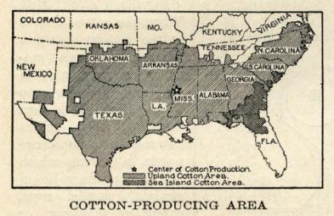
King Cotton
Cotton = South’s most important cash crop b/c:
The invention of the cotton gin made cotton more profitable
Rich new farm land in the Deep South was opened to cultivation of cotton
Rise of textile manufacturing in England created demand
America’s most valuable cash crop → cotton = more than ½ of the value of American exports
Tobacco hurt soil so moved west → “Cotton belt” from NC to Mississippi Valley → produced ½ of world’s cotton and southerners declared, “Cotton is King”

Slide 6
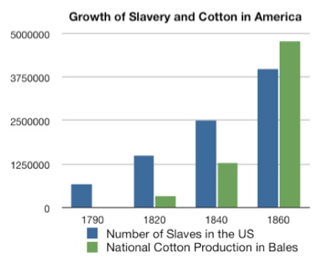
IMPACT of King Cotton
Cotton forever altered South’s view of slavery → prior to cotton gin, south viewed slavery as a “necessary evil” that would gradually be phased out
After cotton gin, S. became committed to slavery (75% of slaves in 1850 worked on cotton production)
Presence of slavery discouraged immigrants from moving to the South
Just 4.4% of pop. Were immigrants
S. devoted resources to growing cotton so lagged behind N in trade and manufacturing
S. commitment to growing cotton slowed urban growth
With the exception = New Orleans and Charleston, S. had very few urban centers → most southerners lived on farms and plantations

Slide 7
The South:
= those states which permitted slavery (included border states, such as Delaware, Maryland, Kentucky, and Missouri)
Southern Thought:
Unique culture and outlook.
Slavery was the basis of political thought (property rights)
White Society
Elite; owned at least 100 slaves. Farmed at least 1,000 acres; held political power; laws favored their interests.
Aristocracy
Code of Chivalry (similar to a feudal society)
Valued:
Personal honor
Defense of womanhood
Paternalistic treatment of inferiors
Owned fewer than 20 slaves; produced most of the cotton crop; worked the fields with their slaves.
Farmers
Education
College education was valued by the upper class.
Acceptable jobs: farming, law, ministry, military
Lower Classes had no education past elementary school
Slaves: legally could not read or write.
Mountain People
Lived on the frontier; were isolated from the South; Disliked planters and slaves; were loyal to the union.
Poor Whites
¾ of the population; didn’t own slaves; known as “hillbillies” or “white trash;” defended the slaves system (“one day…”)
Religion
Methodists and Baptists were popular denominations (they supported slavery)
Unitarians were unpopular (they criticized slavery)
Roman Catholics & Episcopalians saw their membership drop (they were neutral toward slavery)

Slide 8
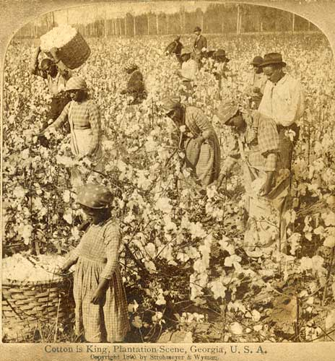
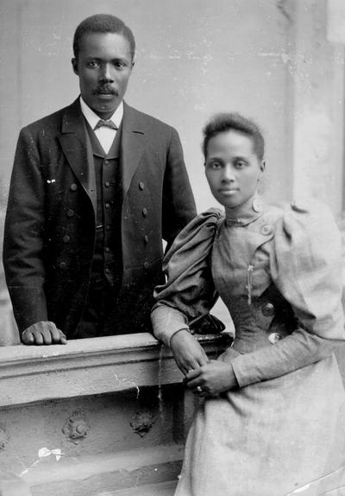
The South
Agriculture & “King Cotton”
Agriculture was the foundation of the South’s economy.
[in the 1850’s, only 15% of US manufacturing was done in the South]
The Cotton Gin (Eli Whitney) + Textile mills (Samuel Slater) made cotton cloth affordable for Americans.
Before 1860: Britain’s textile mills and the American South’s cotton were mutually dependent (South Carolina, Georgia, Alabama, Mississippi, Louisiana, and Texas).
By the 1850’s: cotton made up 2/3 of American exports
➔ “Cotton is King”
Free African Americans
1860: 250,000 African Americans were free in the South.
Some were Mulatto children (freed by their white fathers).
Some purchased their freedom on their own.
Some were freed during the American Revolution.
They lived in cities, had to show their papers to prove their freedom and tended to stay in the South (their family and home was there).

Slide 9
Slavery: “The Peculiar Institution”
Slaves were a source of wealth in the South.
They were bought and sold, treated like property.
Justification for Slavery
Colonial times: it was an economic necessity.
19th Century: historical and religious arguments were introduced (it was good for the slave and the master)
Population
Cotton boom quadrupled the slave population:
Natural reproduction
Thousands were smuggled in after 1808.
The Deep South held 75 % of the population.
Fear of slave revolts led to restricted movement & education for slaves.
Economics
Worked in fields
Were house servants
Were skilled craftsmen
Worked on construction gangs
1860: a slave was worth $2,000.
Capital investment in slaves → less capital in the South for industrialization.
Slave life
Many were beaten.
Some were treated humanely.
Families were sold apart
Females were exploited sexually.
Slaves maintained a strong sense of family and religious faith.
resistance
Methods:
Work slowdowns
Sabotage
Escape
Revolt
Major uprisings: (these were quickly suppressed.)
1822: Denmark Vesey
1831: Nat Turner’s Rebellion
Rebellions
Gave hope to slaves
Tightened slave codes
Showed the evils of slavery

Slide 10
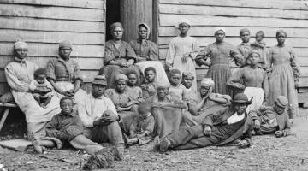
Slave Society Summary
Slaves maintained social networks among kindred and friends, despite forced separations
Dramatic increase in the South’s slave labor force was due to the natural population increase of American-born slaves
During the antebellum period, free African Americans were able to accumulate property in spite of discrimination
Although Southern legal codes didn’t uniformly provide for the legalization and stability of slave marriage, slaves were generally able to marry, and institution was common on plantations
Majority of slaves adapted to oppressive conditions imposed on them by developing a separate African America culture
Slave revolts were infrequent → most southern slaves resisted their masters by feigning illness or working as slowly as possible

Slide 11
Why did the nineteenth-century southern economy remain primarily agricultural?
Climate and cotton → S. expanded westward into lands ceded by the Creek Nation, they gained access to vast quantities of land well suited to the growth of cotton, sugar, rice, and tobacco = most valuable for ag. economy
Plantation economy
small farmers also grew cotton
plantations of the South were responsible for producing the majority of the nation’s cotton for export → helped northern merchants and shippers
saw no need to diversify the economy → southern planters plowed it back into slaves and land instead of manufacturing

Slide 12
What types of resistance did slaves participate in, and why did slave resistance rarely take the form of rebellion?
Oppositional speech: Slaves frequently exchanged stories in which the weak got the better of the strong
Oppositional behavior: This type of resistance included adding rocks to their cotton bags before they were weighed, feigning illness, pretending not to understand instructions, breaking tools, and mistreating work animals
Running away: This was a common form of protest, often practiced by young, unattached men. Running away could involve simply “lying out” for a few days, or trying to escape to the North
Why rebellion was rare: In most of the slave South, whites out numbered blacks by two to one. Whites also controlled most means of communication and were heavily armed. This meant that outright rebellion would be unlikely to produce an end to slavery, and instead, would likely result in the deaths of many slaves.

Slide 13
By the mid-nineteenth century the South had become a “cotton kingdom.” How did cotton’s profitability shape the region’s antebellum development?
Profitability of cotton: By 1860, the S. produced ½ - ¾ of the world’s supply of cotton → lots of money
Westward expansion: The 1840s ushered in a period of rapid westward movement. Southerners moving westward planted their new fields with cotton and imported a slave workforce to work them.
Agricultural economy: Cotton’s profitability and the availability of land and laborers to support its expanding production meant that the 19th c. southern economy remained predominately agricultural while the northern economy diversified
Limited industrial or urban growth: With capital being reinvested in the production of cotton, the South developed little manufacturing and few cities
Distinctive demography: Without cities or industry, the South drew few immigrants. The cotton economy instead depended on slaves for its workforce. By 1860, one in every three Southerners was black. The South’s biracial society shaped its economy and political culture.
Slavery: Cotton’s dependence on slave labor led to the shipping of over 300,000 slaves to the new western cotton lands from the east. Without importation of slaves from Africa, Southerners depended on natural increase to supply their need for laborers.

Slide 14
OER Intro Practice
Compare the experiences of TWO of the following groups of immigrants during the period 1830 to 1860.
English
Irish
German
Pre-Work
Outline
Introction Paragraph

