Slide 1
Antebellum America
Do Now- Brainstorm the answer to this prompt in your notebook:
How did the U.S. change economically, socially, and politically before the Civil War?
You will have only 4 minutes and are being assessed on getting started RIGHT AWAY!!!

Slide 2
Antebellum U.S.: Do Now → Agenda:
1
2
3
Economic and Social Movements
Andrew Jackson
Comprehension Check
Homework:
Tuesday: Read/Text Code Zinn vs. Schweikart
Wednesday: Complete reading analysis

Slide 3
What does antebellum mean?

Slide 4
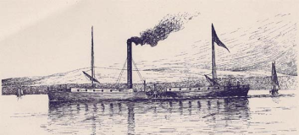
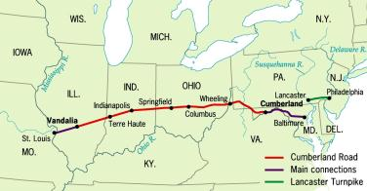
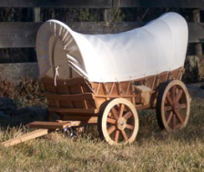
Transportation Revolution
Canals, steamboats, & railroads revolutionized American economic/social life during the antebellum period 1820-1860
Key transportation developments:
Turnpikes (National Road) promote trade/communication w/ “Old Northwest” (OH, IN, IL, MI, MN)
Steamboats to carry wheat, corn, flour (cheaper than covered wagons)
Canals strengthened ties b/n eastern cities & western agricultural regions
Railroads connected cities, encouraged settlement, & reduced cost of transporting goods
1829 → 13 miles of track
1860 → 30,626 miles of track

Slide 5
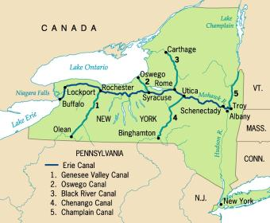
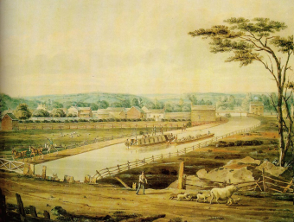
The Erie Canal
Farmers/merchants in Old NW lacked efficient/inexpensive access to the markets on East coast
Ex. Farms around Pittsburgh were forced to use Ohio and Mississippi Rivers to send their products to New Orleans and from there to cities on the east coast!!
Erie Canal connected Albany on the Hudson River to Buffalo on Lake Erie
When it opened in 1825, the 363 mile long waterway created an all-water route that cut travel time from NYC to Buffalo by 20 days & reduced cost of moving a ton a freight b/n the two cities from $100 to $5
Significant consequences!! (AP loves these…):
It helped transform NYC into America’s greatest commercial center
It created commercial ties b/n the eastern manufacturing centers & western agricultural regions
It inspired a mania for building canals that lasted throughout the 1830s

Slide 6
The Market Revolution
During the Era of Good Feelings, most Americans bought goods from friends & neighbors in a local economy
The new network of roads, canals, and rail lines enabled people to buy and sell goods with consumers in distant markets
Market Revolution = the creation of a national economy that connected distant communities for the first time
The creation of large lucrative (profitable) markets led to an American system of manufacturing that utilized machines with interchangeable parts to mass produce standardized low-cost goods

Slide 7
Impact of The Transportation/ Market Revolution
Impact on the Northeast:
Accelerated the rate of industrial growth
Prompted the construction of textile mills in New England
Created a close trade relationship b/n New England and the Old Northwest
Created a wealthy class of urban capitalists
Impact on the Midwest:
Accelerated the migration of settlers into the Midwest
Transformed Chicago into an important rail center and agricultural distributor to the West
Enabled Pittsburgh, Cincinnati, St. Louis, and Detroit to become thriving industrial/commercial centers
Increased production of cash crops (corn, wheat)
Linked closely to the NE by canal/railroad
Impact on the South:
Failed to keep up with the pace of industrialization/urbanization in the NE/Midwest
Extended a plantation system based on cotton & slavery westward into Alabama and Mississippi
Remained an agricultural economy dominated by an elite group of wealthy planters

Slide 8
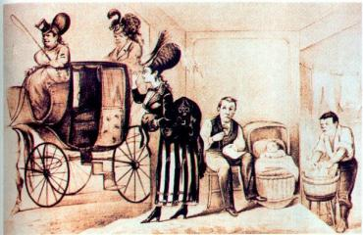
Review: Republican Motherhood & Cult of Domesticity
Republican Motherhood:
Women had the important role of raising their children to be virtuous citizens (even if didn’t have rights)
by instructing children, mainly sons, in the principles of liberty, women played a key role in shaping America’s moral/political character
Cult of Domesticity
Prior to Industrial Revolution, men & women worked together on farms → Industrial Revolution encouraged division of labor b/n home and work
Men = jobs in market economy, Women = jobs at home
Cult of Domesticity idealized women in their roles as wives/mothers → as a nurturing mother and faithful spouse, the wife created a home that was a “haven in a heartless world”
Home became a refuge from world rather than a productive economic unit
Created a cultural ideal that best applied to upper/middle class women
Wide gap b/n CofD & harsh realities of factory & frontier life (slave women not part of CofD)

Slide 9
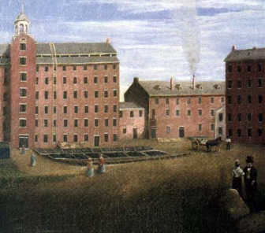
The Lowell Experiment
Background:
1790 – Moses Brown built U.S. 1st textile mill in Rhode Island → production slow until Embargo Act & War of 1812 stimulated domestic production
1812 – Francis Cabot Lowell = first mill→ modern spinning machines and power looms to create cheap cloth → Sales went from $3K in 1814 to $300K in 1823
The Experiment:
Lowell built another mill in Lowell, MA w/ dormitories
Hired young New England farm girls to work in his mill
Girls worked 12 hrs/day, 6 days/week → lived in boarding houses under watchful eye of older women who enforced mandatory church and strict curfews
Worked well @ 1st until factory owners became more interested in profit than good of employees → wages were cut w/o reducing hours
The women went on strike → petitioning MA state legislature to pass a law limiting workday to 10 hrs
No law passed, but owners thought women too rebellious so turned to poor/compliant Irish immigrants

Slide 10
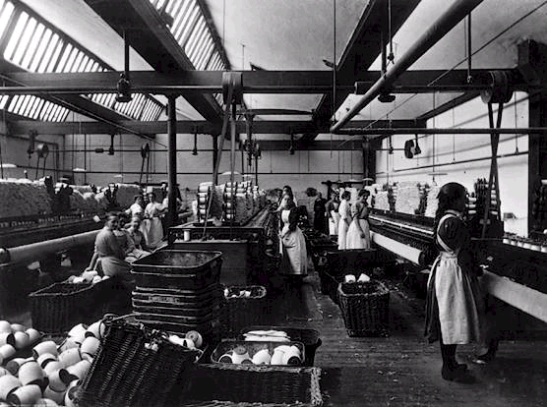
I'm a factory girl Everyday filled with fear From breathing in the poison air Wishing for windows! I'm a factory girl Tired from the 13 hours of wok each day And we have such low pay Wishing for shorten work times! I'm a factory girl Never having enough time to eat Nor to rest my feet Wishing for more free time! I'm a factory girl Sick of all this harsh conditions Making me want to sign the petition! So do what I ask for because I am a factory girl And I'm hereby speaking for all the rest!

Slide 11
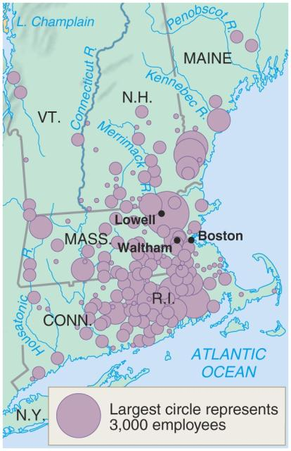
New England Textile Centers: 1830s

Slide 12
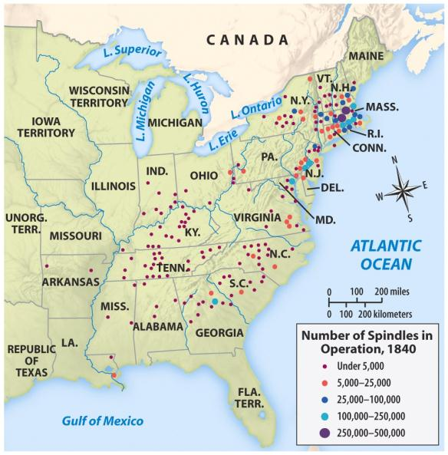
New England Dominance in Textiles

Slide 13
The Second Great Awakening
Background:
18th century ended – religious fervor from 1st GA gone
During the early 1800s, a new wave of religious enthusiasm called the Second Great Awakening swept the country → Began on the western frontier and then quickly spread to the East coast
Key Characteristics:
Puritans believed in a just but stern God -- >2GA preachers replaced hellfire-and-damnation God with a gentler divinity of love and grace
2GA preachers emphasized humanity’s inherent goodness and each individual’s potential for self-improvement
2GA inspired PERFECTIONISM → the faith in human ability to consciously build a just society → THIS CLOSE LINK B/N RELIGION AND REFORM AWAKENED MANY AMERICANS TO A VARIETY OF SOCIAL/MORAL ISSUES
“Burned-Over District”
Intense revivals = widespread in central/western NY
Charles Grandison Finney = most popular/influential preacher → stressed salvation by good works
Birthplace of the Church of Jesus Christ of the Latter-day Saints (aka Mormons)

Slide 14
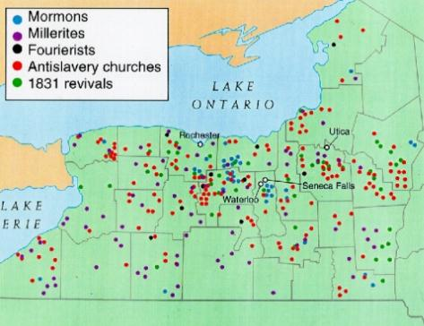
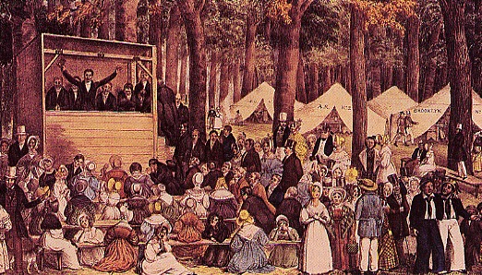
Second Great Awakening Revival Meeting

Slide 15
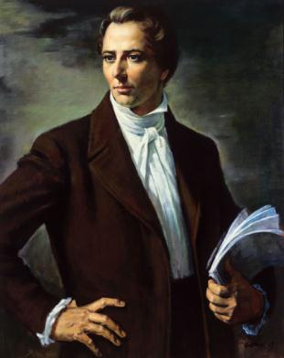
The Mormons (The Church of Jesus Christ of Latter-Day Saints)
Church of Jesus Christ of Latter Day Saints (LDS)
Joseph Smith (prophet for Mormons)
1830s Book of Mormon
Translation of set of Golden Tablets
Ancient Civilization in America (one of lost tribes of Israel)
Dark Skin = Sin
Story of “American Hebrews”
Joseph Smith (1805-1844)

Slide 16
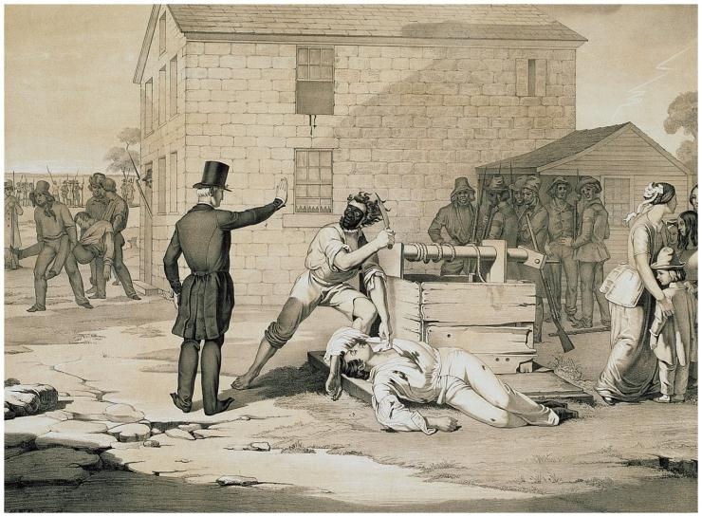
Violence Against Mormons

Slide 17
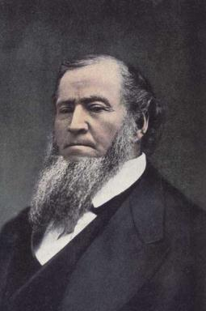
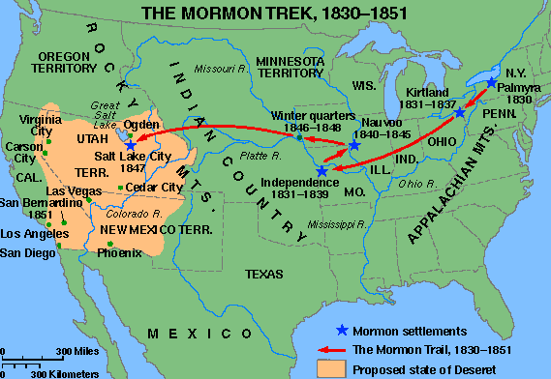
The Mormons (The Church of Jesus Christ of Latter-Day Saints)
Desert community.
Salt Lake City, Utah
Brigham Young (1801-1877)

Slide 18
The Second Great
Awakening
“Spiritual Reform From Within” [Religious Revivalism vs. human reason of Enlightenment]
Social Reforms & Redefining the Ideal of Equality
Temperance
Abolitionism
Education
Asylum & Penal Reform
Women’s Rights

Slide 19
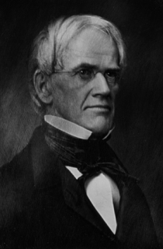
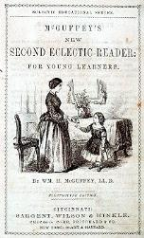
Reform Movements: Educational Reform
Horace Mann = America’s leading education reformer
= Secretary of Massachusetts Board of Education
His reforms led to longer school year, higher pay for teachers, larger public school system
= “Father of the Common School Movement”
Emma Willard founded Troy Female Seminary → U.S. 1st women’s school of higher education
McGuffey Readers = first textbooks, how kids learned literature → also called Eclectic Readers → students learned stories of patriotism, hard work, and honesty
1st half of 19th century → HUGE increase in # of newspapers from 1,200 in 1833 to 3,000 in 1860 → increased literacy and a well-informed public

Slide 20
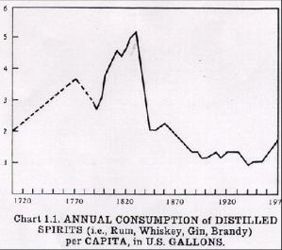
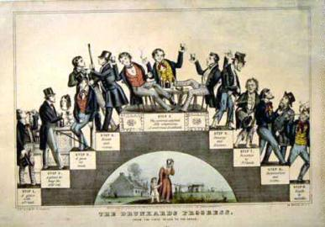
Reform Movements: Temperance
In the early 1800s America had over 14,000 distilleries producing 25 million gallons of alcoholic drinks each year → by 1830, Americans were consuming 5 gallons of alcohol per person each year
Temperance Movement = widespread campaign to convince Americans to drink less alcohol or to drink none at all
Founded in 1826, the American society for the Promotion of Temperance soon had 5,000 state and local groups
Their campaign against “demon rum” = successful → by 1840, Americans drank 2 gallons/person

Slide 21
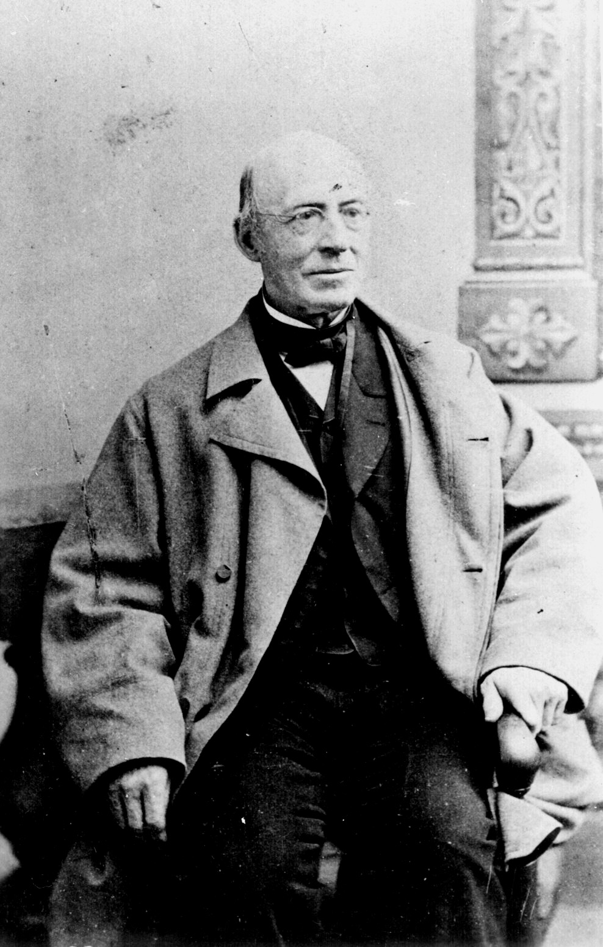
Reform Movements: Abolition → William Lloyd Garrison
Garrison was the editor of the radical abolitionist newspaper The Liberator and one of the founders of the American Anti-Slavery Society
In the first issue of The Liberator, Garrison called for the “immediate and uncompensated emancipation of the slaves.”
Here is a famous quote published in the 1st issue on January 1, 1831:
“Let Southern oppressors tremble….I will be as harsh as Truth and as uncompromising as Justice…. I am in earnest – I will not retreat a single inch – and I WILL BE HEARD!”
Garrison’s support of women’s rights caused the American Anti-Slavery Society to split rival factions

Slide 22
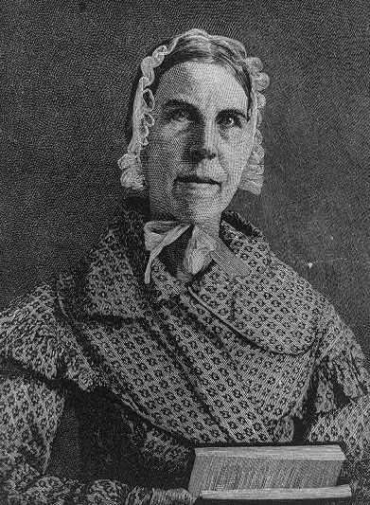
Reform Movements: Abolition → Sarah Moore Grimke
Grimke was one of the first women to publicly support both abolition and women’s rights
“I ask no favor for my sex,” declared Grimke. “I surrender not our claim to equality. All I ask of our brethren is that they will take their feet off our necks.”

Slide 23
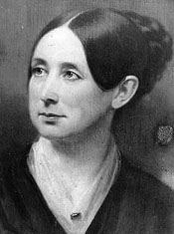
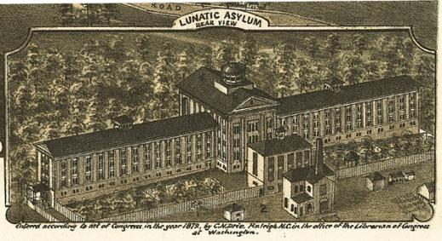
Reform Movements: The Mentally Ill
Dorothea Dix launched a crusade to create special hospitals for the mentally ill
She traveled over 10,000 miles and visited almost every state
Dix and other reformers created the first generation of American mental asylums → by 1850, there were special hospitals in 28 states
Not involved in women’s rights movement

Slide 24
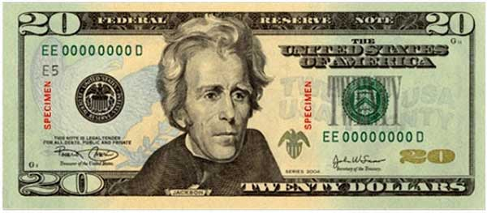
Does Andrew Jackson deserve this..?

Slide 25
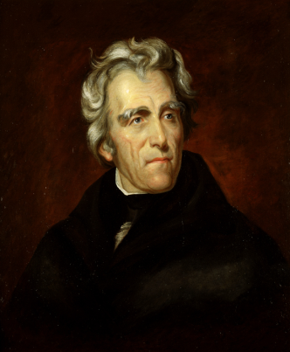
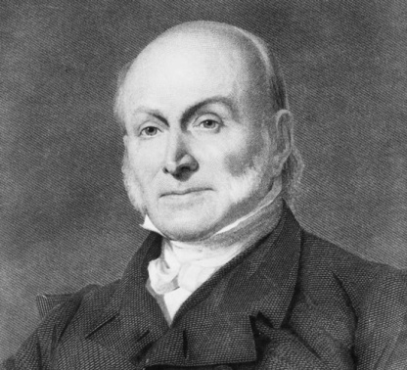
The Election of 1824 vs.
Death of the Federalists left the Republican party unchallenged at the national level → 4 reps chosen from 4 states
Andrew Jackson, Henry Clay, John Quincy Adams, and William Crawford
Jackson (popular war hero) received the popular vote, but didn’t receive the electoral majority so vote went to House
Henry Clay (Speaker of the House) used his powerful position to throw support to Adams → he thought AJ was a “military chieftain” who was unfit for office
John Quincy Adams wins and names Henry Clay as Secretary of State → AJ’s supporters angry and yell “Corrupt bargain”
Adams presidency tarnished by the deal → lacked charm and common touch even though brilliant → Election of 1828 Andrew Jackson wins in a landslide

Slide 26
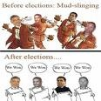
Revolution of 1828
Adams v. Jackson (“Old Hickory”)
Smearing campaign (“mudslinging”):
Jackson accused Adams’s wife of being illegitimate.
Adams accused Jackson’s wife of adultery
Mudslinging ➔ high public interest
Tripled voter turnout
Reputation as a war hero
Reputation as a man of the western frontier
Easy victory for Jackson

Slide 27
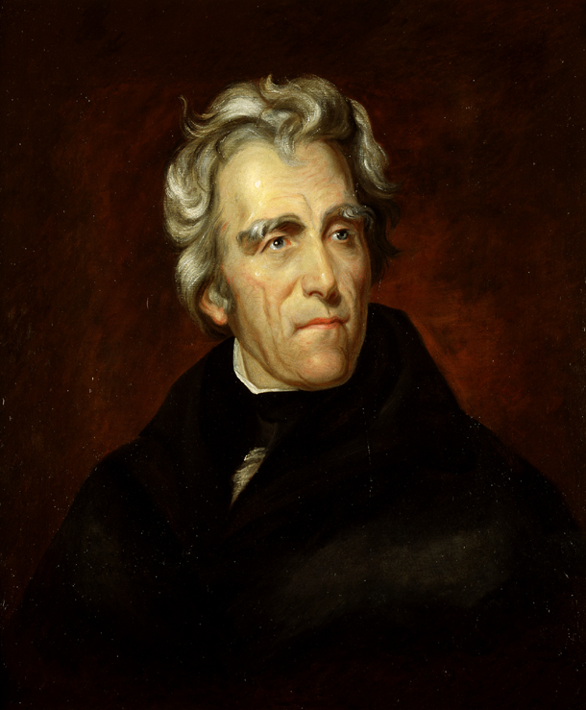
Jacksonian Democracy
Common Man:
Embodies the frontier values of rugged individualism and hostility towards privileged elites
AJ = a self-made soldier, politician, and planter → believed average man could master govt jobs and rise to the top
Universal Male Suffrage:
White lower and middle-class males began to vote.
all white men can vote
In 16 years, the number of voters increased 16-fold.
Spoils System
Rewarded loyal party workers with government jobs
Often times, these men were not qualified for the job
“Every man is as good as his neighbor”
Opposition to Privileged Elites
Common man champions → despised privileged Eastern elite
Special privileges were against the government dedicated to promoting/protecting common man
Jackson was seen as a “Self-Made Man.”
Born in a rough frontier cabin
Indian-fighter, war hero, wealthy plantation & slave owner
Tobacco-chewer, violent temper, not college-educated
=both an ordinary and an extraordinary man

Slide 28
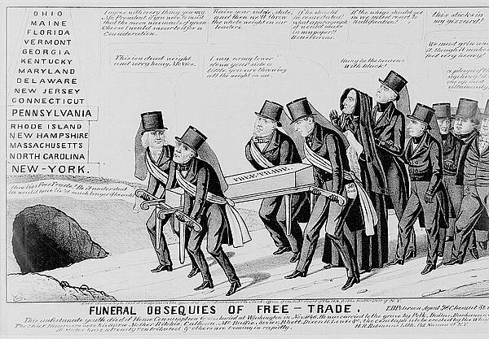
The Tariff of Abominations
1828 – tariffs passed b/n 1816 & 1828 were the 1st tariffs in American history whose primary purpose was protection
Raised revenue/protected American industry from Euro. Competitors
Made buying foreign manufactured goods cost more
Hurt: South → South was forced to sell cotton in a world market unprotected by tariffs and buy manufactured goods at outrageously high prices
The effect: The Tariff of Abominations forced John C. Calhoun to formulate his doctrine of nullification and denounce the Tariff of Abominations

Slide 29
The Nullification Crisis
Nullify = state can nullify (void) a federal law
Caused by: Tariff of 1828
The Doctrine of Nullification:
Developed by John C. Calhoun, it drew heavily on states’ rights arguments advanced in the Kentucky and Virginia Resolutions
In the South Carolina Exposition and Protest¸ Calhoun argued that a state can refuse to recognize an act of Congress that is considers unconstitutional
Calhoun argued that the Union was a compact formed by sovereign states → if a federal law exceeded powers of Congress, states could nullify it
Opposition to Nullification
In the Webster-Hayne Debate, Daniel Webster forcefully rejected nullification vs. Robert Hayne of South Carolina who was for nullification → got national attention
Webster said govt created by the people, not states → Supreme Court not the states had the power to determine the constitutionality of a law

Slide 30
Thursday, November 14th
Do Now
Homework
Write the homework in your agenda.
Chapter 12 reading, notes, and review.
Class is on Monday next week!!!

Slide 31
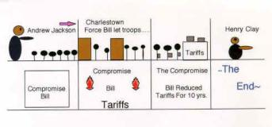
The Nullification Crisis: AJ’s response
South Carolina refused to back down → adopted ordinance of nullification
AJ angry → warned SC that they were committing treason → then called on Congress to pass “Force Bill” authorizing him to use the army to enforce federal laws on South Carolina
Henry Clay proposed compromise tariff that was gradually reduce over next 10 years → worked and crisis over
Jackson’s opposition to nullification enhanced his reputation as a strong president

Slide 32
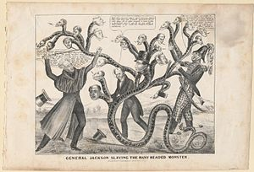
The Bank Wars
Jackson’s Veto
Jackson opposed the bill to re-charter the Second Bank of the United States (BUS)
He believed that the bank was a bastion of special privileges → argued that the Bank of the US was beneficial to advocates of “hard money” → thus, hostile to the interests of the common ppl
Consequences:
Jackson supported the removal of federal deposits from the Bank of the US
Jackson’s attack on the BUS caused an expansion of credit and speculation
The number of state banks, each issuing its own paper currency, increased
Jackson’s war on the BUS = important catalyst for the emergence of a competitive two-party system → The Whigs hated Jackson and supported Henry Clay and his American System

Slide 33
Jackson’s Second Term
Faced consequences of opposing the national bank...
Pet Banks
Jackson revoked the National Bank’s charter & withdrew federal funds; he transferred funds to state banks (“pet banks”)
Specie Circular
Jackson hoped to check land speculation.
He required that all land purchases be made in gold or silver.
Bank notes lost their value.
Land sales plummeted
➔ PANIC OF 1837 = financial crisis (depression)

Slide 34
TWO PARTY SYTEM
FEDERALISTS
1792
DEMOCRATIC-REPUBLICANS
DEATH OF THE FEDERALISTS
1820
REPUBLICANS (ERA OF GOOD FEELINGS)
NATIONAL REPUBLICANS
DEMOCRATIC-REPUBLICANS/ JACKSONIAN DEMOCRATS
WHIGS
REPUBLICANS
DEMOCRATS

Slide 35
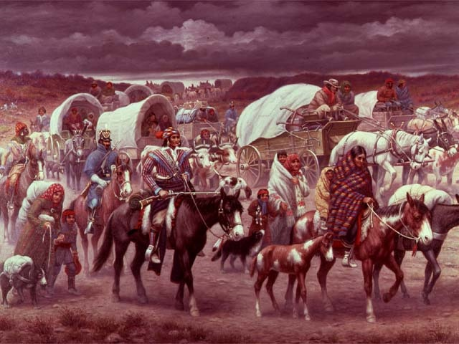
Worcester v. Georgia, 1832
Supreme Court case
The Cherokees differed from other Native American tribes in that the Cherokees tried to mount a court challenge to a removal order
In the case of Worcester v. Georgia, the US Supreme Court upheld the rights of the Cherokee tribe to their tribal lands → aka they don’t have to leave

Slide 36
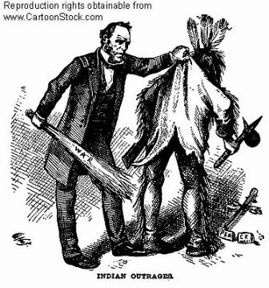
Jackson and the Cherokees
Jackson’s antipathy towards Native Americans was well known → in one speech, he declared, “I have long viewed treaties with Nat. Am. As an absurdity not to be reconciled to the principles of our government.”
Jackson refused to recognize the Supreme Court’s decision in Worcester v. Georgia, declaring, “John Marshall has made his decision: now let him enforce it.”

Slide 37
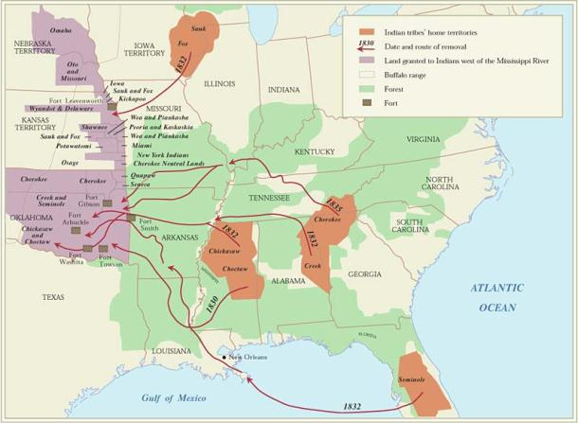
The Trail of Tears
Jackson’s Nat. Am. policy resulted in the removal of the Cherokee from their homeland to settlements across the Mississippi River
The Trail of Tears refers to the route taken by Native Americans as they were relocated to the Indian Territory of Oklahoma
The result: Approximately 1/4 of the Cherokee people died on the Trail of Tears

Slide 38
Does Andrew Jackson deserve this?

Slide 39
Trail of Tears Role Play
You are going to be assigned a role to play at a Congressional Hearing.
The hearing will discuss the Indian Removal Bill.
Each group of people will be allowed to voice their opinions.
You should take on the ideas of the role you are playing to be able to discuss your role’s viewpoints at the hearing.

Slide 40
The Trail of Tears Role Play
Read role
Answer questions
Create and Evaluate
Traveler
“Interior Monologues”
Discuss Presentation to Congress

Slide 41
Andrew Jackson Admin, Black Seminoles, Cherokee, Missionaries and Northern Reformers, Plantation Owners and Farmers:
Who are you?
Invent a person to make you seem more realistic
Ex. = Your name is Wind Talker. You are a Cherokee elder. You are old and sick. You do not believe that you will survive the move to Oklahoma. Your children will not know their culture if you move.
Will you resist if you do not get your way?
Will you try to created an armed resistance?
Will you join with other groups to help you?
With whom would you like to create an alliance?
Who can help you prove your point?
What questions will you ask of the other groups?
How can you prove their point wrong?
You will need to describe yourself to Congress.
WHY are you for or against the bill?
Cherokee
Black Seminole
Missionaries and Northern Reformers
Plantation Owners and Farmers
Andrew Jackson

