Slide 1
The 1950s
Do Now
Get out a pen/pencil and all three HW.
Check last night’s HW (questions) with your partner in a different color pen/marker, etc.
HW:
-Tuesday: Flashcards
-Weds: FRQ

Slide 2
Learning Process in AP
READ the chapter and take notes for KNOWLEDGE
Recall the chapter
Check knowledge in lecture
Show mastery
Questions
Quizzes
Recall the chapter
IDs

Slide 3
Cold War Overview
Topics | The United States and the Early Cold war The 1950s
Big Questions | What was the political mood in post-war America? What demographic shifts did America experience post WWII? What factors/events gave birth to the Civil Rights Movement?
Aims | Diplomatic strategies and policies of the Eisenhower and Kennedy administrations Emergence of the modern civil rights movement The affluent society and "the other America“ Consensus and conformity: suburbia and middle-class America Social critics, nonconformists, and cultural rebels

Slide 4
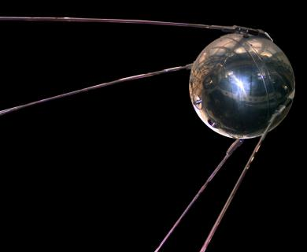
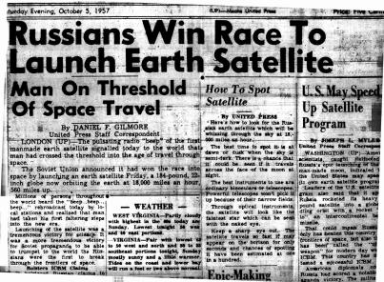
Cold War Events Under Eisenhower: Sputnik
Launched by Soviet Union in 1957 → 1st Earth-orbiting satellite!
Sputnik stunned the US → prompting Eisenhower to establish the National Aeronautics and Space Administration (NASA)
Sputnik made education an issue of national security → Congress responded by passing the National Defense Education Act
Dramatically expanded federal aid to education by funding programs in math, foreign language, and the sciences

Slide 5
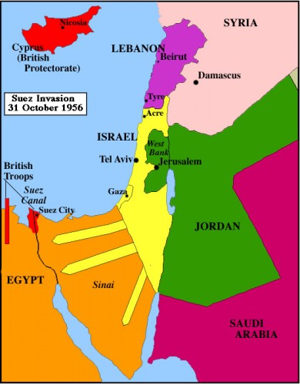
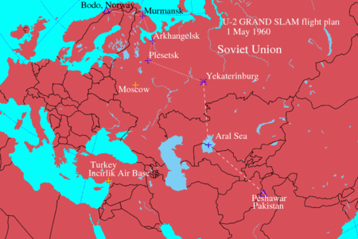
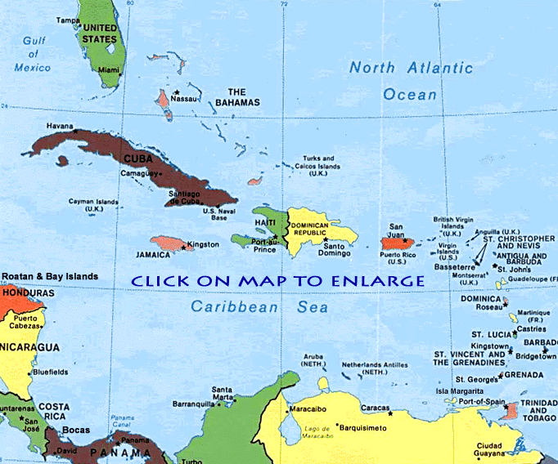
Cold War Events Under Eisenhower: Diplomatic Crises
Egypt seized the Suez Canal
Castro gained control of Cuba
The Soviet Union shot down an American U-2 spy plane

Slide 6
1950s: Milestones in Civil Rights
President Harry S. Truman
Issued an Executive Order desegregating the armed forces in 1948 → Marked most significant civil rights breakthrough of his admin
The Dixiecrats walked out of the 1948 Democratic National Convention to demonstrate opposition to this legislation
Dixiecrats? = right-wing Dems who opposed the Civil Rights program of the Dem party

Slide 7
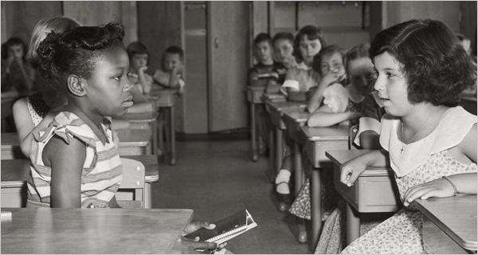
1950s: Milestones in Civil Rights
Here, the first day of desegregation, on Sept. 8, 1954, at Fort Myer Elementary School in Fort Myer, Va.
Brown v. Board of Education of Topeka, 1954
Supreme Court ruled that segregation in public was a denial of the equal protection of the laws guaranteed in the 14th Amendment
Directly contradicted “separate but equal” established by Plessy v. Ferguson
The NAACP (National Association for the Advancement of Colored People) continued to base its court suits on the “equal protection” clause of the 14th Amendment

Slide 8
“Little Rock Nine” http://www.history.com/topics/1950s/videos#little-rock-9

Slide 9
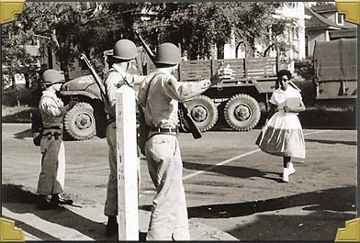
1950s: Milestones in Civil Rights
President Dwight D. Eisenhower (“Ike”)
Sent fed troops to Little Rock’s Central H.S. to enforce court-ordered desegregation
Although sent troops, not a huge supporter of civil rights legislation
The primary power granted to the Civil Rights Commission in 1957 was the authority to investigate and report on cases involving discrimination
Said: “The very basis of our individual rights and freedoms rests upon the certainty that the President and the Exec. Branch of Government will support and insure the carrying out of the decisions of the Federal courts, even, when necessary, with all the means at the President’s command”

Slide 10
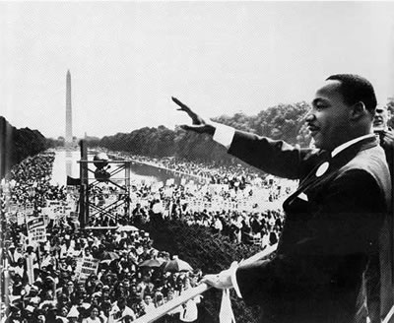
1950s: Milestones in Civil Rights
Dr. Martin Luther King, Jr.
Dr. King’s goal was a peaceful integration of the races in all areas of society
King’s theory of nonviolent civil disobedience was influenced by the writings of Henry David Thoreau
Was head of the Southern Christian Leadership Conference (SCLC)
On Dec. 1, 1955, Rosa Parks refused to give up her bus seat to a White passenger → her refusal helped galvanize the Montgomery Bus Boycott led by Dr. King

Slide 11
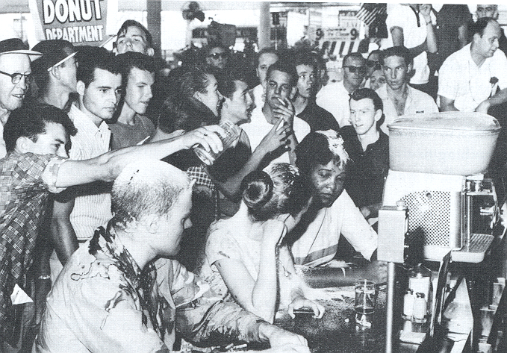
Sit In movement
Students staged sit-ins in Greensboro, NC in 1960 to protest segregation in public facilities
The sit-ins provided an excellent example of nonviolent civil disobedience

Slide 12
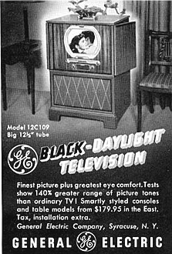
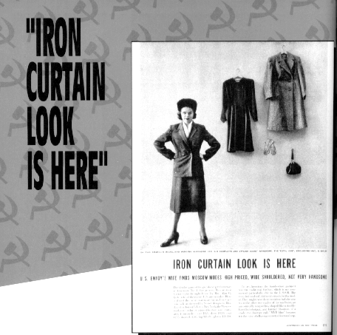
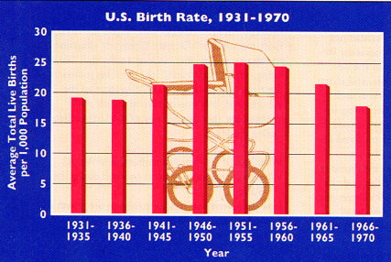
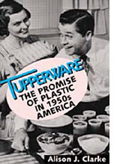
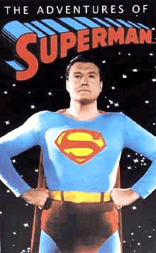
1950s: Prosperity and Change
The Affluent Society
The decade after WWII was characterized by the following:
Unprecedented prosperity
A population explosion known as the baby boom
Rapid and extensive suburbanization

Slide 13
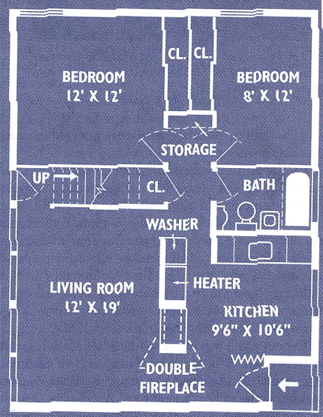
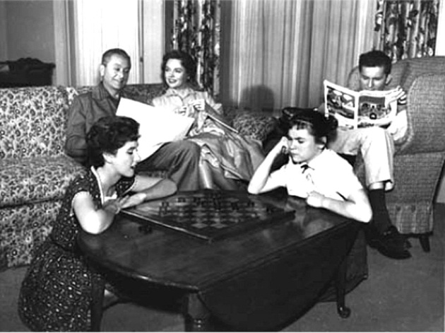
Suburban Living
Levittown, L. I.: “The American Dream”
1949 → William Levitt produced 150 houses per week
$7,990 or $60/month with no down payment
By 1960 → 1/3 of the U. S. population in the suburbs.
http://www.youtube.com/watch?v=wT_A9PFOY18

Slide 14
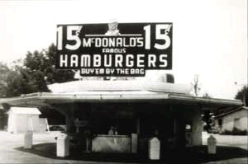
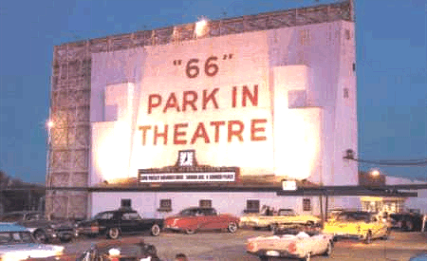
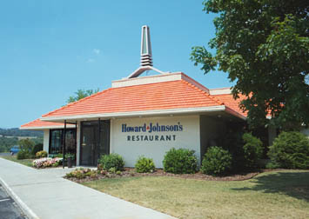
1950s: Prosperity and Change
Interstate Highways and the Growth of Suburbia
Passed during the Eisenhower administration, the Federal Highway Act of 1956 created the interstate highway system
Federal Highway Act of 1956 vastly accelerated the growth of suburbia
= largest public works project in American history!
Cost $32 billion.
41,000 miles of new highways built
http://www.youtube.com/watch?v=W7-m3FEm5VA
First McDonald’s (1955)
Drive-In Movies
Howard Johnson’s

Slide 15
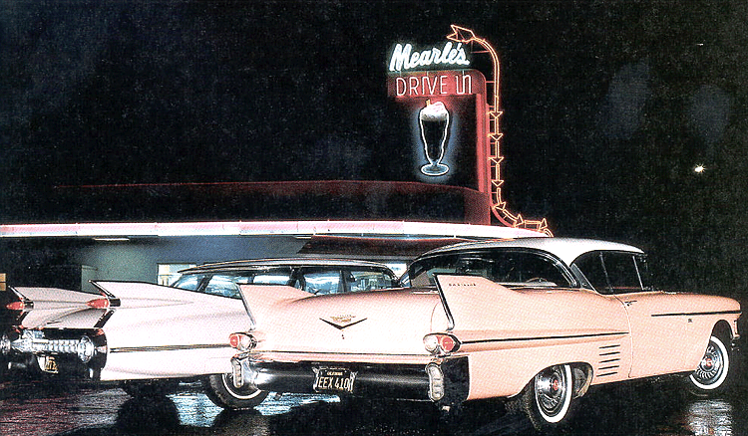
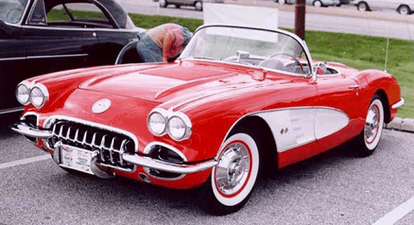
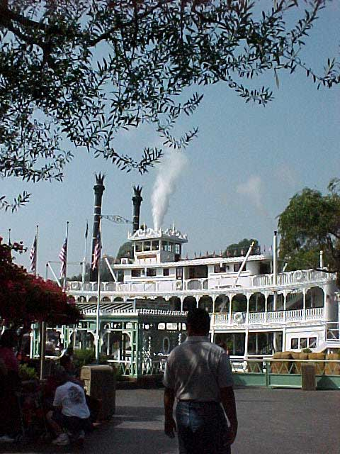
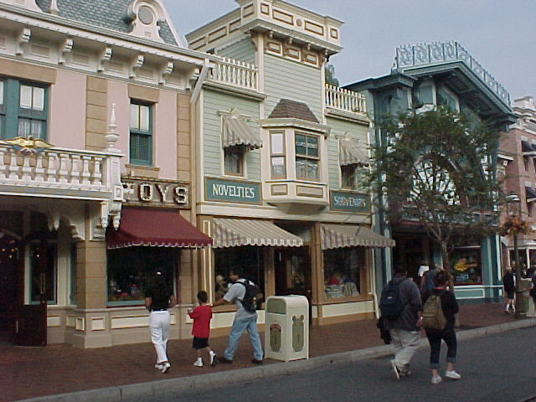
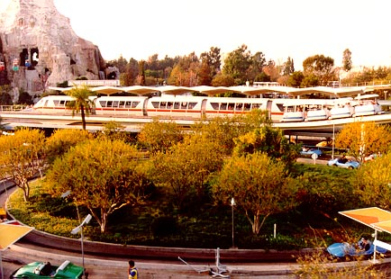
Car Culture
1958 Pink Cadillac
Car registrations:
1945 = 25,000,00
1960 = 60,000,000
2-family cars doubles from 1951-1958
The U. S. population was on the move in the 1950s.
NE & Mid-W → S & SW (“Sunbelt” states)
1955 - Disneyland opened in Southern California → 40% of the guests came from outside California, most by car.
1959 Chevy Corvette
Frontier Land
Main Street
Tomorrow Land

Slide 16
1950s: Prosperity and Change
Women and the Workplace
Following WWII, large numbers of women left their industrial jobs to make room for returning soldiers
As Rosie the Riveter gave up her tools and returned home, the housewife became the new ideal for married women
TV programs such as I Love Lucy, Father Knows Best, and The Honeymooners all portrayed women in their roles as housewives
http://www.bing.com/videos/watch/video/womens-roles-shift-in-the-1950s/17wwxgnm4?q=motherhood+parenting&rel=MSN&cpkey=3335275a-fc8a-45ba-a4ae-f9eede26f885%257cmotherhood%2Bparenting%257cMSN%257c%257c
The ideal modern woman married, cooked and cared for her family, and kept herself busy by joining the local PTA and leading a troop of Campfire Girls. She entertained guests in her family’s suburban house and worked out on the trampoline to keep her size 12 figure. -- Life magazine, 1956

Slide 17
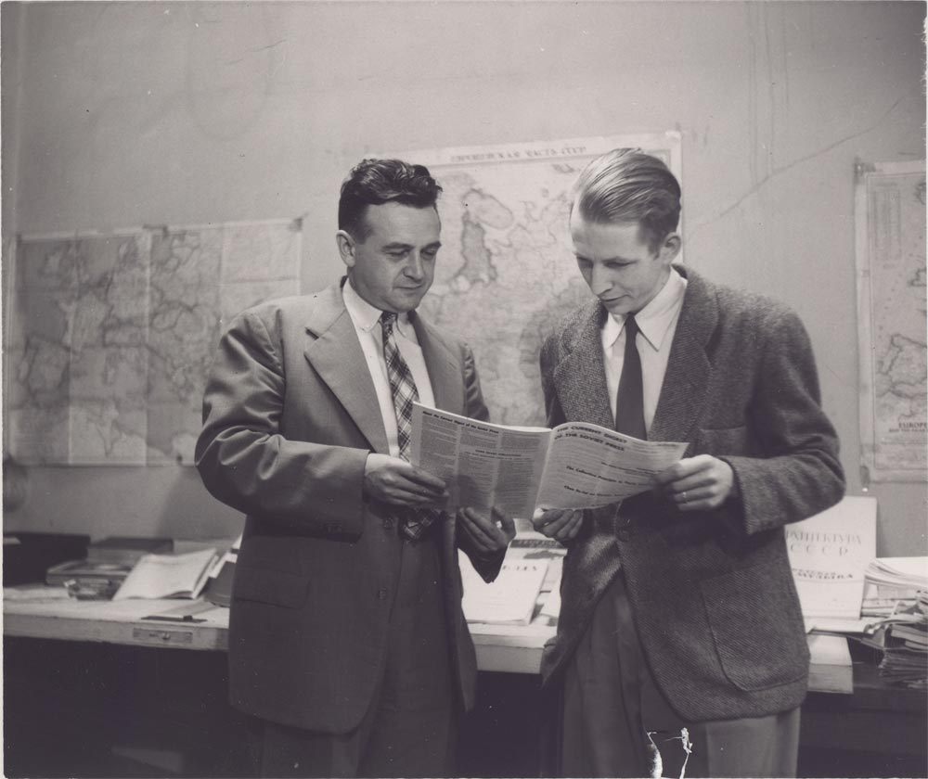
1950s: Social Critics
Social Critics
Social commentators criticized the conformity of postwar culture
The leading critics were:
William H. Whyte’s The Organization of Man
David Riesman’s The Lonely Crowd
Sloan Wilson’s The Man in the Gray Flannel Suit
John Kenneth Gailbraith’s The Affluent Society
Critics criticized most TV programs, calling the new medium a “vast wasteland”

Slide 18
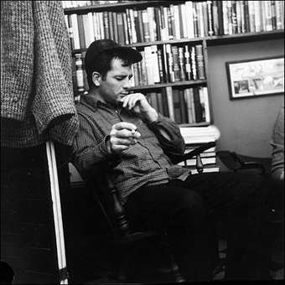
1950s: Nonconformists
Nonconformists
Led by Jack Kerouac, Beat Generation writers rejected middle-class culture and conformity
In his book, On the Road, Kerouac expressed the alienation and disillusionment he felt toward mainstream American culture
Both the Lost Generation writers of the ‘20s and the Beat Generation writers of the ‘50s wrote about alienation/disillusionment with American conformity and materialism

Slide 19
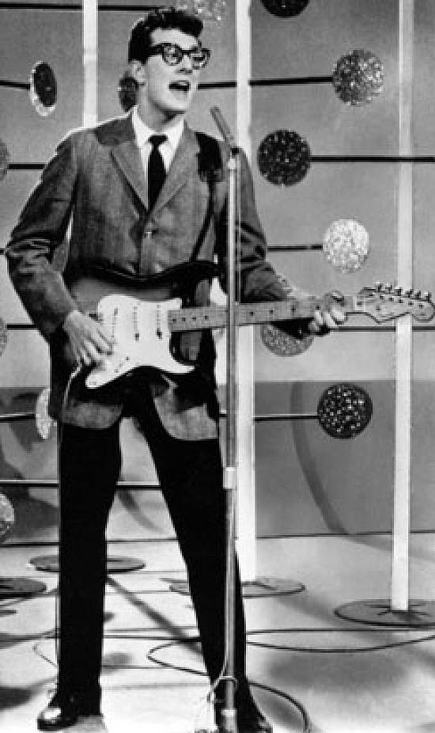
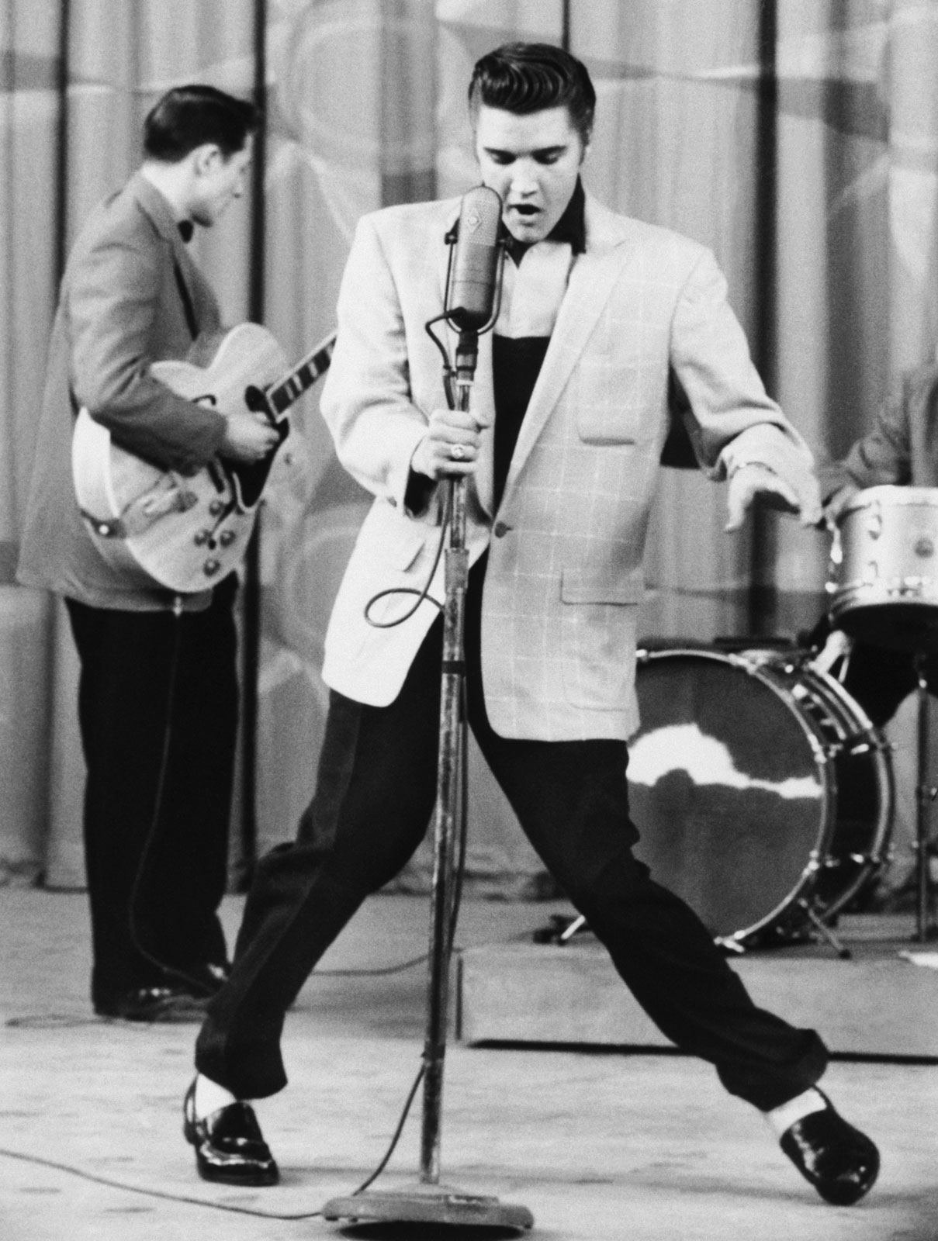
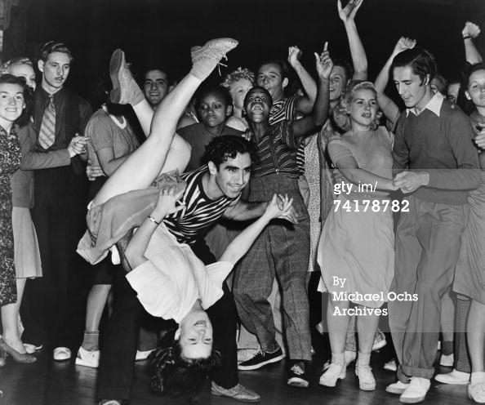
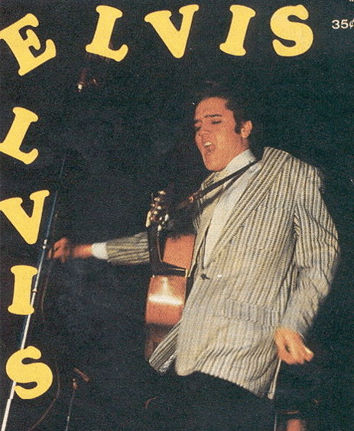
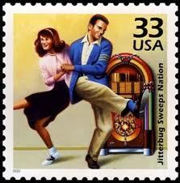
1950s: Cultural Rebels
Rock and Roll
Rock and Roll 1st emerged during the 1950s
Inspired and strongly influenced by Black musical traditions, especially rhythm and blues
http://www.youtube.com/watch?v=WQiIMuOKIzY
http://www.youtube.com/watch?v=gj0Rz-uP4Mk

Slide 20
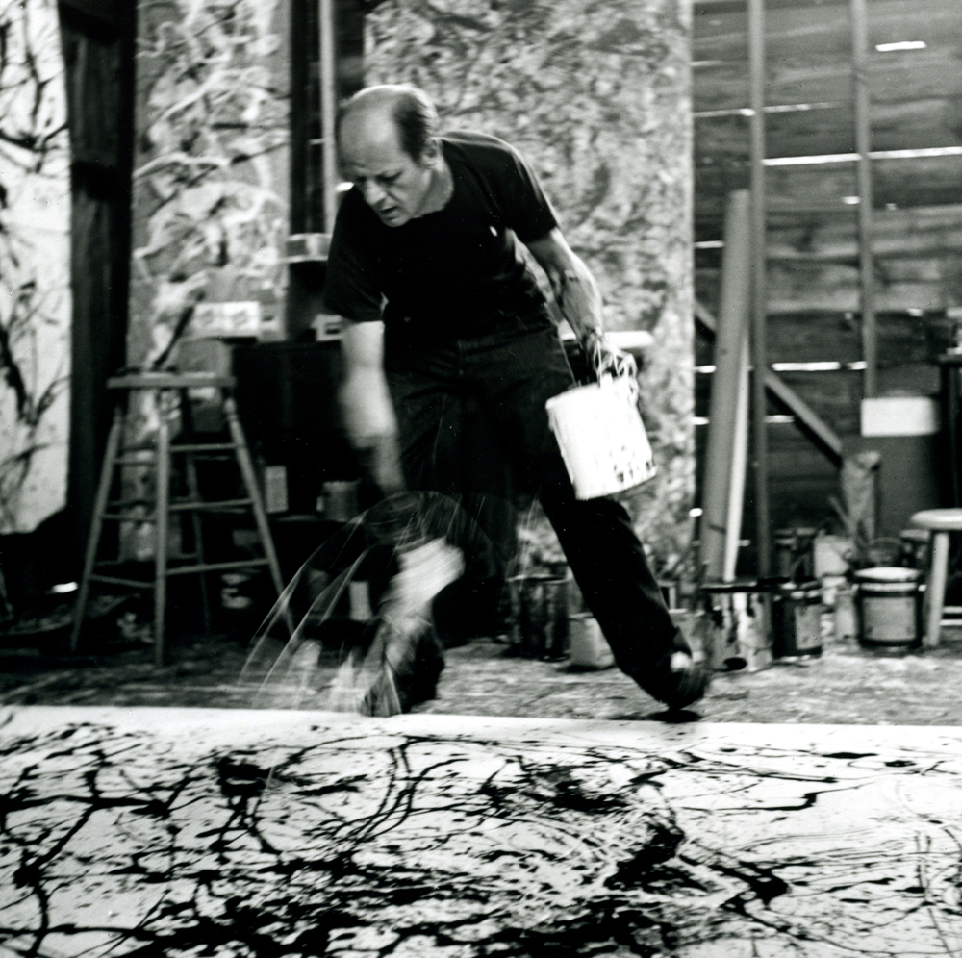
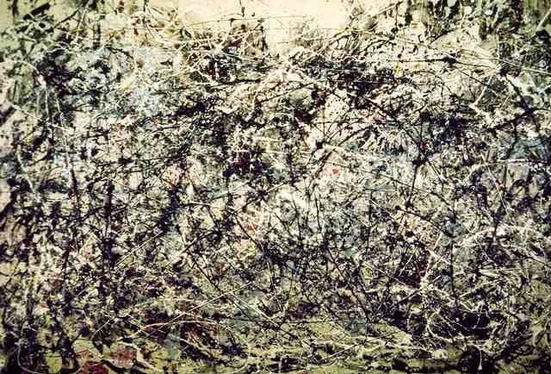
1950s: Cultural Rebels
Abstract Expressionist Artists
Emerged in NYC in the late 1940s/early 1950s
Led by Jackson Pollock, artists abandoned paintings that represented reality → created works that expressed their state of mind

Slide 21
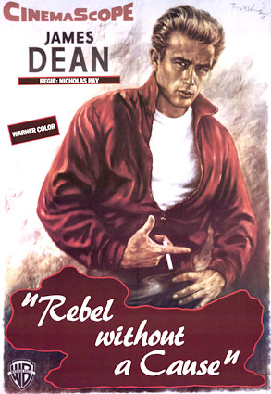
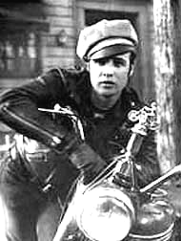
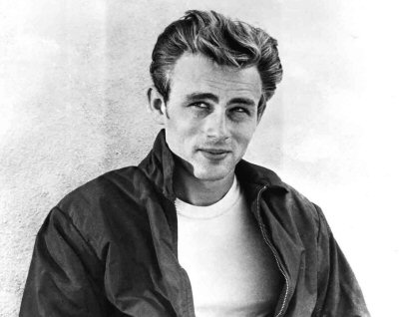
1950s: Cultural Rebels
Movie Stars
Movie stars such as James Dean and Marlon Brando symbolized youthful rebellion
“Juvenile Delinquency”
1951→ J. D. Salinger’s A Catcher in the Rye
James Dean in Rebel Without a Cause (1955)
Marlon Brando in The Wild One (1953)

Slide 22
The 1950s
The Montgomery Bus Boycott succeeded because
A) the bus drivers were primarily African-American B) the white community was frightened of potential violence C) the entire community became involved D) African Americans were the primary bus-riders E) the federal government forbid segregation on public transport
The correct answer is (D).
Although we can't say that the entire community became involved (after all, much of it was white—including most of the bus drivers), the Bus Boycott succeeded because it punched the bus companies right in their wallets. It didn't necessarily frighten the white community—after all, no violence was used, and only the wallet was hurt—but it did create concern. It also created action, since the Supreme Court then forced public buses to be desegregated.

Slide 23
The 1950s
All of the following are reasons the labor movement lost power in the 1950s EXCEPT
A) increased emphasis on consumer rather than labor rights B) the Taft-Hartley Act C) attention diverted to the Civil Rights Movement D) fear of communism E) economic prosperity
The correct answer is (C).
When things are going well, and everyone feels rich, and most of society cares more about goods than the people who make them…labor movements lose their power. Plus, when working men's movements become associated with communism, labor unions become mighty suspect. All of these things contributed to the decline of the labor movement, and the passing of the Taft Hartley Act—which, of course, made it decline even more. However, none of these things happened because people were more concerned with Civil Rights. That was one thing happening in America, but not the main thing.

